Slide 1
Great Lakes Partners for Patients
Improvement Model
Notes:
Hello and welcome to the Great Lakes Partners for Patients Improvement Model webinar. Over the next hour or so, you are going to learn about a powerful improvement process, that has been adopted as a common approach by our three-state partnership, will be taught and applied to improve patient safety and effective teamwork. We believe that this model can be implemented across the HIIN topics to engage leaders as well as point of care staff in data-driven improvement. Let’s get started…

Slide 2
Key Components of HIIN Improvement Model
Engaging Stakeholders and Building a Team:
Executive sponsor, leader, subject matter experts, front line staff, patient advisors
Clearly articulate goals or aims:
Goals are specific, measurable and achievable
Perform gap analysis between current and ideal state:
Develop action plan for ideal state with identified accountability for action plans
Perform small tests of change until measured aims are met:
PDSA/PDCA
Spread and Sustain the changes:
Develop communication plan, “lock-in” changes to hospital systems, share with other hospitals
Notes:
This is a graphic that articulates what we believe are the critical building blocks of an effective improvement strategy and the key components of our model. During today’s presentation, we will explain the crucial roles that staff and executives from across the organization play in authorizing, driving, and hardwiring positive change in clinical and organizational improvement efforts. Getting everyone on board means that what you aim to improve has to be well-thought out, and is well understood by stakeholders that will be giving the green light to the project. During the HIIN project, you’ll hear some folks talk about the “science of improvement”. We would like you to start thinking in a scientific way about improvement – using critical thinking to analyze the current state of the topic you are setting out to improve, understanding where the gaps are, and using data to monitor your progress in the small tests of change that are part of the historic PSDA (Plan-Do-Study or Check-Act) model. You will learn that communication throughout all of the phases of any improvement project is essential to keeping everyone abreast of the progress of your improvement work, as well as “locking in” successful changes and being ready to share like a saint when it comes to raising all boats in our healthcare partnerships.

Slide 3

Getting Started
How we know we have work to do:
  Data indicates an improvement opportunity, or
  A process or procedure is being changed or updated
Who will do this work?
  Who will be the Leader?
  Who will provide senior leader support?
  Who are the people that know how the work is done and will make the changes?
Good improvement work takes a whole team
Notes:
So let’s get started. You are watching this second webinar in the starter pack, and likely, you have already watched the first, and may have already completed your gap analysis tool for the HIIN topic you will be starting an improvement project on. The first webinar in each of our starter packs contain basic educational background and best practices related to the topic. We believe that a good grounding in the topic, even, and especially, if you do not have a current working knowledge or need a refresher of the topic is critical to being able to lead or participate in an improvement project.
Opportunities for improvement come from various sources. You may have a clinical topic that your hospital regularly reports performance data on – either externally – like CMS or Joint Commission, or internally –like a medical staff committee or other PI stakeholder group. A opportunity for improvement could present itself if your performance data OR the program that you are reporting this data for shifts.
Your data has shown that your hospital has improvement work to do in one of the 11 HIIN harm-reduction topics! Whether you are setting up proactive, concurrent, or retrospective monitoring, you will want to apply the improvement science, that you will learn as part of the HIIN work , to these opportunities.
You are not alone. Good improvement takes a team. In the next few minutes we will discuss the attributes of a good project leader, as well as someone from the senior staff position who can support the effort. You will also need to identify and engage people who do the work and know the best. This is the exact mix that will move the project and keep you in the most appropriate supportive and coaching role.

Slide 4

The Role of the Project Leader
Someone with operational authority to ensure success
Convenes stakeholders and team
Keeps the project on track
Keeps senior leaders informed
Ensures project aims are met
Notes:
Recruiting and engaging a project leader is a critical component of setting the stage for successful QI work. Vince Lombardi, beloved coach of the Green Bay Packers, once said that “Leaders are made, they are not born”. That is true in quality improvement team leadership. Leaders have attributes and skills that are learned and developed over time and with practice. It may be likely that you will be called on to lead a project as part of the HIIN worl. You may need to recruit a project leader for a topic that you will only oversee. Either way, here is a list of skills that we believe make an effective leader.
The project leader needs operational authority- by this we mean that the leader has the ability to assess the status of the work and act to adjust and redirect resources that have been allocated to the project to make sure that forward motion, or recovery and righting the project can take place expeditiously. The project leader makes wise use of human and time resources to convene the right people at the right time to make critical or operational decisions. But with all that authority comes responsibility. The leader has the responsibility to manage all of the indicators of project progress to make sure the project meets the constraints of time, budget, and deliverables. Project leaders use information from various sources to make sure the project is on course. Another primary responsibility is being the conduit of project progress communication with senior leaders. Done well, senior leaders, who ultimately endorsed the project and allocated resources to it are not burdened with too much detail about the project, but aren’t also kept in the dark about what is going on either. The skilled project leader is able to inform senior leaders with just enough information, delivered at the right time and in the right way.
Ultimately, the project leader sees the project through while some team members may enter and exit. The leader makes sure that the aims are clearly articulated and achieved.

Slide 5

The Role of the Senior Leader Champion
Holds Project Leader accountable
Has authority to allocate resources (capital and human)
Asks for routine progress reports
Attends meetings, but only as needed
Notes:
A senior leader sponsor or champion may be a bit easier to identify, recruit, and engage. Sometimes it’s intuitive. For instance, if the quality improvement project is related to Catheter Associated Urinary Tract Infections – specifically nurse-driven removal protocols, you’ll likely have a clinical senior leader. If your project is related to the High Reliability Organization HIIN topic, you may have a more general administrative senior leader. In any case, the senior leader will allocate resources to the project, and will be the point of contact for the project leader. The senior leader will likely attend an initial meeting to make sure that he or she is introduced to the team and get a general understanding of the subject, scope and timeline of the work. Thereafter, senior leaders will not regularly attend meetings, unless their presence is needed for decision making. In fact, over-involvement of senior leadership in meetings and operational issues often is a detractor and can wear them out as an ally.

Slide 6

Engaging Stakeholders
Advisory (Oversight, resources and insight)
  Senior Leaders
  QI/Safety Committee
  Medical Staff
  Patient advisors
Implementation Teams (expertise)
  Multidisciplinary
Unit-based (do the work, know the best)
  Front line
  Point of care
Notes:
We have discussed two really strategically important members of the team: the project leader and the senior leader champion. There are other stakeholders that will be key to success quality improvement project work. In the next few minutes we will talk about possible improvement team members from various disciplines in the hospital setting. Not all of these are needed for every project, but you will want to reference this list as you begin to build teams for improvement work, to make sure that you have the right people at the table and have not left anyone out. Too many people involved in the project can create complications in communication and carrying out the actual small tests of change. Too few people can limit creativity and place unintended burden because you don’t have enough hands to lighten the load. Let’s take a deeper dive into each of these categories of possible stakeholders.

Slide 7
Advisory Level Stakeholders
To get maximum engagement and resources for the project to be successful:
  Provide clear and concise information about the project: “Our hospital’s patient fall rate is higher than others, and we have a couple of ideas…”
  Provide clear goals for the project
  Provide context: “This is important because...”
  Clearly request what you need: “We would like…”
  Articulate the stakeholder’s commitment: “If you come to the first meeting, then we will update you periodically on our progress…”
Notes:
Advisory level stakeholders are those that have some knowledge and insight into the topic of your improvement project, and can offer valuable advice on your proposed strategy or actual project progress. A key consideration for inviting and enlisting as advisors to your project depends on what they know and what they can commit to. Their input can be valuable if you are very clear about the topic you are going work on. One best practice is to make the case coupled with actions that you can already talk about. Often, we mistakenly present a problem to advisory stakeholders without thinking through and talking about possible approaches to solutions. The more you can assure them that you have depth of understanding the issue, as well as having done some preliminary strategizing will help guide them into the role of advisor. Make sure you can accurately state what the project will be about, and what you need from them to launch or continue the work. Make sure that your “ask” is reasonable and related to the work of the project. You will want to make sure that the points on this slide are well thought-out and clearly communicated. Help the potential advisor feel like they can be your ally and represent your work to their colleagues accurately.

Slide 8
Project Team Members
To get maximum engagement and resources from this group:
  Provide clear information about the project and assure authority from senior level stakeholders
  Be honest about the time commitment – people will not sign up to participate permanently
  Balance the team between managers, point of care staff, and disciplines
  Be transparent with the team members and all staff about failing often and learning quickly from experiences
Notes:
Once you have identified your senior leader and advisory members, you can begin to recruit project team members. This task is made so much easier if potential team members know that senior leaders, one of whom might be their supervisor, is already aware and has blessed the project. As you invite, give potential project team members your best guess as to the scope and length of commitment. While you might get someone to sign on if you sugar coat or minimize the commitment, you will be inviting frustration if the project wears on or the expectation for time and resources reaches far beyond what your recruit originally thought. That’s not to say that a project does not ever miss target deadlines – for sure they sometimes do – but the more transparent and honest you are with folks you are trying to engage into participating on the project team, the likelier they are to hang in there with you when the going gets tough. Next, make sure that the project team is well-balanced with representation from various disciplines and staff roles, as applicable to your project topic. The best laid plans for small tests of change can go terribly if the change impacts a point of care workflow that was created without the input of the people who actually do that work. Additionally, there can be little known, undocumented work flows that bedside care staff are performing that the team will want to know about – and sometimes the only way to get to that information is to make sure that staff are at the planning table. The project leader has to be attentive to make sure that all members have equal access and input. In some organizations, point-of-care staff are seldom included in the patient quality and safety work. The last point on this slide is really important. Failures are expected and learned from. Reflective activities like always asking “What did we learn?” can invite honest feedback and game future work for success.

Slide 9
Point-of-Care Staff
To get maximum engagement and resources from this group:
  Provide clear information about the project and assure authority from senior level stakeholders
  Involve them in meetings only as needed, but create a mechanism for their feedback as the project progresses
Notes:
Another few words about point of care staff. Like managers, these folks will want to know that their time away from patients to help with improvement work has been considered and allocated. Likely, point of care staff will be somewhat useful at formal meetings, but you really want to get their input in the design and carrying out small tests of change, which can occur at huddles or shift change brief meetings. Their sense of belonging to the team and influencing the work will be key to deep engagement, pride, and sustaining the improvement work gains.

Slide 10

The Role of the Quality Leader
Improvement Model Coach
Is a resource to the team:
  use of data to drive project success
  provide advice to team leader if the project becomes stalled
Is NOT the team leader
Notes:
Finally, what about the Quality Leader? In our opinion, the quality leader is the holder of the improvement science model that is applied to the QI work throughout the organization. This person serves as a coach and a resource to the teams. If the organization continually looks to the single quality leader to manage and facilitate all of the quality teams, it will see minimal gains. The organization risks burning out the leader as well as losing the opportunity to expand improvement science and application as close to the point of care as possible. So the quality leader is resourced as needed, but should be called on to help out a team that is stuck.

Slide 11
Patients and Families
Invite a patient to be a team member
If your hospital has a Patient and Family Advisory Council (PFAC), tap them for information and advice
Do you know any patient stories that can help make the case?
To get the information you need from patient advisors:
  Provide clear and concise information about the project: “Our hospital’s patient fall rate is higher than others, and we have a couple of ideas…”
  Provide clear goals for the project
  Provide context: “This is important because...”
Notes:
A few slides ago I mentioned formal and informal ways that families and staff communicate with each other. The patient and family voice in care preferences and delivery is becoming more sought after, and remains a topic of the HIIN work. Each hospital in the HIIN is discovering ways to not just listen to, but really integrate the voice of the patient and family as an organizational strategy. Inviting a patient or family voice to your project team can be something you haven’t thought about or done before. But, depending on the topic of the project, incorporating the perspective of the patient and family can provide insights that might influence your project to success, and would otherwise be impossible to get. Just like your pitch to the other stakeholder groups, you will need to be very clear about the need, scope and expectations for their involvement in the project work. Be aware of their need for education on any details related to the topic, however, don’t underestimate the capacity for learning in your PFAC. Through their experience in the hospital as patient or family, they have learned a lot about how your systems work (or don’t) and about their clinical condition.

Slide 12
Addressing Common Barriers to Quality Improvement
Why is it hard to get buy-in for this work? | How might we re-design our work to address this issue?
Takes time away from the work of the staff | Ensure the focus IS patient care Keep the “ask” and the work simple and clear Minimize meetings; get creative about ways to communicate
Only a small group of staff are willing; get burned out | Intentionally invite others Try engaging someone who will “do it once”
Staff are uncomfortable with trying new things so getting “buy-in” is hard | Don’t make radical changes Break the tasks into “bite-size” pieces Make sure the reason for change is well understood – show evidence for patient care Allow staff to decline participation twice Create a 2-minute high level “elevator” speech of why this is important
Notes:
The next two slides address common barriers to QI work that our team has heard over the years. As you look at the barrier on the left, you can read some successful approaches to this work on the right hand column. Hopefully, what we have covered already in this webinar, and the experience you bring to the table from your role in the hospital will give you even more re-design ideas. The thing that strikes me about this table is that the barriers to buy-in listed in the left column are so part of our human nature. We are comfortably entrenched in work processes and habits, and change is hard. Many staff already have a pre-conceived belief about quality improvement work. If the culture of your hospital is represented on the left hand columns of these two slides, it’s time to take another approach.

Slide 13
More Common Barriers to Quality Improvement
Why is it hard to get buy-in for this work? | How might we re-design our work to address this issue?
It’s hard to get the right people involved, like those with the most expertise or experience | Start with a core team, the invite those who are willing Re-invite others after an initial improvement is made Keep the ask clear and simple – what do they need to be able to participate
It’s tough to get the authority to make a change | Document your plan first; be specific and present it to leaders Present results and data before proposing next steps Ask leaders directly about concerns
Keeping the focus on the patient is a challenge – sometimes change becomes all about the staff | Involve the patients and include their voice Keep asking “how does this work keep our patients safe?”
Notes:
We have talked about getting the right people on board, and we have talked about the necessity of open, transparent communication. We have talked about doing the hard work of garnering authority and allocating resources. But all of that work is necessary to gaming your QI work for success. In the next slides we are going to learn the “science” of improvement. Even if you weren’t an A student in science in school, I will bet you have been using this science in your adult life as you navigated from school to work, establishing your first home away from home, and you are certainly using it if you are around kids. Let’s learn together.

Slide 14
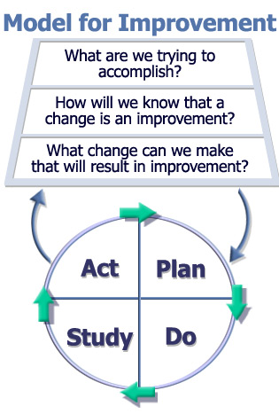
Making PDSA Work for You
Aims
Reduce Readmissions by 12% by 12/31/19
Measurement
Change ideas
Trying ideas before
implementing changes
using
Small Tests of Change
Institute for Healthcare Improvement
Notes:
14
Here we see what is called the IHI Model for Improvement. It’s the model our Great Lakes Partners for Patients has adopted as its standard for teaching and supporting your improvement work across the HIIN. IN the center of the slide, you see a circle, separated into 4 quadrants, titled “Plan, Do, Study, Act”, or PDSA. You’ll also see that there are green arrows moving the PDSA quadrants in a clockwise motion. This indicates that PSDA is a repeating cycle, done over and over until the aim or goal of the project is achieved. If you look above the PSDA cycle, you’ll see three questions. The first, way at the top asks “What are we trying to accomplish? This asks you to know and articulate exactly what you are trying to do – having a clear and easily communicated aim. Take a look at the green box to the left of the questions. Here is a great aim statement. We will talk about the qualities of a great aim statement in a little bit, but for now read this one: Reduce Readmissions by 12% by 12/31/19. It’s pretty clear. The aim statement does not go into detail about what you are going to do reduce readmissions. The statement articulates how you will know when you are done. A famous QI statement is “start with the end in mind”. By starting with the end in mind you set up a clear statement for everyone that is involved in the project. How will we know that a change is an improvement? We can do lots of things, in fact we are really good at producing a lot of work. But if we don’t set up good measurement of the work we are doing, we tend to do a lot of work that may not achieve our aim, or make progress seem ambiguous. Measuring processes and outcomes are key to keeping our work on course. We will talk about measurement in a little bit. What changes can we make that will result in an improvement? Remember the tables of barriers we looked at in slides 12 and 13? Here’s where we need to pay attention to who, how, when, and what kinds of changes we will try to see if we can make positive movement toward the aim statement. What have others done? What hunches do we have? What new ideas have we come up with? What can we learn as we go along? We are going learn about trying small changes, measuring their impact, and learning from them.

Slide 15

Setting the AIM
Goal Setting:
  Make goals easy to understand by others
  Stay focused on the patient
AIM statements:
  State the outcome (reduce or increase)
  Define the measure of improvement (by x%)
  Give a time span (by when)
Example: Reduce Readmissions by 12% by 12/31/19
Notes:
How do you set a really good aim statement? Make sure that everyone who is going to work on this project understands the mission. They should be able to easily repeat it to their peers, and it really describes “the end” of the project. Aim statements talk about direction - do you want more or less? Next define the measure of improvement, and includes a time span. Now, notice that the aim statement doesn’t include details like “certain” readmissions, or “12% as compared to a previous time period” – these important to be sure, but we don’t need to articulate those details to make a good aim statement. If you’d like to pause the webinar here and practice writing a couple, that would be great. If you want to practice in non-healthcare topics, practice writing aim statements for real life scenarios like decreasing the amount of time you watch TV, or maybe increasing the number of steps you take daily for fitness… Like any other QI work, it takes practice.

Slide 16
Outcome Measures and Process Measures
An Outcome Measure – how are we doing?
  Mortality rates
  Readmission Rates
  Infection Rates
A Process Measure – what are we doing?
  Antibiotics prior to incision
  Three-hour sepsis bundle protocols
  Readmission risk assessment performed
Always make sure that your tests of change are linked to your measures and your aim statement
Notes:
There are two basic measure types that we talk about when we are gauging the effectiveness of the quality improvement work we are doing. They are outcome and process measures. Sometimes they can be hard to differentiate. But if you ask yourself the how and what questions, how are we doing and what are we doing, that can help you. Note the red text on the right side of the page? It is really important to make sure that the small test of change that you do as part of the PDSA inform the measures that inform the aim statement. That alignment is critical to make sure your tests stay within the scope of the project, and are directly impacting the outcome of your work

Slide 17
Making PDSA Work for You
Aims
Reduce Readmissions by 12% by 12/31/19
(Outcome measure)
Measurement
Change ideas
Phone Script for follow up calls
Trying ideas before
implementing changes
using
Small Tests of Change
(Process measures)
Each patient receives follow-up call within 72 hrs post-d/c
Institute for Healthcare Improvement
Notes:
17
So let’s go back to our model. Reducing Readmissions by 12% by 12/31/19 is an outcome measure. It describes a rate. You can see the new ideas that the staff are going to test in the green boxes outlined in red. You can monitor the success or failure of these tests and call them process measures. In this example, we are going to try a new process that includes creating a phone script. Then there is another new process that includes follow-up phone calls for each discharged patient. A word of caution here about overloading the project with too many new processes all at once. Hopefully your team will have lots of ideas about small tests of change, but trying only one or two at a time allows you to study what works and what might be a good idea but needs to be tweaked before it is re-tried. Also remember those tables in slides 12 and 13? People’s capacity for change has to be monitored. Too much change can be overwhelming. So, steady and study is the name of the game.

Slide 18

Finding Ideas That Will Work
Gap Analysis
Top 10 Checklists
Clinical Guidelines
Literature
Root Cause Analysis
HIIN Improvement Action Networks and QuEST events
Other hospitals or industries
Notes:
In the last slide I guessed that your team might have lots of ideas about changes they might want to try to further the cause of reduced readmissions. But what if you don’t have a lot of ideas OR your ideas are met with “We tried that before”? Here is a partial list of common resources that might give you ideas about small test of change you can try. In each of the first starter pack webinars, our subject matter experts included best practice resource guides to really help you get your small tests of change kickstarted. I can’t say enough about the last bullet point. The power of networking is understated in this slide. Understanding what did or did NOT work in another hospital can help save you time. Not all ideas that worked in other hospitals or on other units will work on yours, but at least you have the power of a relationship with someone who does the work that you do and understands the challenges of improvement. It is our hope that during the HIIN IANs and QuEST events, you will have the opportunity to meet new peers and exchange ideas.

Slide 19
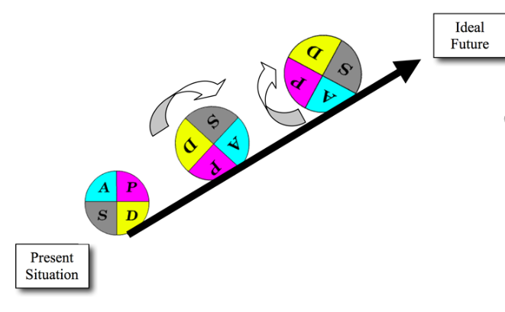
Small Tests of Change = PDSA
How often do we get it right the first time?
Checklist used with every patient
How often do we give up when we don’t get it right?
Checklist not being used
Notes:
The idea of implementing a checklist sounds so simple, but it can be fraught with failed attempts. When I introduced PDSA a few slides ago, I mentioned that the cycle is intended to be repeated as often as necessary until the desired outcome is achieved. And from experience I can tell you that repeated PDSA cycles can really feel like an uphill push. But with practice, your team can use more inspiration and less perspiration. It’s in the design of the test and the study of the test results.

Slide 20
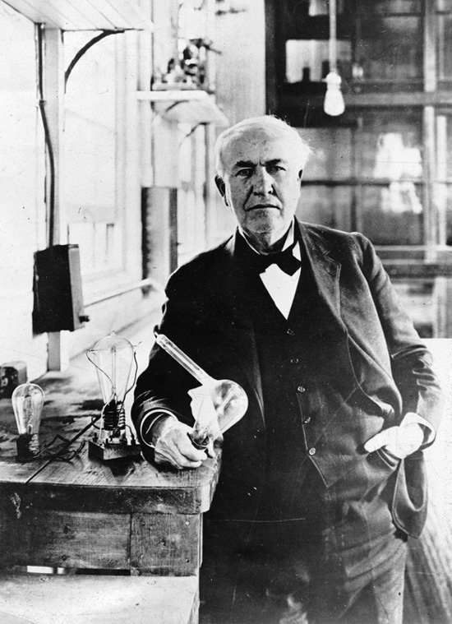
The Value of “Failed” Tests
“I did not fail one thousand times; I found one thousand ways how not to make a light bulb.”
Thomas Edison
Notes:
There is value in failed tests! When asked by a critical journalist how it felt to have failed 1000 times, Edison is said to have replied “I did not fail one thousand times, I found one thousand ways how not to make a light bulb. Learning from what didn’t go right is important. We expect that there will be multiple trials and failures as you begin your improvement work in the HIIN. That is okay. Your job as a leader is to assist the team to learn quickly, not repeat errors, and keep working.

Slide 21
Sometimes You Should “Just Do It”
Notes:
Face it, we are doers. Lots of Do Do Do. In some cases we can “just do it”. I mean if there is an imminent threat to patient safety, or there is water filling the basement, DON”T take time to get a project team together. Just do it. If your issue would take a simple fix, one step- one-person, one-time, then by all means “just do it”. PDSA is not meant for those situations. Just Do It is not PDSA

Slide 22

This is Not How You Do Small Tests of Change…..
Notes:
And THIS is not how you do small tests of change. This might be how you PLAN, but not how you DO.
“Doing” occurs outside of the conference room. It is done in real time on the unit, at the bedside by the people who do the work and know the best.

Slide 23
Designing Small Tests of Change
Key Information before beginning:
What is the test?
What is the smallest unit of change?
Who has to change?
How many staff need to change?
How many staff need to test the change?
When will the testing take place?
Notes:
Remember at the beginning of this webinar I told you how critical it was to do the leg work in getting the right people at the right table for the project team work? It’s the same with designing small tests of change. Critically thinking through this list will really help you keep the test manageable and its impact light. First clearly define the test. I urge you to resist writing a policy and putting it in a book. That is not a test and it rarely generates lasting improvement. Think back to the readmissions slide. One of the test processes we were going to measure talked about conducting phone calls to patients within 72 hours post-discharge. Is that a clear test? Yes. The rest of the questions on this slide ask us to really think about how small we can get this change to be? When we say small tests of change, we are talking as small as we can get it. Two reasons, one – we want to minimize work flow impact, and two its easier to study the results of one or two tests, right?

Slide 24
Time to Test the Ideas
Aim: Reduce readmissions of patients discharged to home from Med-Surg 4 achieving a 12% reduction by December 31, 2019.
Measure: A consistent phone script will be used for 100% of follow-up calls.
Test: Develop standardized phone script for discharge calls.
Idea Testers:
  People that do the work should be testing the ideas
  Bedside nurses
Notes:
Here is a perfect example of how the test informs the process measure that informs the aim statement. You can see how the aim is stated and the measure and test are clear. This is important - Make sure that the testers are the ones most familiar with the regularly accepted workflows. If the only people around the table discussing the next steps are those who do not do the task on a regular basis – don’t expect a successful implementation.

Slide 25
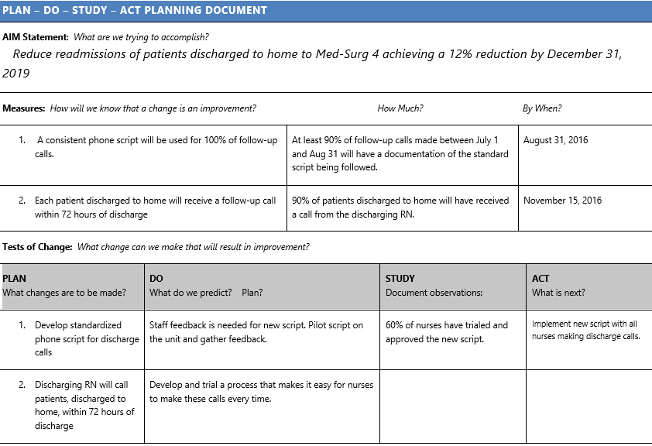
Notes:
Here is a clear concise roadmap that details each of the measures and tests of change, and you can see how the tests of change drive right up toward the aim statement. Take a look at the PDSA wheel. Then look at the aim statement, the measures and the PSDA. You can easily see the connection between the test wok and the project outcome. You can easily create a worksheet like this. We have also posted the Small Tests of Change User Guide to each of the state’s HIIN websites. We will also be using this model in the Quality Essentials Training (QuEST) events. If you attend QuEST, you will get lots of hands-on practice with this tool.

Slide 26
How Small Is Small?
Remember the “Rule of One”
One nurse
One patient
One shift
One hour
One time
1
Notes:
Small tests of change means small. Almost anyone in your organization (even those who most resist change) will be willing to try anything once. When you are designing your small tests of change remember the rule of 1

Slide 27
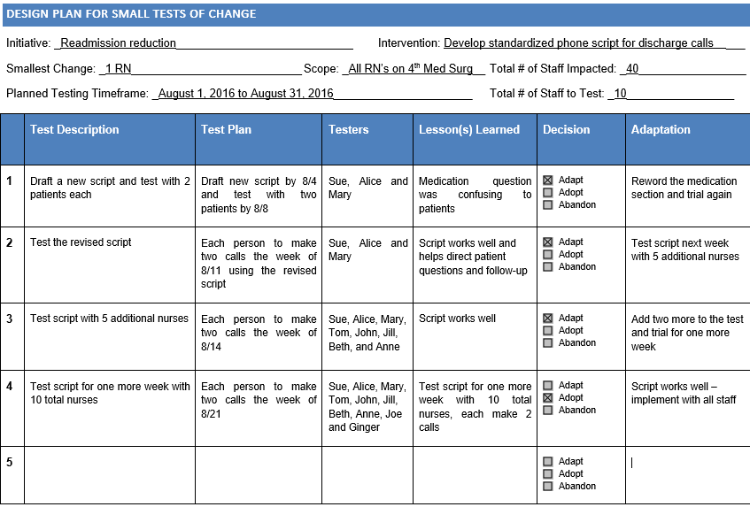
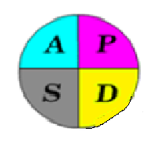
Notes:
Documentation is key when you are engaging in quality work. You need good documentation to be able to accurately analyze what has worked as well as what did not. If you look at this tool, it simply articulates the plan for starting small and moving on to larger testing groups ONLY when the necessary tweaks have been made and are successful. This is key. Think of your doer staff. There are lots of those who want to Just Do It. Resist. Be a scientist. If you look at the time lapse for this round, testing started on 8/4 and was ready for implementation by 8/21. This team was able to avoid a scrapped project OR implementing a faulty script just to keep plowing on to the next project.

Slide 28
Designing the Tests
Begin with the smallest unit of change possible
  “Rule of 1’s”: One care team, one patient, one day
Plan for easy and efficient collection of feedback from your volunteer ‘testers’
Spread systematically:
  1 day → 2 days → 4 days and/or
  2 teams/ 1 patient→ 2 teams/ 4 pts→ 4 teams/ 8 pts
  Pair an experienced tester with someone new
Know when to report progress & to whom
Notes:
Minimize the ‘ Cost of Failure’. Take your time. Likely the process that needs fixing was faulty when it first was implemented, OR has eroded with workarounds that will be difficult to just fix with a rewritten policy.
The purpose is to INVOLVE and learn from those who do the work and to speed up the rate of innovation adoption. When you are ready to move forward from the Rule of 1 testing, you want to incrementally add testers, time periods, shifts or units. It’s possible that a test of change that works on one unit may not work on another. It’s important to continue to study those changes by getting rapid feedback and being agile to tweak the tests.

Slide 29
Successful Cycles to Test Changes
Plan Multiple Cycles For A Test Of A Change
Think A Couple Of Cycles Ahead
Make The ‘Ask’ Small By Starting Small
Test With Volunteers
Do Not Wait To Get Total Buy-in Before Starting
Be Innovative To Make Test Feasible
Collect Useful Data During Each Test
Test Over A Wide Range Of Conditions
Notes:
25
Teaching people to run small scale tests is critical. Keep the size of tests small - We don’t need consensus here for tests. Let’s run a set of tests if people have more than one opinion, we can learn more from a range of tests. Consensus only needed at implementation time, when we believe we have a lot of evidence for our theory of how the system works.
Keep tests small
These are all tips to use in designing a test on a small scale. A small scale test does not mean that the test is insignificant. The test should be “big” only in that it is based on an important idea for how the process can be improved. The scale is small to conserve resources, and to be able to work quickly to learn as much as possible in the quickest time.
Testing over a wide range of conditions is important. Apply your tests on the weekend, on the night shift, when you are at low staff and high census. You want to know that your test will be successful under varying circumstances and situations.

Slide 30

Gathering Feedback during Tests
You will be more efficient, and improve faster, if you do not rely solely on scheduled meetings to gather feedback:
Quick “standing” huddles
Patient Feedback
White board / sticky notes
E-mail
Quick surveys
5 minute phone calls
Notes:
You have taken the time to build a dream team, engaged people’s commitment in doing testing, you have stakeholders that are awaiting word of your project’s progress. Getting and giving feedback regularly and outside of a meeting room can be key to keeping the momentum for improvement going. Communicate successes and plans for re-work with your testers and other stakeholders. A little success will be contagious and inspiring. If appropriate, post your testing results in a conspicuous place for others to see and comment on.

Slide 31
Adapt - Adopt - Abandon
The basic decision point after each cycle of testing:
Adapt – the test shows improvement is needed OR the tipping point has not been reached yet
Adopt – the test shows the process or tool is stable and is ready for use
Abandon – the test didn’t work OR some aspect of change should be abandoned
Notes:
Feedback is critical for understanding if and when you are ready to proceed. The decision to adopt a practice should only be made after testing has been done successfully often enough by enough people. Otherwise, keep at it and adapt or abandon and rework the test until you are certain it works. Remember Edison? If it didn’t work at all, and needs to be scrapped, pick yourself up and dust yourself off. Collect your learning and get back at it.

Slide 32
How to Move Forward with Testing
Expand the number of participants
Expand the scope of tests
Expand the conditions of the test – weekends, nights, etc.
  (i.e. the tests are not abandoned when census is high or staffing is low)
Document what is learned from each cycle of testing
  Keeps the team “on task”
  Clarifies the reason for testing
  Demonstrates clear accountability
  Enhances the learning from small tests because you can see what happened virtually in “real time”.
Notes:
Ready to move small tests of change move beyond the rule of 1. Here are a number of strategies you can use when expanding testing. Again, documentation is key. You don’t want to miss a step, but you also don’t want to repeat something that has not worked in the past.

Slide 33
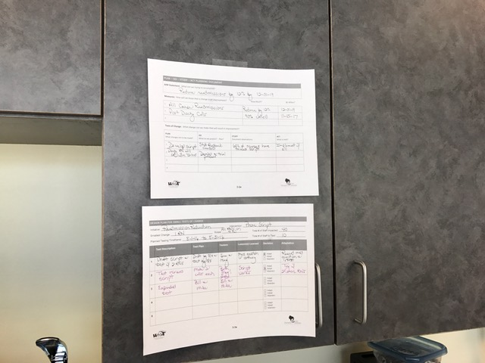
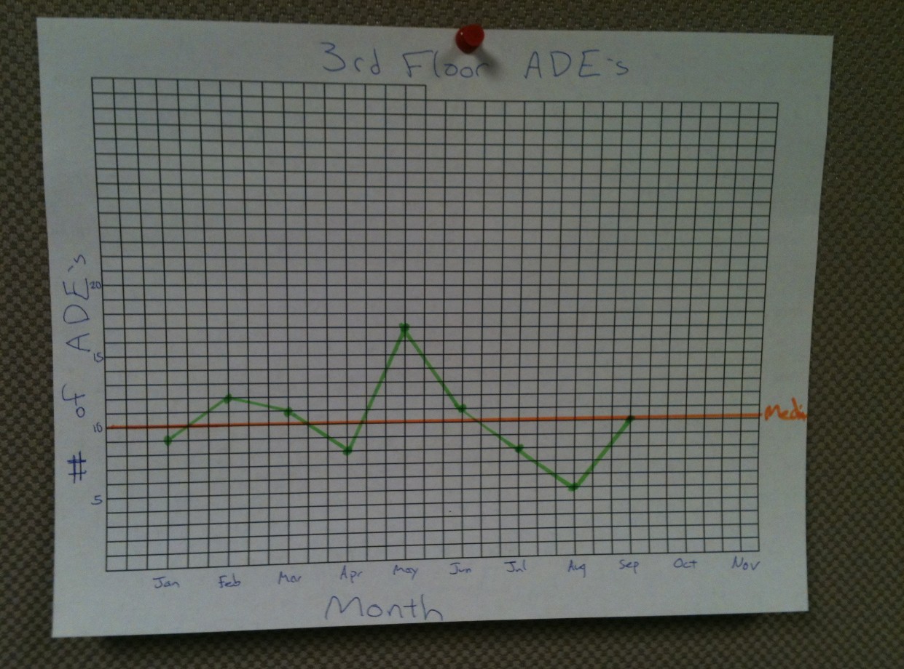
Be Transparent and “Public”
Post the PDSA sheet where staff can see what you are up to
There should be something new on it every few days – this is a living document
Show how your data looks – post it
It’s okay to post copies of hand-written PDSA sheets
Notes:
Of course, you want to be sensitive to your topic and public perception. The key here is how to communicate effectively with those who need to know, bearing in mind that there are likely those who will engage with the improvement work after they see that there has been some success.

Slide 34

How Do We Know that a Change is an Improvement?
“In God we trust.
All others bring data.”
W. E. Deming
We measure!
Notes:
34
Remember that the second question in the Model for Improvement is “How Do We Know That a Change is an Improvement?” The collaborative is about change, not about measurement, but measurement is important to support the improvement work of the team.
The second question requires that the team decide on how it will measure its progress in reaching the aim.
For example: you don’t know whether your golf game is improving unless you keep track of the number of strokes per round.
I don’t know how much weight I’m loosing, if I don’t weigh myself

Slide 35

Analyzing Data for Monitoring Progress
Notes:
In this second part of the webinar, we are going to ask you to start doing some analytical thinking. And I promise you it won’t look like this!

Slide 36
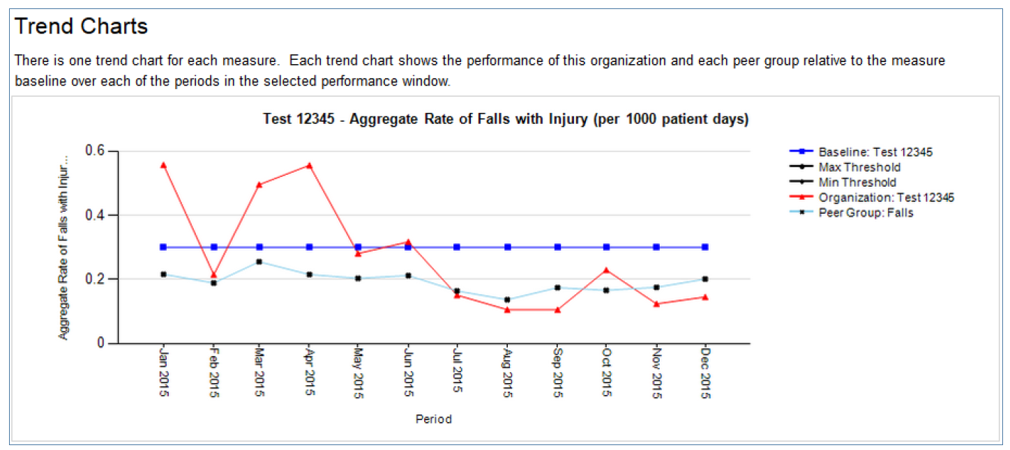
Tracking Your Results
Notes:
If data is not displayed or interpreted correctly, adverse actions and incorrect assumptions can be made. This is a run chart that was generated from our HIIN data source, the Keystone Data System, or KDS. We put these charts together to help all stakeholders to see the progress of quality improvement work in your hospital. Becoming familiar with how to read and interpret this data should be on your to-do list if you need to sharpen your analysis skills. Of course, monitoring your own improvement is really important, but the use of comparison data – like, how do your HIIN topic rates compare to hospitals like your size, or in your state, or in your system, can also inform your QI work.

Slide 37
Analyze Variation in Your System
Run Charts are the best tools to determine if our improvement strategies have had the desired effect
Notes:
Run charts can identify variation which we can call trends or shifts in performance. They can also help us know whether a strategy implemented at a specific time made an improvement. Let’s take a look at a typical run chart.

Slide 38
Elements of a Run Chart
Median
Time
“Plot the Dots”
Notes:
Simply put, a run chart is data over time. It is one of the most simple to make and easy to interpret tools we have in quality work. It displays process performance in an easy way to determine if a change resulted in an improvement AND whether implemented changes have stayed stable. We call the dark line at the bottom of the chart the horizontal axis or X axis. It always measures time. We call the vertical line the Y axis. It’s easy to keep the two straight if you think about the Y looking like a tree and it stands up from the ground. It displays the individual value. So, let’s say you are measuring your readmissions rate for your quality project. The Y axis displays the number of readmissions, and the X axis are the time markers, whether you are measuring by month or by quarter. The line in the middle of the run chart that has the arrow pointing to it is the median. It is a straight line that tells you the “middle” number of all of the values on the Y axis. How do you know what the median value is, and how do you calculate it? Let’s find out….

Slide 39
Set of Numbers Sorted Order
10 2
7 3
3 3
10 5
10 6
8 6
12 7
8 7
6 8
7 8 Median: 10TH
13 9 [9 smaller, 9 larger]
6 9
9 10
3 10
10 10
2 10
9 12
12 12
5 13
The Median allows all of the numbers in the set to be counted – including 0’s
Calculating the Median: 1. Take a set of numbers and sort them in order
2. Find the MIDDLE number in the set – that is the median
3. If there is an even number of numbers, calculate the average of the middle two numbers – that is the median
Notes:
Here is a vertical demonstration of calculating a median. You can also do a calculation of the median of a set of numbers when written out horizontally across a page. It doesn’t matter. What does matter is how you understand the difference between the median and the mean. Remember that the mean is just another way of saying “average”. You know how to calculate an average, so we won’t go over that. Look at the left hand set of numbers. They are “distributed”, that is, listed in a random order. In the list on the right, you can see that the same set of numbers has now been listed in order, lowest value to highest. Find the “middle number” and that is your median. Understanding your data in relationship to a median helps you with one more way to analyze your data over time. Median values may shift over time as well to correlate with the data. Half of your dots will be above the median and half of your dots will be below the median.

Slide 40
How to Analyze Your Run Chart
Shift: A consecutive sequence of 8 or more points ALL on one side of the median
Trend: A sequence of 6 successive increases or decreases
  (If you have fewer than 20 data points, use 5)
Notes:
Here are a couple of standard rules and terms we use to identify a movement in data points. A shift is a consecutive sequence of 8 or more points ALL on one side of the median. A trend is a sequence of 6 points in a row going up or down.

Slide 41
Elements of a Run Chart
Shift or Trend?
Median
“Plot the Dots”: Data over time
Notes:
Is this a shift or a trend. Remember that a shift is a consecutive sequence if 8 or more points all on one side of the median.
A trend means that 6 data points are going in a single direction.
This is a shift. Even though the dots aren’t all going in one direction there is a sequence of 8 dots above the median in this chart.

Slide 42
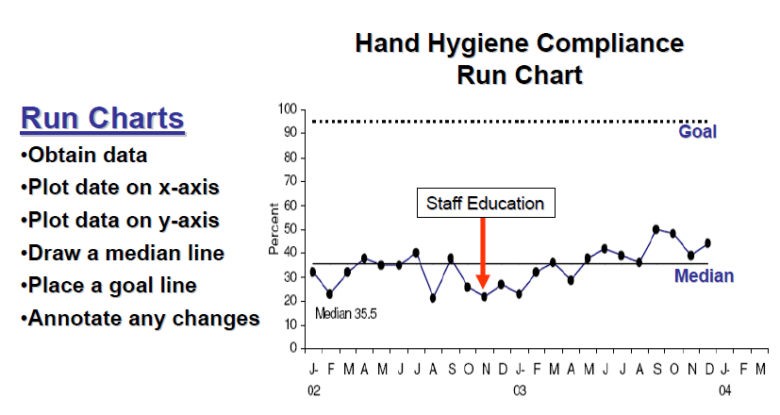
Annotation Example: What is Happening Here?
Notes:
Here is a run chart that is annotated to add a goal and a test of change. See the goal of what looks to be 95% at the top? The chart is also annotated with a staff education intervention that occurred in November of 2002. These kinds of annotations assist the interpreter in understanding the progress of the improvement work. Even without being on the Hand Hygiene Compliance team, I can tell you what is going on with this project. When you follow the directions on the left side, building a run chart – even without a computer, can be done.

Slide 43
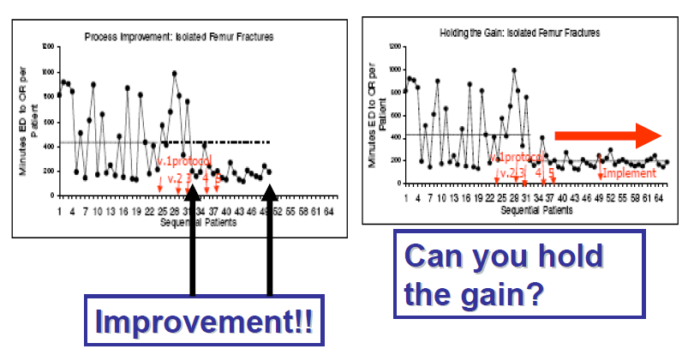
Has the System Changed?
Notes:
Here are a couple more. Let’s talk about stability. These are what you want your charts to look like when they show positive progress in your improvement project work. Look at the data over time on each chart. Look at the wild variation in each of the chart, followed by a much more stabilized, less variable data display. There are terms for kinds of variation, and how we think about and explain variation helps our stakeholders understand the stability of the process and not overreact. Another way to think about it is the more variability your data shows, the less predictable your process is. As variability decreases (where the peaks and valleys change into a more shallow line) the more stable or predictable your process is becoming. We strongly encourage you to attend a QuEST event in your state to learn about variation, and how to effectively understand and use variation.
Both charts contain markers along the X axis that denote the small tests of change in testing a protocol, and the chart on the right shows the marker for implementation of the protocol. In the next few slides we will talk about how to know when to stop testing and move to full implementation of the tested process. After implementation, data collection and monitoring must continue to make sure that implementation goes as planned and there is no backslide.

Slide 44
What Run Charts Don’t Tell You
The reason(s) for unusually big or small data points
Is the performance of the process acceptable?
How the process should actually be improved or redesigned
Notes:
Run charts, while a valuable tool, may not tell you everything you need to know about the progress of your quality improvement work. Unusually large or small data points may be due to a low number of patients in the measure population. Data displays should be supplemented with a narrative that helps stakeholders understand the progress or past work, as well as support future decision making – like whether the improvement is acceptable or needs to be re-worked or redesigned. We believe that data drives improvement, and improvement drives data. A strong relationship like this helps you to use data to drive decision making in your quality improvement agenda and project life cycles o explain it to your stakeholders. Effective data displays support decision making,

Slide 45
“Perfectly Stable” –
A Place You Don’t Want to Be, if You are Trying to Make a Change
Notes:
What does this chart tell you? Are there shifts or trends? Take a look at the relationship between the data points and the median. We could analyze this chart and call it “stable”. Stable is not where you want to be if you are trying to make a change. For instance, let’s say that this is your data display representing your current inpatient falls with injury rate. You can look at this past performance and correctly say that you have a process that is perfectly designed to achieve about a 4.8% rate. You have some quarters above that rate, and some below. Pizza parties in each third quarter, and temper tantrums in each quarter 4. Doing a careful analysis of current state is really important to understand how to prioritize and direct your improvement work in the future.

Slide 46
When are you “done” with testing?
Everyone who needs to test the change has
The process is stable, with few changes
Staff are satisfied with the current state
Your measure is moving in the right direction
Notes:
How do you know when to stop testing? Here are a few tips that may help you decide. Remember a few minutes ago when we talked about spreading test so that more staff try the test over more time? When the team feels like enough people have tested – that is, you have data over time for the testing period, AND you have engaged staff – especially those you suspect might have doubts or are true naysayers - to get enough input – then you can consider implementation. There may be some minor tweaks to the process – even after implementation, but if you find that there is major re-work, then you need to continue to test the process. Remember to let data drive your decision making. Data and documentation are key to all quality work, and especially with this critical juncture of testing to implementation.

Slide 47

Making Change “Stick”
Update policies and procedures
Ensure everyone is trained
Build the process into orientation guides
Build the process into your electronic record
Decide who will continue to monitor this
Notes:
Okay- let’s say you are ready to make the move. You are done testing. Just as carefully as you tested, you will want to make sure that you cover your bases for successful implementation. A special note for clinical teams that have multiple shifts or occasional staff. Updating a policy will not be enough for folks who work occasionally on your unit. Find out the formal as well as the informal ways that staff communicate with each other and utilize these tools to make sure everyone is aware of changes. Likely you will be able to identify unit or subject champions. We suggest you keep these people engaged by asking them to continue to monitor results of the implementation.

Slide 48
Making it “Stick”
The changes should be tied to an existing accountability structure:
  Quality Committee
  Patient Safety Committee
  Shared Governance
  Management Team
At least an annual spot check of the outcome measure; may need a process measure if the outcome is “slipping”
Think about a contingency plan – new PDSA cycles – if performance starts to slip
Hospitals that are highly reliable have cultures that support sustained quality and safety work
Notes:
Additionally, you will want to make sure that the new process is linked to a senior leadership or accountability structure. Who will ultimately own this new process and hardwire it into their oversight. It may be the senior leader champion you engaged at the beginning who will decide. As soon as this decision is made, you will make sure that this accountability team has a briefing (without too many details) on its next agenda. Remember to keep an eye on the spread and sustained performance.
All of this good work is very difficult to do if the organization’s culture does not support good quality work. You are viewing this webinar because your hospital signed on to the Great Lakes Partners for Patients hospital improvement network. By signing the enrollment document, your leadership pledged to begin its own work in discovering how they can establish and further their work in creating an environment where highly reliable systems can support quality and safety. We call these hospitals High Reliability Organizations. In the next slides we will describe the attributes of an HRO.

Slide 49
HIGH RELIABILITY MODEL
Robust Process Improvement®
Safety Culture
Leadership
Commitment to zero patient harm
Empowering staff to speak up
Systematic, data-driven approach to complex problem solving
Notes:
The Joint Commission Center for Transforming Healthcare is leading the nation to educate and assist hospitals to become highly reliable organizations. The foundation for highly reliable healthcare is first do no harm and focus outcomes related to the six domains or aims of health care quality: care that is safe, patient (person)-centered, timely, efficient, effective and equitable. (Institute of Medicine - IOM).
Although a lot of work has been accomplished since the Institute Of Medicine’s initial 1999 publication, “To Err is Human: Building a safer health system’ in which the Institute Of Medicine identified that medical errors were rampant with an estimated 98,000 deaths per year in medical errors alone. Healthcare is still far from being reliable. A study of evidence-based treatments, the proper care was provided less than 60 percent of the time (McGlynn 2003).
The Joint Commission Center for Transforming Healthcare has put forward the concepts of leadership, safety culture and robust process improvement as foundations in achieving highly reliable healthcare.

Slide 50
Principles of Highly Reliable Organizations
Five key principles that highly reliable organizations have in common:
  Pre-occupation with Failure
  Reluctance to Simplify
  Sensitivity to Operations
  Commitment to Resilience
  Deference to Expertise
Notes:
The key to being highly reliable is making the decision to promote excellence in patient care for ‘every patient, every time’.
Senior leadership, hospital boards and other influential leadership must commit and weave these five key principles into how care is delivered. Being highly reliable is not a new initiative to sign up for, it is the way the hospital operates every day. The ‘hallmark of an HRO is not that it is error-free but that errors do not disable it”.
The book, Managing the Unexpected by Karl Weick and Kathleen Sutcliffe, navigates learners through the five principles needed for the highly reliable journey.
Preoccupation with failure “captures the need for continuous attention to anomalies that could be symptoms of larger problems in the system”. HRO’s practice this three ways: they work to detect small, emerging failures as that clues them in to additional failures elsewhere in the system, they work diligently to anticipate significant mistakes that they don’t want to make and they know that people’s knowledge of a situation, the environment around them and their own group is incomplete. Preoccupation with failure is about ‘detecting small discrepancies anywhere”.
Reluctance to simplify involves teaching others to resist the temptation to simplify their observations and their experiences of the environment around them; having them identify the subtle differences that may make the difference between early and late recognition - thus, identifying the situation and making simple corrections versus failing to recognize a problem until it gets out of control. Reluctance to simplify is about “the concepts people have on hand to do the detecting and recovery”.
Sensitivity to Operations means that these systems are sensitive to ‘expectable interactions with a complicated system. An HRO expects their staff to report any deviation from normal from expected, and making the expectation that staff will speak up with any concern. Sensitivity to operations is “about the work itself, about seeing what we are actually doing regardless of intentions, designs and plans”.
Commitment to resilience – it is known that errors in patient safety and adverse events may happen, but resilience is to recognize and contain them quickly, contain them so that they mitigate the harm that results when small errors are compounded and emerge in to major problems.
Deference to expertise – this means that when confronted by a problem, an HRO identifies the individual with the greatest expertise to manage the situation, instead of assigning authority by job title or hierarchy. If you are a part of an HRO, you are not afraid to ask for help or admit you are in over your head.

Slide 51

More Resources to Help You Start
Designing Small Tests of Change User Guide
Improvement Action Network (IAN)
  Contact your hospital’s Improvement Advisor for the next IAN in your area
Quality Essential Skills Training (QuEST)
  Two-day QI training, semi-annually in your state
Your team at WHA – IHA - MHA
Notes:
You have reached the end of this second webinar in the starter pack. As you begin to apply the improvement model to the clinical topic you learned about in webinar one of the starter pack, you will likely need some more help. Each of the states in our Great Lakes partnership have prepared virtual and in-person resources to help you get started and be successful. The Designing Small Tests of Change User Guide is posted on your state’s HIIN website. This is a great tool for mapping out your improvement work, and you can teach others to use it too. There are improvement action network opportunities in each state. These events are designed to help your team analyze and prioritize your opportunities for improvement and network with others who have achieved success in the gaps you are working on. Take advantage of the QuEST events as well. We’ll reinforce the learning you have had in this webinar, as well as teach you to use data to guide your work. Finally, make sure that you are in contact with your hospital’s improvement advisor. Use them to get ideas and resources.
Thanks for joining me today.

