Slide 1
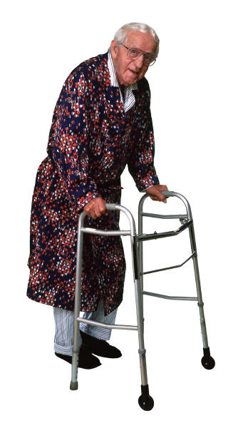
Essential Steps to Protect Patients from Injurious Falls In Rural and Critical Access Hospitals
June 15, 2018
Pat Quigley, PhD, MPH, ARNP,
CRRN, FAAN, FAANP
Nurse Consultant
pquigley1@tampabay.rr.com

Slide 2
Objectives
Identify essential actions to protect patients from fall related injury.
Discuss tips to integrate protective injury reduction interventions at the point of care.
Examine at least 3 core clinical nursing practices to differentiate injury risk.
Apply injury reductions strategies to case studies.

Slide 3
The Burden of Fatal and Non-Fatal Falls
Estimated medical expenditures attributable to older adult falls using methodology: population data from National Vital Statistics System and cost estimates from web-based injury statistics (WISQARS)
Florence, C., Bergen, G., Atherly, A., et al. (2018). Medical cost of fatal and non-fatal falls in older adults. JAGS, 66(4). https://doi.org/10.1111/jgs.15304

Slide 4
Results
In 2015, estimated costs attributable to fatal and non-fatal falls: approx $50 Bil
Non-fatal falls:
$28.9 Bil – Medicare
$8.7 Bil – Medicaid
$12.0 Bil Private and other payers
Fatal falls: $754 mil

Slide 5
Falls: US population aged 65 and older during 2015
Fatal falls from 2015 NVSS (N=28,486)
Non-fatal falls from 2011 MCBS (N=3,460/10,102 respondents) (Medicare Current Beneficiary Survey)
Non-fatal falls: 52.1% fell once, 21.3% fell twice, 24.1% fall three times of more (What percent enter into your care?)

Slide 6
65 and older
Approx 30% fall once each year
Only 1/3 who fall seek medical care
Problems with mobility, balance, and loss of muscle strength contribute to the likelihood of falling

Slide 7
Falls In Hospitals
Each year, between 700,000-1,000,000 people in US hospitals fall
A fall may result in fracture, lacerations, or internal bleeding
Research shows that close to 1/3 of falls can be prevented
AHRQ (2013). Preventing falls in hospitals. A toolkit for improving quality of care. www.ahrq.gov/professionals/systems/hospitals/fallpxtoolkit/index/html

Slide 8
Fall Rates
Variable | Overall | Rural | Urban
Hospitals In%) | 625 | 65 (10.4%) | 560(89.6%)
Nursing Units | 4,496 | 222 (4.9%) | 4,274 (95.1%)
Quality Indicator
Unit Fall Rates (per 1000 pt days) mean (SD) | 3.24 (2.55) | 3.3 (2.44) | 3.24 (2.56)
Baernholdt, M., Hinton, I., Yan, G., Xin, W., Cramer, E., Dunton, N. (2018). Fall Rates in Urban and Rural Nursing Units: Does Location Matter? JNCQ. DOI: 10.1097/NCQ.0000000000000319
Notes:
Fall Rates in Urban and Rural Nursing Units: Does Location Matter?.
Baernholdt, Marianne PhD, MPH, RN, FAAN; Hinton, Ivora D. PhD; Yan, Guofen PhD; Xin, Wenjun MS; Cramer, Emily PhD; Dunton, Nancy PhD, FAAN
[Article] Journal of Nursing Care Quality.
we found that geographic region, unit type, and nurse staffing, education, experience, and outcomes were associated with fall rates. Implications include specific attention to fall prevention in rehabilitation units, creating better work environments that promote nurse retention, and provide RN-BSN educational opportunities.

Slide 9
Aging Hospital Population: 2010
45% of the inpatient hospital population in the US was 65 years of age and older
among whom 19% were ages 75-84, and
9% 85 and older
Levant, S., Chari, K., & DeFrances, C.J. (2015). Hospitalizations for patients age 85 and over in the United States, 2000-2010. NCHS Data Brief. No. 182. Available at: hppt://www.cdc.gov/nchs/data/databriefs/db182.htm.
Notes:
Most falls are preventable. Falls happen because of unsafe environments or known risk factors not treated. We can change practice and make a difference by reducing falls, focusing on reversible fall risk factors. Obviously, if a fall is prevented, the harm is avoided; but, not all falls can be prevented. Brief statistics confirm why prevention of falls must be among the top patient safety priorities: falls are leading cause of injury in adults 65 and older, the leading cause of unintentional injury death in adults 85 and older and in 2010, 45% of the inpatient hospital population in the US was 65 years of age and older – among whom 19% were ages 75-84, and 9% 85 and older (Levant, Chari, & DeFrances, 2015). To protect these patients from falls and resulting injury, you approach to care requires a population-based approach. You cannot approach all patients as if their risks are the same. Consider these do’s and don’ts in your approach to reconsider core interventions for fall prevention and surveillance.

Slide 10
Tips to Integrate Protective Injury Reduction Interventions at the Point of Care.
Patient Care
Injury Risk and History Assessment on Admission
Injury Reduction Strategies
Assess Your Patient
Patient Education
A, B, C, S Bundle
Environment of Care
Assess environmental injury risk factors
Assess interaction of patient and environment
Guidelines for Footwear
Mobility Aids in Room

Slide 11
5 Essentials to Protect from Fall Related Injury (FRI)
Programmatic Shift
Change in assessment structures: add risk for FRI and Hx of FRI
Change in interventions: Environmental Redesign
Assess to protective interventions
Organizational Support
You can protect patients from injurious falls

Slide 12
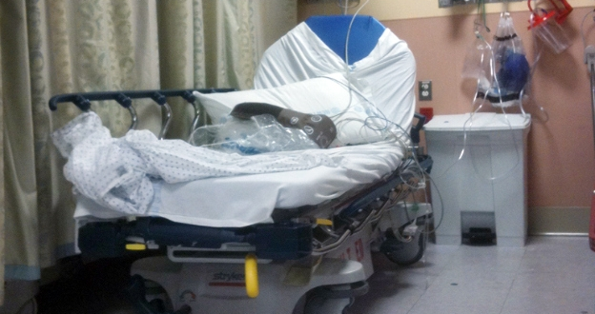
The Problem of Falls
Notes:
National Quality Forum (NQF) “never event” (Patient death or serious disability associated with a fall while being cared for in a health care facility
Among older adults falls are the leading cause of injury death (CDC)
http://www.psnet.ahrq.gov/primer.aspx?primerID=3 (NQF)
2. http://webappa.cdc.gov/cgi-bin/broker.exe?_service=v8prod&_server=app-v-ehip-wisq.cdc.gov&_port=5082&_sessionid=el9hNCLlM52&_program=wisqars.details10.sas&_service=&type=U&prtfmt=STANDARD&age1=65&age2=85&agegp=65+&deaths=39111&_debug=0&lcdfmt=lcd1age&ethnicty=0&ranking=10&deathtle=Death

Slide 13
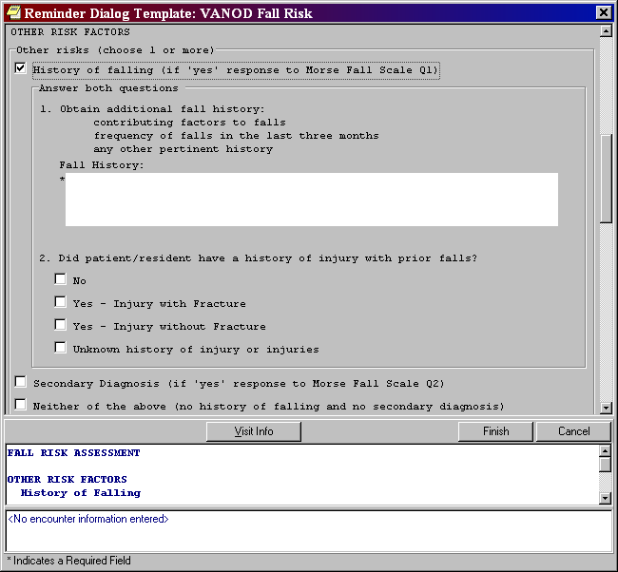

Slide 14
3 Core Clinical Nursing Practices to Differentiate Injury Risk
Demographic Variables
Medical/Surgical History
Injury Risk
Extrinsic Risks

Slide 15
Sept 28, 2015: TJC Sentinel Alert: Preventing Falls and Fall Injuries
Lead efforts to raise awareness of the need to prevent falls resulting in injury
Establish an interdisciplinary falls injury prevention team or evaluate the membership of the team in place
Use a standardized, validated tool to identify risk factors for falls and injury risk factors
Develop an individualized plan of care based on identified fall and injury risks, and implement interventions specific to a patient, population or setting

Slide 16
Suggestions con’t
Standardize and apply practices and interventions demonstrated to be effective, including:
A standardized hand-off communication process
One-to-one education of each patient at the bedside
Conduct post-fall management, which includes: a post-fall huddle; a system of honest, transparent reporting; trending and analysis of falls which can inform improvement efforts; and reassess the patient
Conduct a post-fall huddle
Report, aggregate and analyze the contributing factors on an ongoing basis to inform improvement efforts.

Slide 17
Hospital Falls: D. Oliver, et al. Falls and fall-related injuries in hospitals. (2010, Nov). Clinics in Geriatric Medicine.
30% to 51% of falls result with some injury
80% - 90% are unwitnessed
50%-70% occur from bed, bedside chair (suboptimal height) or transferring between the two; whereas in mental health units, falls occur while walking
Risk Factors: Recent fall, muscle weakness, behavioral disturbance, agitation, confusion, urinary incontinence and frequency; prescription of “culprit drugs”; postural hypotension or syncope

Slide 18
Most effective, fall prevention interventions should be targeted at both point of care and strategic levels
Best Practice Approach in Hospitals:
Implementation of safer environment of care for the whole patient cohort (flooring, lighting, observation, threats to mobilizing, signposting, personal aids and possessions, furniture, footwear)
Identification of specific modifiable fall risk factors
Implementation of interventions targeting those risk factors so as to prevent falls
Interventions to reduce risk of injury to those people who do fall
(Oliver, et al., 2010, p. 685)

Slide 19
The Flex Monitoring Team: Critical Access Hospitals
University of Minnesota
University of North Carolina at Chapel Hill
University of Southern Maine
http://www.flexmonitoring.org
Notes:
“The Flex Program” refers to the Medicare Rural Hospital Flexibility Program, which was created by Congress in 1997. It allows small hospitals to be certified as Critical Access Hospitals (CAHs) and offers grants to States to help implement initiatives to strengthen the rural health care infrastructure. The grant program is administered by the Health Resources Service Administration’s Federal Office of Rural Health Policy. HRSA is a division of the U.S. Department of Health and Human Services.

Slide 20
Evidence-based Falls Prevention in Critical Access Hospitals
Most falls commonly occur as a result of
Medication-related issues
Toileting needs
Hospital environmental conditions
Pearson, K.B., & Coburn, A.F. (2011, Dec.), Policy brief. Evidence-based fall prevention in critical access hospitals, Office of Rural Health (PHS Grant No. U27RH01080).

Slide 21
Effective Falls Prevention
Target:
Intrinsic risk factors
and
Extrinsic risk factors

Slide 22
Fall Risk Factors
Intrinsic
Age-related changes
Decreased vision
Mobility/Gait
Urinary Incontinence
Chronic Illness
Confusion
History of Falls
Extrinsic
Lack of Grab Bars
Poor Condition of Floor Surfaces
Inadequate or Improper Use of Assistive Devices
Proper Footwear

Slide 23
Interventions
Physiological Changes
Toileting Regimens
Medication Review
Environmental Changes
Alarm Usage
Limiting Restraint use
Lowering Bedrails
Use of Floor Mats
Education and Training
Notes:
Use of bedrails as a falls prevention strategy needs to be targeted to the fall risk of the pateint: ie. Pts who are visually impaired or confused but mobie enough to be at risk for climbing over the bedrails should not have their bedrails raised.

Slide 24
Targeted Interventions: Prevention + Protection + Surveillance
Prevention
The act of preventing, forestalling, or hindering.
Plus Protection
Shield from exposure, injury or destruction (death).
Mitigate or make less severe the exposure, injury or destruction.
Plus Surveillance
Detection, interaction, response - supports both prevention and protection.
Notes:
Comment for Prevention: A strong telesitter is able to prevent falls with skilled verbal redirections and also by "learning their patients behaviors" and anticipating risky behavior.

Slide 25
Protection from Injury
Protecting Patients from Harm
Our Moral Imperative

Slide 26
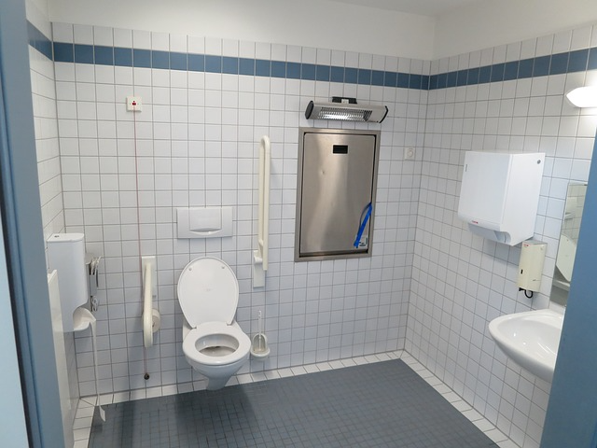

Slide 27
Universal Injury Prevention
Educates patients / families / staff
Remember 60% of falls happen at home, 30% in the community, and 10% as inpts.
Take opportunity to teach
Remove sources of potential laceration
Sharp edges (furniture)
Reduce potential trauma impact
Use protective barriers (hip protectors, floor mats)
Use multifactorial approach: COMBINE Interventions
Hourly Patient Rounds (comfort, safety, pain)
Examine Environment (safe exit side)

Slide 28
Moderate to Serious Injury: A, B, C, S
Those that limit function, independence, survival
Age
Bones (fractures)
Bleeds / AntiCoagulation (hemorrhagic injury)
Surgery (post operative)

Slide 29
Age: > 85 years old
Education: Teach Back Strategies
Assistive Devices within reach
Hip Protectors
Floor Mats
Height Adjustable Beds (low when resting only, raise up bed for transfer)
Safe Exit Side
Medication Review
Criteria for Surveillance

Slide 30
Bones
Hip Protectors
Height Adjustable Beds (low when resting only, raise up bed for transfer)
Floor Mats
Evaluation of Osteoporosis
Criteria for Surveillance

Slide 31
Bleeds/AntiCoagulation
Evaluate Use of Anticoagulation: Risk for DVT/Embolic Stroke or Fall-related Hemorrhage
Patient Education
TBI and Anticoagulation: Helmets
Wheelchair Users: Anti-tippers
Criteria for Surveillance

Slide 32
Surgical Patients
Pre-op Education:
Call, Don’t Fall
Call Lights
Post-op Education
Pain Medication:
Offer elimination prior to pain medication
Increase Frequency of Rounds
Criteria for Surveillance

Slide 33
Protect from Injury
Remember:
Protection from Injury is
separate and distinct
from fall prevention

Slide 34
Injury Protection
Floor Mats
Hip Protectors
Helmets
Eliminate Sharp Edges, esp. bathrooms
Safe Exit Sides

Slide 35
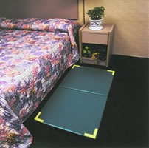
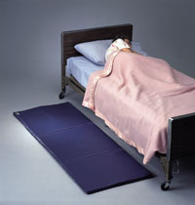
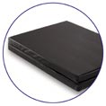
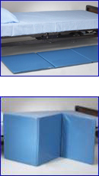
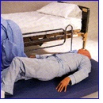
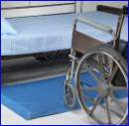
Bedside Mats – Fall Cushions
bedside fall cushion
Floor Mat
Floor Cushion
Roll-on bedside mat
Soft Fall bedside mat
Tri-fold bedside mat

Slide 36
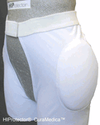
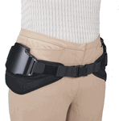
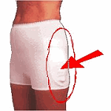
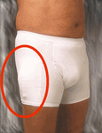
Hip Protectors – Examples

Slide 37
Your Patient: Mr. Veteran
CC: Dizziness and Fell face forward, at Home Getting Up from Toilet
82 year old accompanied by 2 daughters and son-in-law using 4 wheel walker
in good health and active until one year ago
1 fall in the last 3 months

Slide 38
Falls hx.
4 falls ever (this fall)
First fall October -fell twice with sugar in low 50’s
March - fall-returning from bathroom at night –climbed into bed over the foot of the bed and lost balance-sustained L1 comp. fx.
Frequent stumbling and loss of balance
Family noticed dragging L foot and tendency to lean to the side since March
Not using an assistive device at the time of falls

Slide 39
HPI/PMH
8 hospitalizations in 2014
treated for lung cancer with LUL resection; no chemo or radiation tx.
had AAA repair, f/u by bilateral FEM/POP bypass and DVT with IVC filter placement
significant weight loss over the last year
at least 2 episodes of hypoglycemia

Slide 40
PMHx.
Compression Fx. following a fall
Paroxysmal atrial fibrillation on warfarin
HTN
CAD/CABG x 3 1981
DM II
TIA
Dementia
GERD
Low back pain
AAA- Repair 3/2006
PVD-s/p fem-pop bypass 3/2006
DVT with IVC filter placement 3/2006
CHF

Slide 41
History
Functional Hx:
Independent in basic ADL’s except bathing, ambulates with a 4 wheel walker most of the time
Unable to get up unassisted
Needs assist with bathing, meals preparation and medications
Family hx: non-contributory

Slide 42
Social History
Married, wife dx with Alzheimer’s Disease
has day-time caregivers
family members have been staying with parents at night until 2 days when they felt parents were safe to stay by themselves
Smoking HX: quit 25 years ago
ETOH: current none: denies hx of heavy use in past

Slide 43
Pertinent ROS and VS
Denies syncope, palpitations, hx of kidney stones
Has constant chronic low back pain 5-9/10
Denies lower extremity weakness or numbness
VS: 106/69 HR 76 Sitting
91/59 HR 85 standing immediate
94/61 HR 86 Standing one minute
93/60 HR 80 Standing 3 minutes
*Pt denied dizziness (13mm drop in SBP)

Slide 44
Physical Exam
Gen: in NAD
HEENT: PEERLA, EOMI, no nystagmus
Neck: no JVD, no bruits
Heart: irregular, S1, S2, Systolic murmur III/VI
Lung: clear, Abd: benign
Ext: L ankle 1+edema

Slide 45
Physical Exam cont.
Neuro exam: MMSE 25/30, GDS 7/15
CN II-XII grossly intact, VA L 20/30, R 20/100 uncorrected, gross depth perception intact, fine impaired
Motor: R ankle DF 4+, Lt 2-.
R knee ext 4+, Lt 3+
R hip flex 4, Lt 4

Slide 46
Neuro Exam
Sensory: intact with 5.07 and 4.08 filament on Rt leg, impaired on L foot with both
nl proprioception bilat., vibration nl on R, absent on L
Tone- few beats of clonus L foot, otherwise nl, no cogwheeling
DTR’s 1+ on R, 2-3+ on LLE, 2 LUE
Babinski positive on L
Coordination: finger taps impaired, RAM impaired, foot taps impaired (slow and decreased amplitude on L)

Slide 47
Assessment/Identification of Fall and Injury Risk Factors
Deconditioning
Episodes of hypoglycemia
Chronic low back pain secondary to lumbar DDD and DJD, and compression fracture of L1,
Lf foot weakness and sensory impairment most likely multifactorial (lumbar spine DJD, r/o spinal stenosis, residual effects of CVA?)
Borderline hypotension with 15mm drop in SBP
Anticoagulant therapy with Warfarin

Slide 48
Plan: To Admit What Will You Do?
In the ER to work him up and keep him safe from falls and injury?
In the Acute Care Unit to work him up and keep him safe from falls and injury?

Slide 49
My Plan
1. Deconditioning: PT for reconditioning, strengthening, balance and gait training
2. Lf foot weakness and sensory impairment:
- Orthotics referral for Lt foot AFO
- use Lt foot AFO at all times with walker for fall prevention
MRI L-S spine to evaluate pathology (r/o spinal stenosis)
- Use 4 wheel walker at all times

Slide 50
Plan Continued
3. Episodes of hypoglycemia: Work to achieve optimum control of blood sugar- check tid before meals and at hs and bring log to PCC to adjust regimen
4. Compression fracture/Osteopenia:
- Osteoporosis work-up, consider Alendronate tx. (not ideal candidate)
- Start Ca/D bid (600mg/200IU)
- Wear Hip Protectors –ordered from Prosthetics
- Pt and family educated about rationale for hip protectors

Slide 51
Plan Continued
5. Borderline hypotension:
-Change position slowly from sit to stand while holding onto firm support
-change terazosin to tamsulosin to reduce risk of orthostasis
-monitor and record blood pressure daily and bring to next PCC appt- - ordered BP cuff for pt/family
- consider changing Furosemide to QOD if Low BP continues

Slide 52
Plan Continued
6. For Anticoagulant therapy with warfarin for CVA prophylaxis:
-recommended continuation of warfarin therapy
- stressed need to use 4 wheel walker at all times to reduce risk of injury
-need for close supervision of pt to assure compliance with walker use
Patients at high risk for falls with a. fib., because of their high stroke rate, appear to still benefit from anticoagulant therapy, if they have multiple stroke risk factors (Gage et al., 2005).

Slide 53
Plan Continue
Create a Safe Environment
Floor Mats
Safe Exit Side
Bed Side Commode
Virtual Surveillance

Slide 54
Your Turn
Share Your Patients
Let’s Discuss

Slide 55
You Can Always Reach Me!
Patricia Quigley, PhD, MPH, ARNP, CRRN, FAAN, FAANP, Nurse Consultant
pquigley1@tampabay.rr.com

Slide 56
Thank You!
Shruthi Murali – smurali@wha.org
Pat Quigley - pquigley1@tampabay.rr.com

