Slide 1

Advancing Fall and Injury Prevention Practices Workshop
Aurora Sinai Medical Center
Wednesday, October 10th 2018

Slide 2


Agenda
Time | Description | Speaker
9:00am - 9:15am | Opening: State-of-the-state: falls with injury data and plans for the HIIN | Shruthi
9:15am - 9:45am | Understanding Falls | Pat Quigley
9:45am - 10:15am | 2018: Summary Report: Learnings from Consultation Visits | Pat Quigley
10:15am - 10:30am | Break
10:30am - 11:15am | Integrating Protection from Injury into Your Practice | Pat Quigley
11:15am - 12:00pm | Reducing Barriers to Floor Mat Use | Pat Quigley
12:00pm - 12:45pm | Lunch (on your own)
12:45pm - 1:30pm | Changing Conversations with Patients: Patient Engagement | Pat Quigley
1:30pm - 2:00pm | Experiences Redesigning Post Fall Management | Pat Quigley
2:00pm - 2:15pm | Break
2:15pm - 3:45pm | Hospital Presentations and Panel Discussion: Lessons Learned and Progress Made
3:30pm - 3:45pm | Summary/Closing Remarks | Pat Quigley

Slide 3
State of the State
Current 3 months
 | Baseline Rate | Performance Rate | Improvement
GLPP HIIN | 0.511 | 0.509 | 0.37%
Wisconsin | 0.644 | 0.580 | 9.94%
Individual Hospital Touch-bases
Site-visits in Michigan and Wisconsin
Falls webinar for Critical Access Hospitals

Slide 4
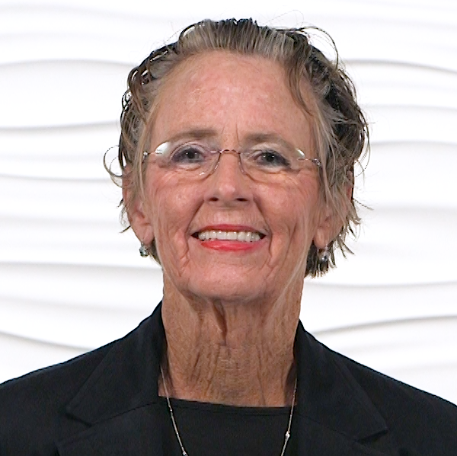
Presenter: Pat Quigley
Dr. Patricia Quigley, PhD, MPH, ARNP, CRRN, FAAN, FAANP, Nurse Consultant, is a retired Associate Director of the VISN 8 Patient Safety Research Center of Inquiry and is both a Clinical Nurse Specialist and a Nurse Practitioner in Rehabilitation.

Slide 5
Understanding Falls
Pat Quigley,PhD,MPH,ARNP,CRRN,FAAN,FAANP
Nurse Consultant
Retired Associate Director, VISN 8 Patient Safety Center
Retired Associate Chief for Nursing Service/Research
E-Mail: pquigley1@tampabay.rr.com

Slide 6
Objectives
Differentiate Definitions of Falls
Understand Types of Falls
Examine Root Causes of Falls to Determine Type of Fall

Slide 7
Definitions
What is your definition of a fall?

Slide 8
VA Definition: National Falls Toolkit
Fall Definition - Loss of upright position that results in landing on the floor, ground, or an object or furniture, or a sudden, uncontrolled, unintentional, non-purposeful, downward displacement of the body to the floor/ground or hitting another object like a chair or stair; excluding falls resulting from violent blows or other purposeful actions. (NCPS National Falls Toolkit)

Slide 9
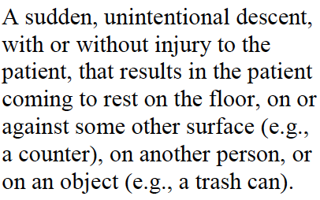
NDNQI Fall Definition
(ANA/NDNQI Harmonization Project)

Slide 10
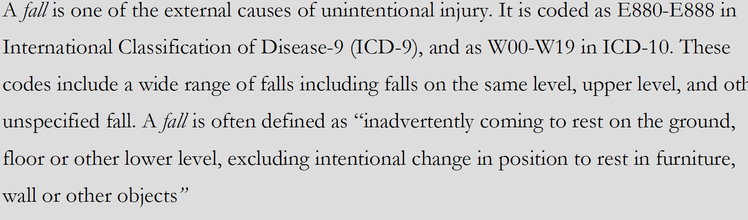
ICD 9 Code

Slide 11
But First………………..
https://www.youtube.com/watch?v=A7EcprAXtRE
Take notes … of fall risks……..

Slide 12
What is considered a fall:
Falls from the low bed to a mat 4 inches below
Falls against the wall then slides to the floor
Falls off-unit when the patient went outside to smoke
A patient is attempting to get up or is ambulating with assistance and loses control and is
Unintentionally assisted back down to a chair or bed
A fall during a transfer due to weak knees, a fall when the patient was eased to the floor by a nurse
A veteran slides out of bed onto the floor due to blankets being wrapped around his feet
A fall on a supervised outing.

Slide 13
What is NOT a Fall:
An assault that caused a fall.
A fall during a non-supervised therapeutic pass off the unit.
A patient is attempting to get up or is ambulating with assistance and is assisted back down to a chair or bed with control and intention
If a patient falls while in contact with a family member, and the family member falls, knocking the patient to the floor (external force)

Slide 14
Types of Fall: Getting to Precision
Morse (1997):
Accidental falls
Anticipated physiological falls
Unanticipated physiological falls

Slide 15
Let’s Be Clear:
Accidental Fall: Fall due to extrinsic environmental risk factors: spill on the floor, clutter, tubing / cords on the floor, etc.
Anticipated Physiological Falls: Factors associated with known fall risks as indicated on the Morse Fall Scale: loss of balance, impaired gait or mobility, impaired cognition/confusion, impaired vision. Falls that we anticipate will occur to the patients’ existing physiological status, history of falls, and decreased mobility upon assessment.
Unanticipated Physiological Falls: Factors associated with unknown fall risks that were not predicted on a fall risk scale:
unexpected orthostasis; extreme hypoglycemia; stroke; heart attack.

Slide 16
What are your questions?
Assisted
Unassisted
Witnessed
Unwitnessed
Root Causes

Slide 17
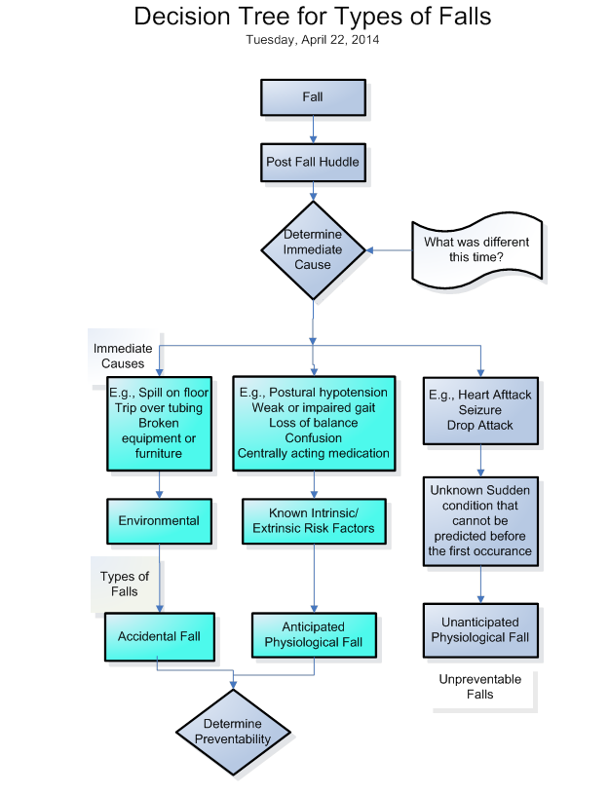

Slide 18
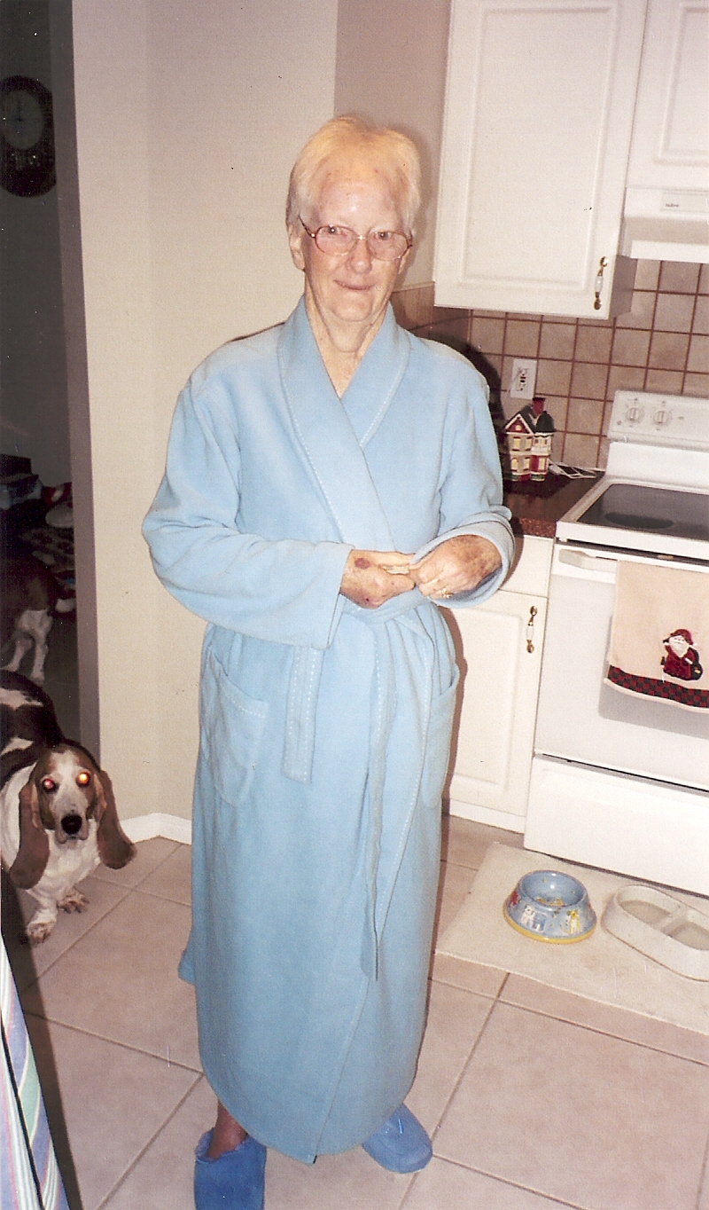
Doris Heap
My Mom
Lots of Falls….
What are her fall risks?

Slide 19
Questions? Comments?
Patricia Quigley, PhD, MPH, ARNP, CRRN, FAAN, FAANP, Nurse Consultant
pquigley1@tampabay.rr.com

Slide 20
2018: Summary Report: Learnings from Consultation Visits
Pat Quigley,PhD,MPH,ARNP,CRRN,FAAN,FAANP
Nurse Consultant
Retired Associate Director, VISN 8 Patient Safety Center
Retired Associate Chief for Nursing Service/Research
E-Mail: pquigley1@tampabay.rr.com

Slide 21
Objectives
Define strategies to improve
  Environmental Safety
  Clinical Practices
  Patient Engagement
  Post Fall Management

Slide 22
Thank you!
WHA
MHA
And Participating Hospitals

Slide 23






Wisconsin Hospitals, CAH, LTC

Slide 24
Michigan Hospitals, CAH, LTC

Slide 25
Consultation Visit Process
Organizational Self Assessment
Individualized Agenda
Clinical Rounds (Everywhere!)
Meetings: Leadership, Falls Committee, Nurse Managers/Nurse Educators
Education Session

Slide 26
Consultation Framework
High Reliability Organizations
  Organization-Level
  Unit-Level
  Patient-Level
Best-Practice Recommendations

Slide 27
Hospital Falls: D. Oliver, et al. Falls and fall-related injuries in hospitals. (2010, Nov). Clinics in Geriatric Medicine.
30% to 51% of falls result with some injury
80% - 90% are unwitnessed
50%-70% occur from bed, bedside chair (suboptimal height) or transferring between the two; whereas in mental health units, falls occur while walking
Risk Factors: Recent fall, muscle weakness, behavioral disturbance, agitation, confusion, urinary incontinence and frequency; prescription of “culprit drugs”; postural hypotension or syncope

Slide 28
Most effective, fall prevention interventions should be targeted at both point of care and strategic levels
Best Practice Approach in Hospitals:
  Implementation of safer environment of care for the whole patient cohort (flooring, lighting, observation, threats to mobilizing, signposting, personal aids and possessions, furniture, footwear)
  Identification of specific modifiable fall risk factors
  Implementation of interventions targeting those risk factors so as to prevent falls
  Interventions to reduce risk of injury to those people who do fall
  (Oliver, et al., 2010, p. 685)

Slide 29
Implementation of a safer environment of care for the whole patient cohort (reduce risk of accidental falls due to an unsafe environment).

Slide 30
1. Implementation of a safer environment of care for the whole patient cohort (reduce risk of accidental falls due to an unsafe environment).
Bed Rooms
  Beds (Bed Height)
  Chairs
  Bedside Stands
Bathrooms
  Injury Risks – Metal, Sharp Edges
  Toilet Height
  Grab Bars
  Access

Slide 31
Safe Exit Side
SIKANA, a non-profit organization whose aim is to equip people with practical skills through free education video programs, in partnership with the SIEL Blue Group Association, also a non profit organization, developed over 50 free exercise videos to improve the health of older and adults living with chronic diseases. https://www.sikana.tv/en/sport/50-gym-exercises-for-seniors#chapter-5_

Slide 32
Getting Out of Bed Safely
The exercise program is organized in 7 chapters. Chapter 5 has exercises to improve balance. Two videos are specific to safe transfers in and out of bed.
The first video, Good Everyday Habits: Getting Out of Bed, guides older adults in step-by-step body mechanics to get into bed safely with special focus on reducing risk of falls: https://www.sikana.tv/en/sport/50-gym-exercises-for-seniors/how-to-get-out-of-bed

Slide 33
My Bathroom

Slide 34
2. Identification of specific modifiable fall and injury risk factors (reduce risk of anticipated physiological falls).
Multifactorial Fall Risk Assessment.
  Orthostasis
  LE Peripheral Neuropathy
  Medications
Progressive Mobilization.
  Shoes
  Mobility Aides

Slide 35
3. Implementation of interventions targeting those modifiable fall risk factors so as to prevent falls (reduce risk of anticipated physiological falls).
Use of Clinical Judgment.
identify individual specific fall risk factors,
develop intra and interdisciplinary handoff, and
communication systems that communicate patients’ fall and injury fall risk factors, changes in risks and clinical interventions.

Slide 36
4. Interventions to reduce the risk of injury to those patients who do fall.
Injury Risk Assessment
Floor Mats
Hip Protectors

Slide 37
Falls Committee Redesign
Consider hospital-level committee - Membership, Creating the Invitation
Focus on goals, objectives, membership (that includes members to focus on injury reduction, such as facilities management, and engineering); use of organizational assessment
Strategic planning
Meeting Planning and Quarterly Agenda

Slide 38
Patient Surveillance and Detection
Rounding
Sitter Usage
Virtual Surveillance

Slide 39
Patient Education/Engagement
Materials and Resources
  CDC STEADI program
  CDC National Center for Injury Prevention and Control, National Council on Aging (NCOA)
  VA National Falls Toolkit
  ARHQ Falls Toolkit for Hospitals, and
  VISN 8 Patient Safety Center of Inquiry.
Teach Back

Slide 40
Program Evaluation
Post Fall Huddles
Data Collection and Analysis
  accurate classification of fall rate by type of falls,
  analysis of root causes of falls and injuries,
  analysis of data by age groups of 75-84 and 85 and older due to higher risk of repeat falls and injury.
Teach Back Resources

Slide 41
AHRQ Health Literacy Strategies
On 8/24/18, AHRQ released Health Literacy Strategies in their new Primary Care Guide to Patient Family Engagement
The interventions highlighted include:
Teach Back
Be Prepared to Be Engaged
Create a Safe Medication List Together
Warm Handoff Plus

Slide 42
Teach Back
Each strategy has resource and training materials to support your implementation. The new Teach-Back section includes a quick start guide, and resources for patients and families (poster, flyer, handout), clinicians (job aid and self-assessment), and practice staff (handout and assessing use in practice).
https://www.ahrq.gov/professionals/quality-patient-safety/patient-family-engagement/pfeprimarycare/teachback.html

Slide 43
Questions / Comments
Your Turn!

Slide 44
Words Only Begin To Express……..
Gratitude
  Rain, Snow, Sunshine………..

Slide 45
Break ~15 minutes

Slide 46
Integrating Protection from Injury into Your Practice
Pat Quigley,PhD,MPH,ARNP,CRRN,FAAN,FAANP
Nurse Consultant
Retired Associate Director, VISN 8 Patient Safety Center
Retired Associate Chief for Nursing Service/Research
E-Mail: pquigley1@tampabay.rr.com

Slide 47
Objectives
Discuss essential elements and guidelines for fall and injury prevention programs
Summarize synthesized literature for fall and injury reduction in hospitals and long term care
Translate actionable elements of a Fall Prevention Program
Segment high-vulnerable populations to protect from fall related injury

Slide 48
5 Essentials to Protect from FRI
Programmatic Shift
Change in assessment structures: add risk for FRI and Hx of FRI
Change in interventions: Environmental Redesign
Assess protective interventions
Organizational Support
You can protect patients from injurious falls

Slide 49
2007 JCAHO Standard: Fall Prevention Program
Establish a Fall Prevention Program
Evaluation
Interventions
Educate Staff
Educate Patients and Families
Program Evaluation
Sept 28, 2015: TJC Sentinel Alert: Preventing Falls and Fall Injuries

Slide 50
Suggestions from TJC
Lead efforts to raise awareness for the need to prevent falls resulting in injury
Establish an interdisciplinary falls injury prevention team or evaluate the membership of the team in place
Use a standardized, validated tool to identify risk factors for falls
Develop an individualized plan of care based on identified fall and injury risks, and implement interventions specific to a patient, population or setting

Slide 51
Suggestions con’t
Standardize and apply practices and interventions demonstrated to be effective, including:
  A standardized hand-off communication process
  One-to-one education of each patient at the bedside
Conduct post-fall management, which includes: a post-fall huddle; a system of honest, transparent reporting; trending and analysis of falls which can inform improvement efforts; and reassess the patient
  Conduct a post-fall huddle
  Report, aggregate and analyze the contributing factors on an ongoing basis to inform improvement efforts.

Slide 52
Shifting
From Reducing Falls to Protecting from Fall Related Injury
Integrate Injury Risk /History on Admission
Implement Universal Injury Reduction Strategies
Implement Population-Specific Fall Injury Reduction Interventions

Slide 53
Hospital Falls: D. Oliver, et al. Falls and fall-related injuries in hospitals. (2010, Nov). Clinics in Geriatric Medicine.
30% to 51% of falls result with some injury
80% - 90% are unwitnessed
50%-70% occur from bed, bedside chair (suboptimal height) or transferring between the two; whereas in mental health units, falls occur while walking
Risk Factors: Recent fall, muscle weakness, behavioral disturbance, agitation, confusion, urinary incontinence and frequency; prescription of “culprit drugs”; postural hypotension or syncope

Slide 54
Most effective, fall prevention interventions should be targeted at both point of care and strategic levels
Best Practice Approach in Hospitals:
  Implementation of safer environment of care for the whole patient cohort (flooring, lighting, observation, threats to mobilizing, signposting, personal aids and possessions, furniture, footwear)
  Identification of specific modifiable fall risk factors
  Implementation of interventions targeting those risk factors so as to prevent falls
  Interventions to reduce risk of injury to those people who do fall
  (Oliver, et al., 2010, p. 685)

Slide 55
Interventions: Fall and Injury Prevention Program
Fall risk Management Program
Falls Coordinator
Goal Setting
Evidence-based risk assessment tool and detailed management strategies
Tailored Care Plan based on assessment and PT, OT, Medical and Specialist Referrals
Redesigned use of signage
Fall and Injury Risk Reduction

Slide 56
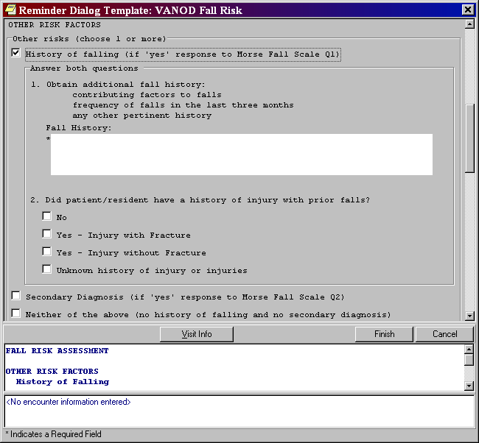

Slide 57
What About?
The 85 yo who says No to a history of recent falls?
The patient who gets admitted because of a fall?
The patient who falls in our care?
Rules? Screening intervals

Slide 58
PROTECTION:
Protect from Injury
Protecting Patients from Harm –
Our Moral Imperative

Slide 59
Moderate to Serious Injury: A, B, C, S
Those that limit function, independence, survival
Age
Bones (fractures)
Bleeds / AntiCoagulation (hemorrhagic injury)
Surgery (post operative)

Slide 60
Fall Prevention and Injury Reduction Matrix
(Assumes Universal Falls Prevention Implemented)
+
RISK
OF
FALL
_
+ RISK FALL/-- RISK INJURY
Implement fall reduction interventions
Assess, intervene and communicate if injury risk changes
+ RISK FALL/+ RISK INJURY
Implement fall reduction interventions
Implement injury prevention interventions
Assess, intervene and communicate if fall risk or injury risk changes
--RISK FALL/--RISK INJURY
Assess, intervene and communicate if fall risk or injury risk changes
--RISK FALL/+RISK OF INJURY
Implement injury prevention interventions
Assess, intervene and communicate if fall risk changes
- RISK OF INJURY FROM A FALL +

Slide 61
Universal Injury Prevention
Educate patients / families / staff
  Remember 60% of falls happen at home, 30% in the community, and 10% as inpatients.
  Take opportunity to teach
Remove sources of potential laceration
  Sharp edges (furniture)
Reduce potential trauma impact
  Use protective barriers (hip protectors, floor mats)
Use multifactorial approach: COMBINE Interventions
Hourly Patient Rounds (comfort, safety, pain)
Examine Environment (safe exit side)

Slide 62
Age: > 85 years old
Education: Teach Back Strategies
Assistive Devices within reach
Hip Protectors
Floor Mats
Height Adjustable Beds (low when resting only, raise up bed for transfer)
Safe Exit Side
Medication Review

Slide 63
Bones
Hip Protectors
Height Adjustable Beds (low when resting only, raise up bed for transfer)
Floor Mats
Evaluation of Osteoporosis

Slide 64
Bleeds/AntiCoagulation
Evaluate Use of Anticoagulation: Risk for DVT/Embolic Stroke or Fall-related Hemorrhage
Patient Education
TBI and Anticoagulation: Helmets
Wheelchair Users: Anti-tippers

Slide 65
Surgical Patients
Pre-op Education:
  Call, Don’t Fall
  Call Lights
Post-op Education
Pain Medication:
  Offer elimination prior to pain medication
Increase Frequency of Rounds

Slide 66
Post Fall and Injury Safety Huddles
Post Fall Analysis
  What was different this time?
  When
  How
  Why
  Prevention: Protective Action Steps to Redesign the Plan of Care

Slide 67
Biomechanics of Fall-Related Injuries
Understanding the
“rate of splat” and its
impact on injury

Slide 68
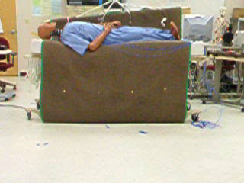
Falls from High Bed: Head First

Slide 69
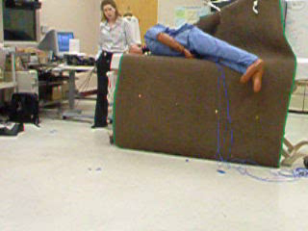
Falls from High Bed: Foot First

Slide 70
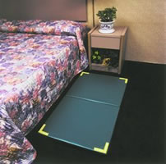
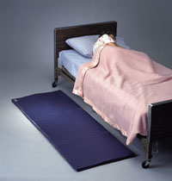

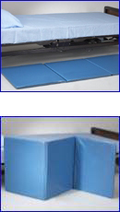
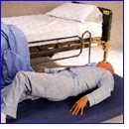
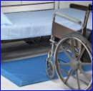
Bedside Mats – Fall Cushions
bedside fall cushion
Floor Mat
Floor Cushion
Roll-on bedside mat
Soft Fall bedside mat
Tri-fold bedside mat

Slide 71
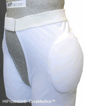
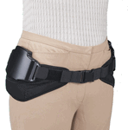
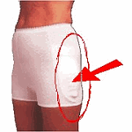
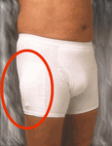
Hip Protectors – Examples

Slide 72

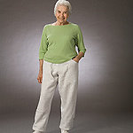
Hip Protectors

Slide 73
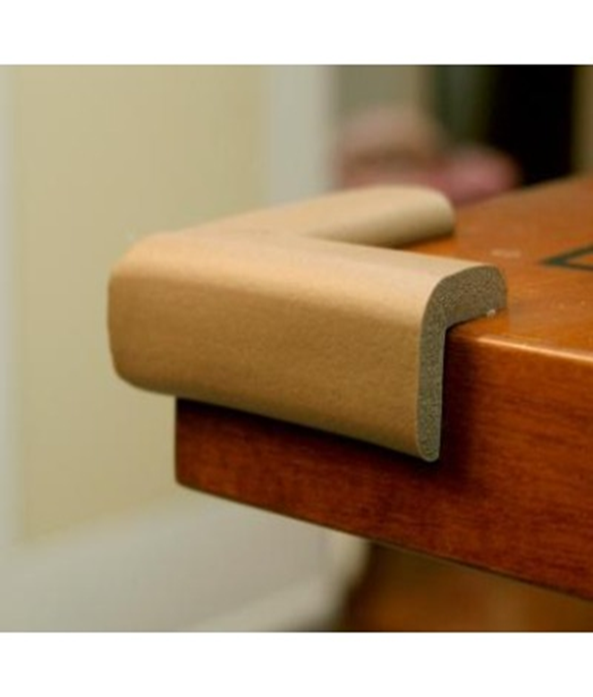
Eliminate Sharp Edges
KidCo
KidSafe
Search:
Furniture
Corner Cushions

Slide 74
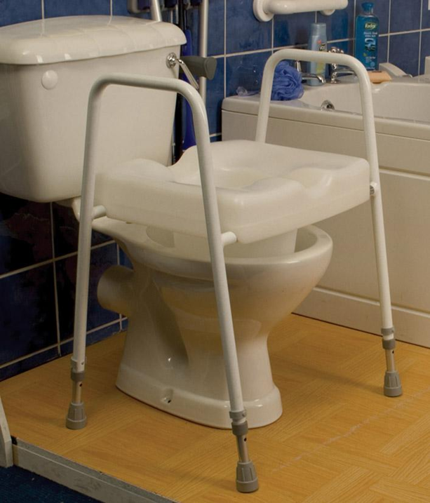
Why Not This?

Slide 75


Helmets

Slide 76
What Have You Tried?
Share your experiences integrating injury prevention into your practices……..
Admission
Care Planning
Environmental Redesign
Selecting a Vulnerable Population

Slide 77
Successful Implementation and Adoption
Plan Implementation
PDSA Cycle
Track results of PDSA Cycle

Slide 78
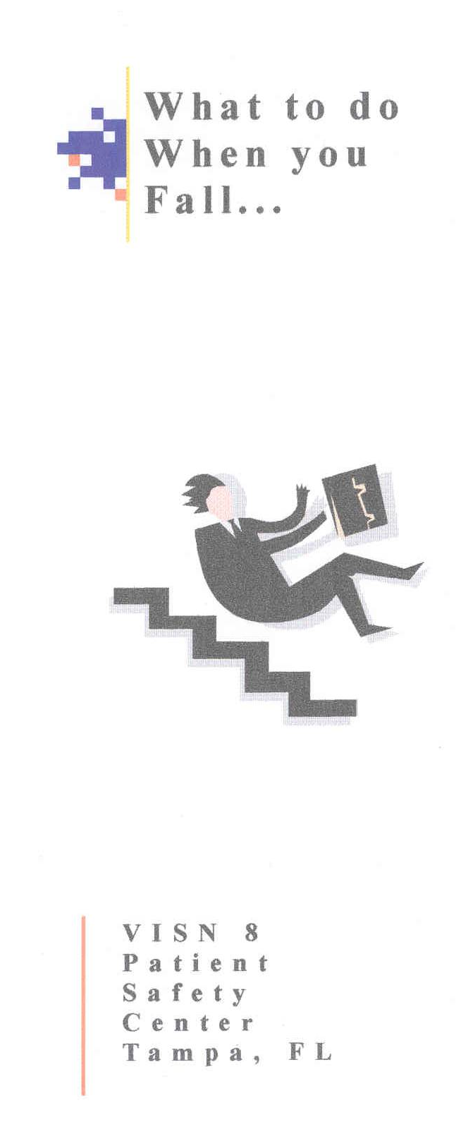

Slide 79
Questions/Comments?

Slide 80
Reducing Barriers to Floor Mats Use: From Science to Implementation to Rescue
Pat Quigley, PhD, MPH, ARNP,
CRRN, FAAN, FAANP
Nurse Consultant
pquigley1@tampabay.rr.com

Slide 81
Objectives
Understand the purpose of floor mats
Restate the evidence of effectiveness to reduce injury
Address Barriers and Facilitators to implement floor mats

Slide 82
Add Injury Technology with Confidence and Commitment
Acknowledging that trauma experienced during a patient’s fall results in harm, organizations have been slow to add injury technology at the point of care, such as floor mats.

Slide 83
Floor Mat Uses
Reduce Standing Fatigue
Prevent accidents (slips, trips and falls) at entrances
Protect Other Surfaces
Reduce Noise and Breakage
Prevent Electric Shock
Types of Mats and Hazards
National Safety Council: Data Sheet 595 Reat. 86. Dec. 2007
http://www.nsc.org/Membership%20Site%20Document%20Library/595-slips,trips,-and-falls-on-floors.pdf
Notes:
Waters, T. R., & Dick, R.B. (2015). Evidence of health risks associated with prolonged standing at work and intervention effectiveness. Rehabiiiitation Nursing, 40(3): 148-165.

Slide 84
Reducing Impact of Beside Falls:
Floor Mats to the Rescue
Floor mats, mats placed on the floor at the bedside (or chair side), is one intervention implemented in many medical centers and long term care settings since 2007.

Slide 85
Myths
Floor mats should always be on the floor
Floor mats create greater risk for falls
One floor mat works for all patients
Notes:
1. Floor Mats should always be on the floor
False.
If the patient is going to stand or transfer with assistance, the floor mat is to be removed and stow away from the bed. The floor mat is only on the floor when the patient is resting in bed.
2. Floor Mats create greater risk for falls
True.
For patients who stand on the floor mat, if the mat is not stowed before standing, may be at greater risk for falls if the patient has decreased balance or loss of lower extremity sensation. It is important to stow the floor mat if you are preparing to assist the patient to stand or transfer. If using floor mats without beveled edges, fall risk may also be associated with tripping on the edge of the floor mats. Thus, organizations should select floor mats with beveled edges and that can be detected at night.
3. One Floor Mat works for all patients
False.
Characteristics of floor mats vary by product and vendor. Patients have differing fall risks associated with intact vs. impaired gait, balance, steppage, proprioception, and somatosensory integration. Thus, one floor mat does not work for all patients. Thus, organizations must have multiple products for clinicians to choose from based on the patient’s characteristics.

Slide 86
Bedside Mats – Fall Cushions
Bedside Fall Cushion
Floor Mat
Floor Cushion
Roll-on bedside mat
Soft Fall bedside mat
Tri-fold bedside mat

Slide 87
Biomechanics of Fall-Related Injuries
Understanding the
“rate of splat” and its
impact on injury

Slide 88
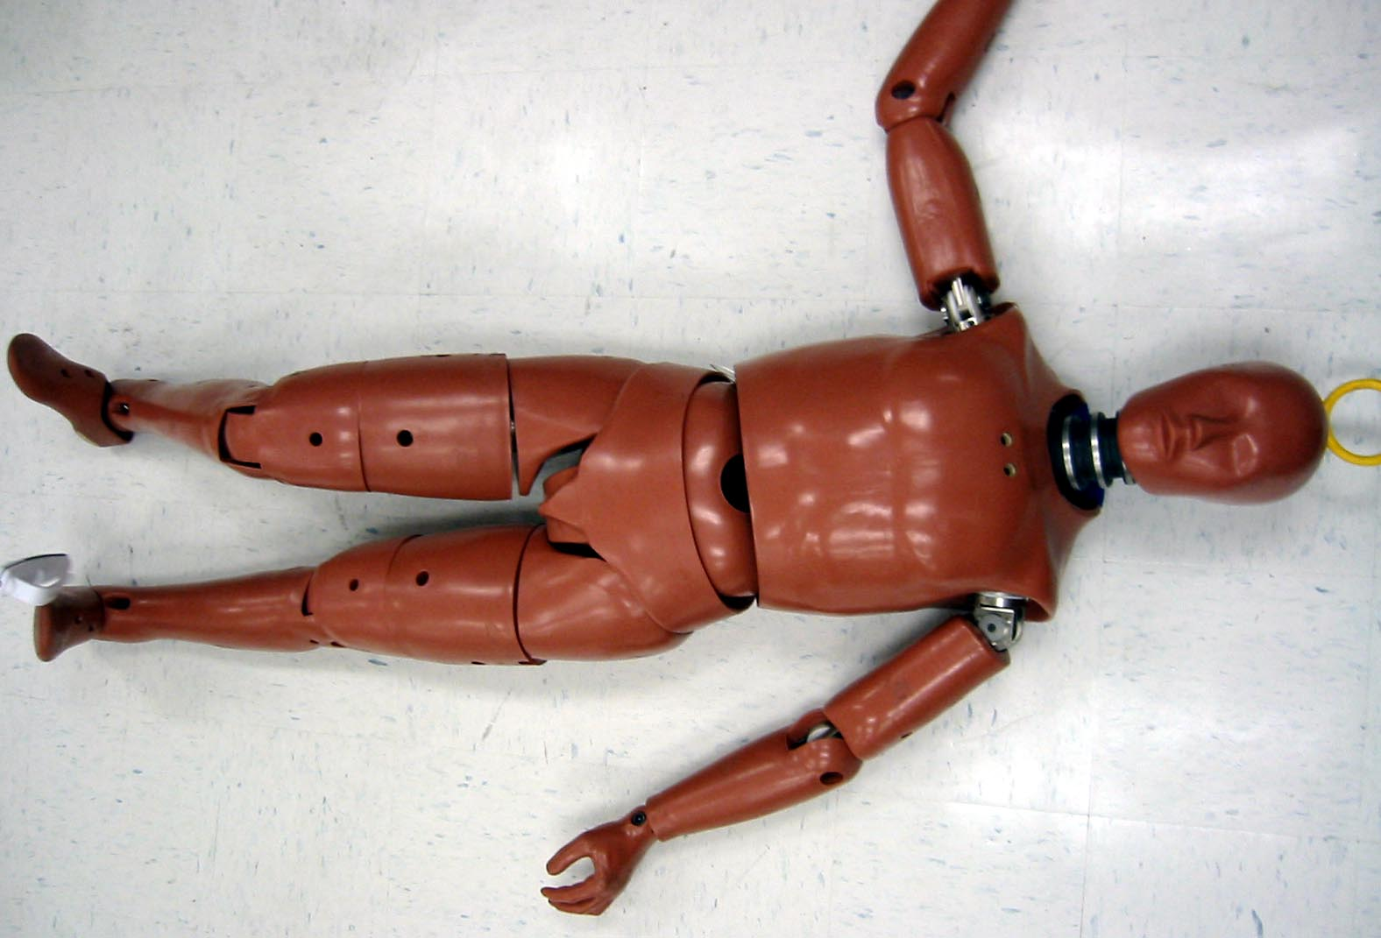
Biomechanics of Falls
Floor surfaces
Effectiveness of Protective Devices
Directional fall impacts
Force of fall likely to cause mild, moderate and severe injury
Installed accelerometers

Slide 89
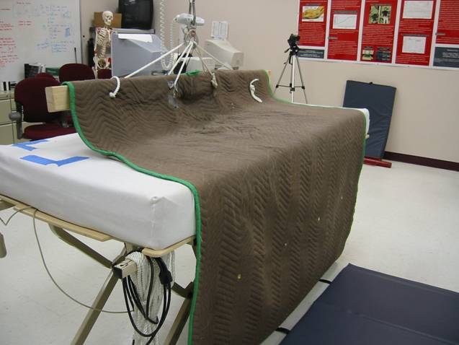
Biomechanics of Bed–related Falls
Six bed heights
Two impact surfaces:
tile, floor mat
Two fall directions:
head first, feet first
(6 x 2 x 6 x 2 = 144 trials)

Slide 90
During the Fall
In some of the trials
The mannequin’s head hit the bare floor at the headboard end of the bed when the bedside floor mat was in place;
occasionally the head hit the floor to the side of the mat; and
the head may also strike furniture near the head of the bed.
Safety Tip: Furniture near the head of the bed should be placed with care or sharp edges padded for persons likely to fall from bed.

Slide 91
Summary of Results
Feet First Fall from Bed
No Floor Mat fall over top of bedrails: ~40% chance of severe head injury
No Floor Mat, low bed (No Bedrails): ~25% chance of severe head injury
Low bed with a Floor Mat: ~ 1% chance of severe head injury

Slide 92
Population-Based Approach to Protect from Injury
Use floor mats to protect vulnerable patient populations from injury.

Slide 93
Reducing Moderate to Serious Injury:
A, B, C, S
Those that limit function, independence, survival
Age
Bones (fractures)
Bleeds / AntiCoagulation (hemorrhagic injury)
Surgery (post operative)
Boushon, B., Nielsen, G., Quigley, P., Rutherford, P., Taylor, J., & Shannon, D. (2008). Transforming Care at the Bedside How-to Guide: Reducing Patient Injuries from Falls. Cambridge, MA: Institute for Healthcare Improvement; 2008. Available at www.IHI.org.

Slide 94
Universal Injury Prevention
Educates patients / families / staff
  Remember 60% of falls happen at home, 30% in the community, and 10% as inpatients.
  Take opportunity to teach
Remove sources of potential laceration
  Sharp edges (furniture)
Reduce potential trauma impact
  Use protective barriers (hip protectors, floor mats)
Use multifactorial approach: COMBINE Interventions
Hourly Patient Rounds (comfort, safety, pain)
Examine Environment (safe exit side)

Slide 95
Age: > 85 years old
Education: Teach Back Strategies
Assistive Devices within reach
Hip Protectors
Floor Mats
Height Adjustable Beds (low when resting only, raise up bed for transfer)
Safe Exit Side
Medication Review

Slide 96
Bones: Fracture Risk / History
Hip Protectors
Height Adjustable Beds (low when resting only, raise up bed for transfer)
Floor Mats
Evaluation of Osteoporosis

Slide 97
Toolkit: Technology Resource Guide: Bedside Floor Mats
Bedside floor mats protect patients from injuries associated with bed-related falls.
Targeted for VA providers, this web-based guidebook will include: searchable inventory, evaluation of selected features, and cost.
www.patientsafety.va.gov/docs/fallstoolkit14/floor_mat_guide_042114v2.docx

Slide 98
Selection Criteria
The criteria used for testing and selecting floor mats are:
Impact Attenuation: the degree in which the mat reduces the impact force during a fall.
Stability: How well a person can stand on the mat without losing their balance
Friction: The mat surface slipperiness
Thickness: The overall thickness of the mat
Weight: The overall weight of the mat
Overall Size: Refers to the mat’s length and width.

Slide 99
Appropriate Use
Floor mats are used for patients who you worry will get out of bed without calling for help and are at risk for injury.
The floor mat is to be place at the side of the patient the patient exits the bed from, and only on the floor when the patient is resting in bed
Stow the floor mat safely when patient is standing and ambulating.

Slide 100
Appropriate Use (con’t)
Should the nurse choose to leave the floor mat at the exit side of the patient’s bed when approaching the patient in the bed, the nurse should exercise caution with stepping to decrease trip risk.
The size of the floor mat is an important consideration for use. It is most prudent to use a mat that extends beyond the head of the bed and one that is at least 44 inches wide.
Furniture near the head of the bed should be placed with care and sharp edges should be padded for persons likely to fall from bed.

Slide 101
Tips for Use
Use floor mats with beveled edges to reduce tripping risk.
Correct placement and position
Inspect the floor mat for curled or raised edges, and if present, request replacement.
Adequate lighting or glow-in-the-dark strips
Ease of handling
Storage space

Slide 102
UAMS: Reducing Fall-Related Injuries using Floor Matting, Davis and Hester (2014)
Evaluate effectiveness of implementing floor matting for fall injury protection in the acute care settings at UAMS Medical Center
Implementation Barriers: reluctance to use, cleaning and infection control, application across units

Slide 103
Floor Mats and EMR
Department of Veterans Affairs
VA’s National Nursing Fall and Injury Care Planning Program Inpatients: Acute and Long Term Care
HD Nursing Inpatient Injury Prevention Strategies

Slide 104
We Want You to be Successful with Implementation and Adoption
Plan Implementation
PDSA Cycle
Track results of PDSA Cycle

Slide 105
Plan
Do
Study
Act
Plan
Do
Study
Act
Plan
Do
Study
Act
Plan
Do
Study
Act
Plan
Do
Study
Act
Notes:
Continuous quality improvement with ongoing rapid tests of change.

Slide 106
Reducing Trip Hazard
Thickness and edge characteristics are important to consider when selecting a floor mat, due to the tripping hazard introduced when a mat is placed next to a bed. Thicker mats will produce a higher risk for tripping. Beveled edges reduce tripping risks.
Glow-in-the-dark strips around the mat’s edges increase visibility of the bedside floor mat at night, and also may decrease trip hazard.

Slide 107
National Resources Materials
Posted on the VA National Center for Patient Safety
National Falls Toolkit
https://www.patientsafety.va.gov/docs/fallstoolkit14/floor_mat_guide_042114v2.docx
Listing of Floor Mats

Slide 108
Egg Drop Experiment
https://www.youtube.com/watch?v=cATSmo1QS4g

Slide 109
2011 and Floor Mats
Did you know that in 2011, 7 years ago now, floor mats were recommended in both acute care and critical access hospitals to reduce injurious falls?
(Pearson, K.B., & Coburn, A. F. Evidence-based fall prevention in critical access hospitals. Policy brief #24 Office of Rural Health Policy (PHS Grant No. U27RH01080)

Slide 110
Did this help?

Slide 111
LUNCH (on your own)
~45 minutes

Slide 112
Redesigning Patient Education:
Patient Engagement and Autonomy
Pat Quigley, PhD, MPH, ARNP, CRRN, FAAN, FAANP
Nurse Consultant
Retired Associate Director, VISN 8 Patient Safety Center
Retired Associate Chief for Nursing Service/Research
E-Mail: pquigley1@tampabay.rr.com

Slide 113
Objectives
Consider patient / resident autonomy as primary factor
Redesign patient/resident education to fully engage them as full partners in care
Apply adult principles to two essential patient education strategies (Teach Back, Ask Me 3)
Expand patient education resources

Slide 114
Questions to ponder…....
How do you know your patient education program is effective?
Can you confirm that patients learned what you taught them?
How to implement patient education for those with cognitive impairment?

Slide 115
Empowering Patients and Families Through Learning

Slide 116
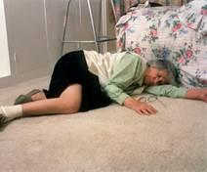
My Focus: Patient Falls
Notes:
The team needs to consider sobering statistics such as these from the Centers for Disease Control and Prevention:
In the next 13 seconds, an older adult will be treated in a hospital emergency department (ED)for injuries related to a fall.
In the next 20 minutes, an older adult will die from injuries caused by a fall.
Falls cause more than half (55%) of traumatic brain injuries among children ages 0 to 14 years.
People ages 85 and older are 10 to 15 times more likely to sustain hip fractures than are those ages 60 to 65.
These statistics reflect the vulnerability of those we care for and must drive changes in practice. They should support changes to your fall and fall-injury programs that are population-specific based on age group, injury risk, and gender. As a start, every organization should answer the following three questions:

Slide 117
Partnership
Patients
  Need support and education to make good choices
  Benefit from easy to use directives
  Need to be accountable
  Need practical examples to put principles into place
Family
  Partners in Care – Advocates, Information Gatherers
  Messengers
  Provide ongoing assessment in the home
  Teach clinicians about their safe practices

Slide 118
Changing Your Conversation with Patients
Do you label Patients / Caregivers: Non-Compliant?
What does Non-Compliant Mean to You?
How do you measure your effectiveness?
How do you evaluate effectiveness of your teaching?

Slide 119
Autonomy
What does this mean to you?
What happens after a fall?

Slide 120
Patient Education is Not One Way Communication
Think Systems Theory
Teaching Individualized Fall Risk Factors
A Simple Example: Blood Thinners – What to do if you fall?

Slide 121
Program Effectiveness AND Implementation Effectiveness
Program
Effectiveness
Implementation Effectiveness
Outcome
+ program, - implementation = inconsistent, unsustainable, or poor outcomes
- program, + implementation = poor outcomes
Notes:
+ = effective
- = ineffective

Slide 122
“Teach Back”
“Teach Back” Testing: what are the trends in patients’ difficulty to understand what is taught ?
  Ask the patient to describe or repeat back in his or her own words what has just been told or taught. Return demonstration is a similar technique used by diabetic educators, physical therapists, and others. When the health professional hears the patient’s description in her/his own words, further teaching can be accomplished to correct misunderstandings. Never ask whether patients understand; they always say “yes”.

Slide 123
“I want to be sure I explained everything clearly.
Can you please explain it back to me so I can be sure I did?”
“I want to make sure I explained this clearly. When you get back home in a few days, what will you tell your [friend or family member] about [key point just discussed]?”
Teach Back Question Card #1
Teach Back Question Card #2
We covered a lot today about preventing falls, and I want to make sure that I explained things clearly. So let’s review what we discussed.
What are three strategies that will help you prevent falls?”
“I want to be sure that I did a good job of teaching you today about risk for falls.
Could you please tell me in your own words what you are doing to prevent falls? How you will prevent falls in the future?
Teach Back Question Card #3
Teach Back Question Card #4
Notes:
123

Slide 124
When “Teach Back” Is Especially Important:
New medications
A new diagnosis
Instructions for calling for help to BR
Instructions for self care
  e.g. ask, “How can you stay safe from falling in the hospital?”
Patients are cautioned on how to prevent falls in the hospital
  e.g. young male patients who suddenly have high doses of pain meds but want to toilet themselves. Ask, “How will you best prevent yourself from falling when you are given this powerful drug for pain that is known to cause falls?”

Slide 125
Ask Me 3
Ask Me 3 materials are available at:
http://www.npsf.org/askme3/

Slide 126
Ask Me 3 – Adapted for Falls
How many patients understand what we teach them?
Teach patients with this format:
  Their main problem putting them at fall risk
  What they need to do to keep from falling in hospital
  Why is it important for them to do this
Check the family‘s understanding:
  What is the patient’s main problem?
  What can the patient to do to stay safe from falling in the hospital?
  Why it is important for the patient to do this?

Slide 127
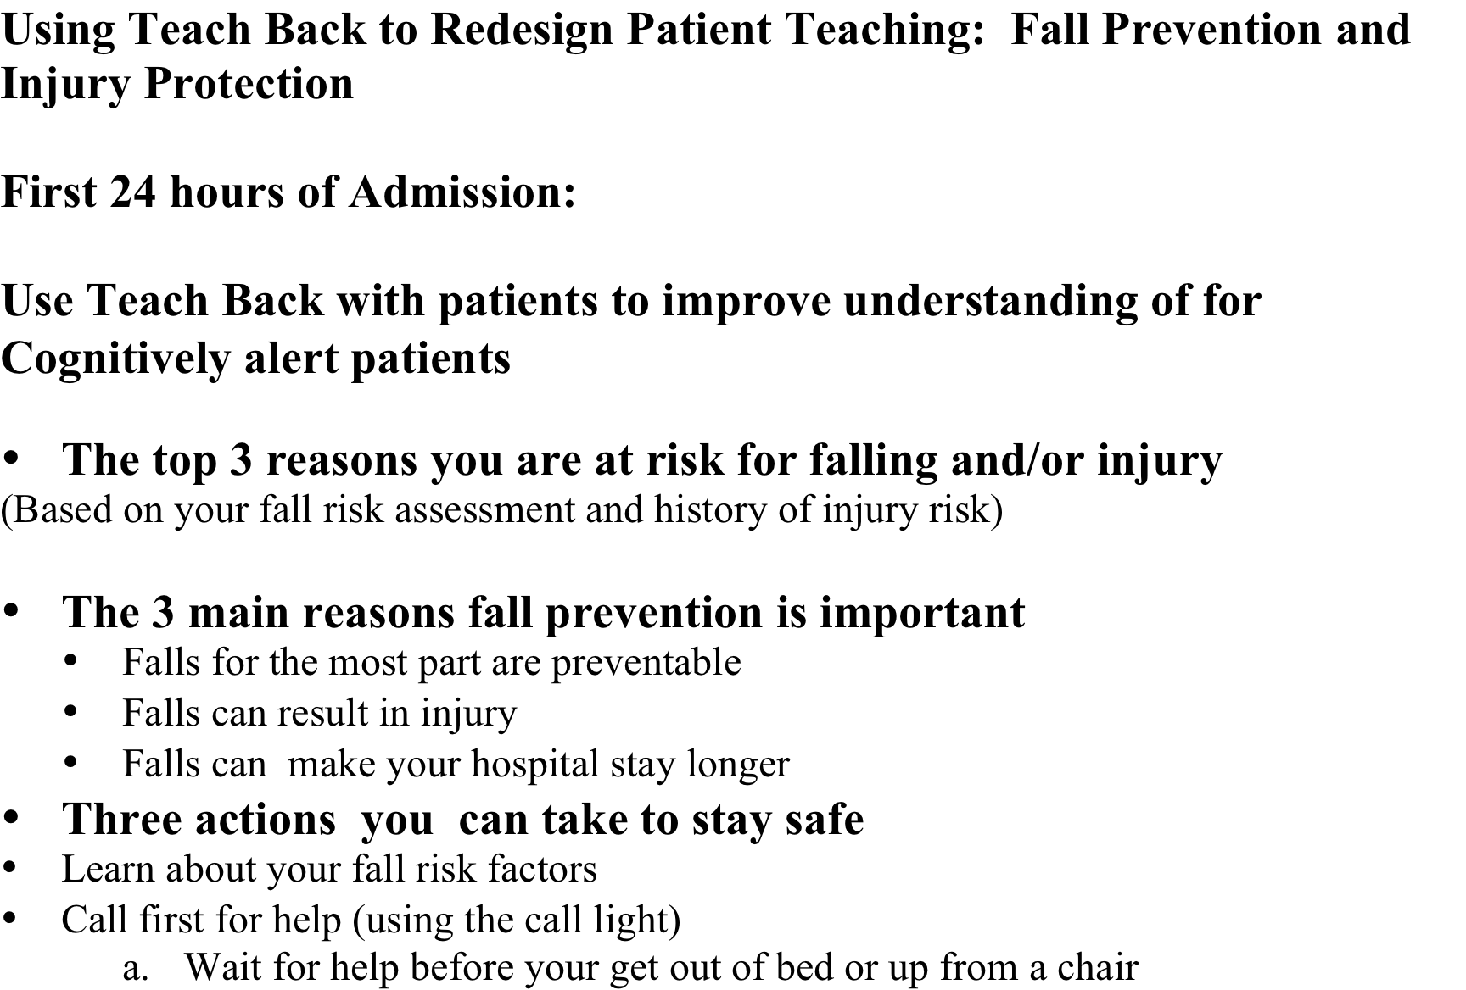

Slide 128
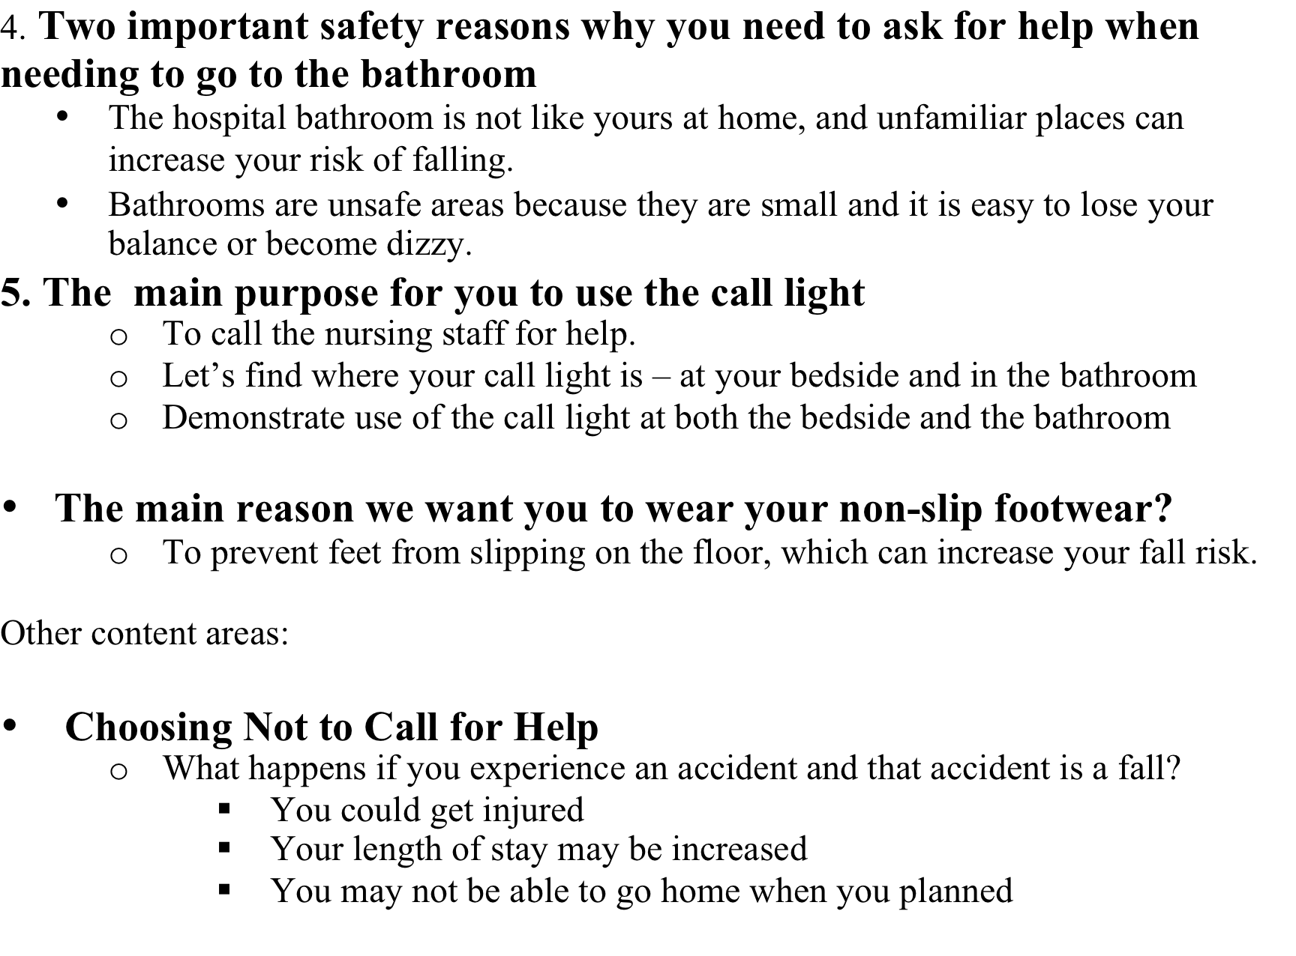

Slide 129
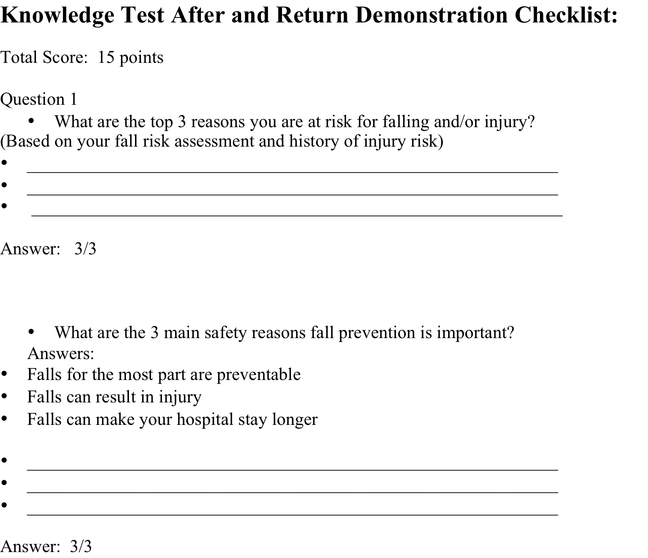

Slide 130
Teaching: After a Fall
Reframe patient education curricula to include "what happens after a fall".
What can we learn from this event?
How can we work together to prevent this again?

Slide 131
Evaluating Your Teaching
A one time test of knowledge - is that enough?
Do you teach a diabetic patient how to manage diabetes one time?
Isn’t fall risk management complex?
Why did we start using “non-compliance?”
I can teach a Stroke Patient how to safely transfer – Why? But how you teach a right brain CVA is different than a left brain CVA
  Right???

Slide 132
Patient Educational Materials
CDC STEADI
  Staying Independent: Are you at risk? (English)
  What you can do to prevent falls (English, Spanish, Chinese)
  Chair Risk Exercise (English, Spanish)
  Postural Hypotension (English, Spanish)
  Check for Safety Brochure (English, Spanish)
VA National Falls Toolkit / VISN 8 PSCI (Patient Safety Center of Inquiry)
  Hip Protectors (video and brochure; pts and caregivers)
  Osteoporosis and Men (video)
  Blood Thinners: What to do if you fall
  What to do when you fall
  Wall of Education Materials
  Group Classes – How to fall and how to get up

Slide 133
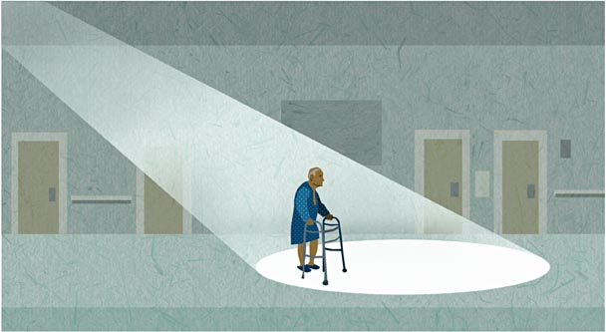



Fall TIPS* Overview
*Tailoring Interventions for Patient Safety

Slide 134
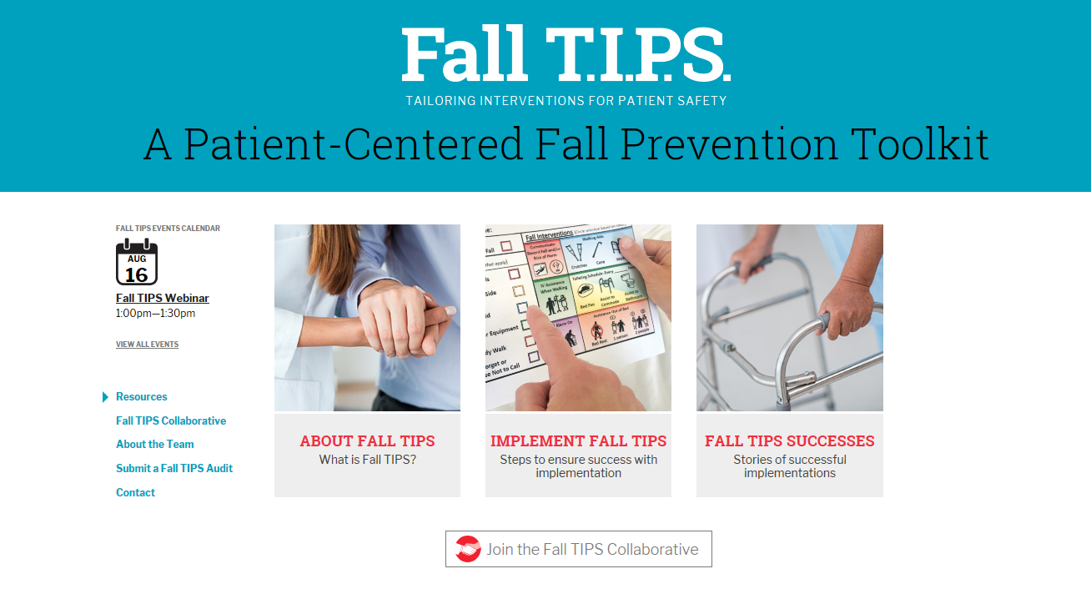
The Fall TIPS Collaborative: A Partnership for Spread
Fall TIPS Toolkit: suite of tools available to promote adoption and use by diverse hospitals
  Based on over a decade of research and practice
  Supports efficient implementation
  Foundation for an effective and sustainable fall prevention program
The Fall TIPS toolkit used in more than 125 hospitals in the United States, Canada, China, and Taiwan
Visit the Fall TIPS Website: www.FallTIPS.org

Slide 135
Fall TIPS (Tailoring Interventions for Patient Safety)
Two year mixed methods study funded by Robert Wood Johnson Foundation:
  Qualitative phase:
    why hospitalized patients fall?
    what interventions are effective and feasible in hospital settings?
  Randomized control trial: to test a fall prevention toolkit designed to address issues identified during qualitative phase.
Supported by the Robert Wood Johnson Foundation, Dykes PI

Slide 136
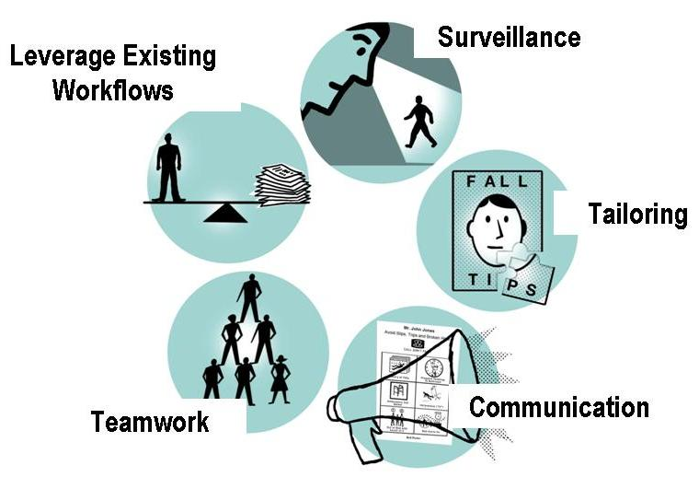
The Fall TIPS Toolkit Requirements

Slide 137
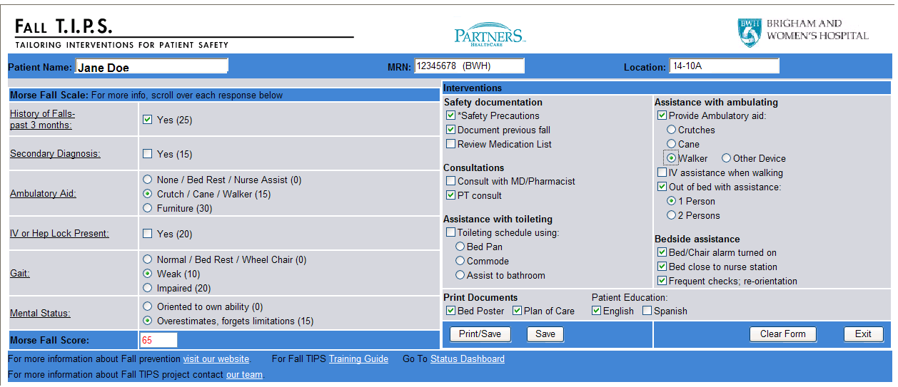
The Fall TIPS Toolkit:
Fall Risk Assessment/Tailored Plan
Fall risk assessment
Tailored plan
Notes:
137

Slide 138
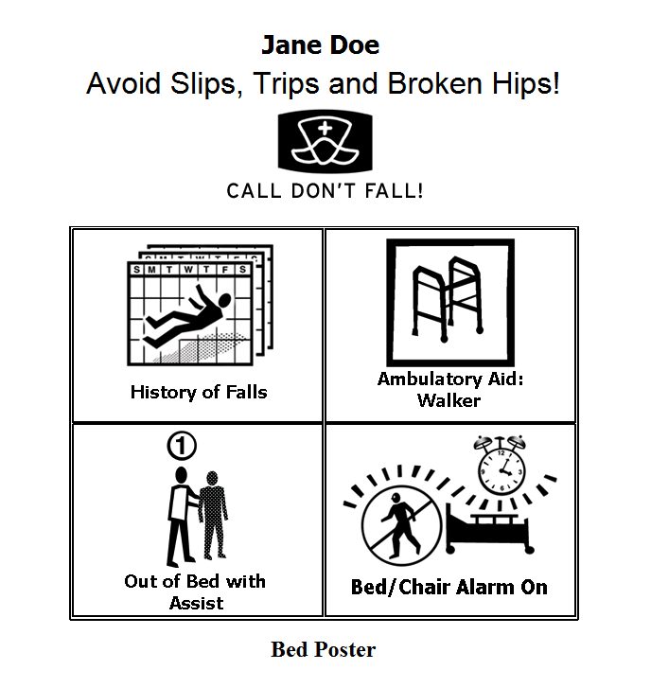
Notes:
138

Slide 139
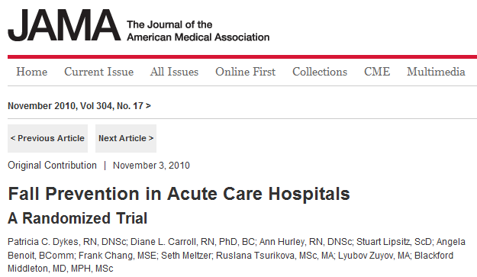

Findings:
  Patient falls were significantly reduced on intervention units.
There were fewer falls in intervention units than in control units
Patients aged 65 or older benefited most from the Fall TIPS toolkit
No significant effect was noted in fall related injuries

Slide 140
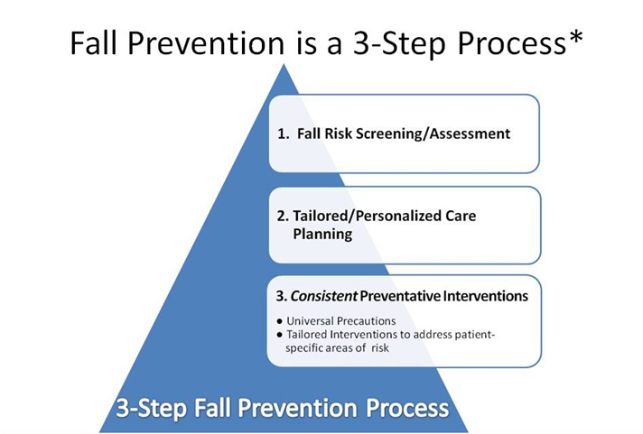
Fall Prevention Lessons Learned
Strategies and tools to facilitate the 3-step fall prevention process will prevent patients from falling!

Slide 141
Fall Prevention Lessons Learned
Fall TIPS reduced falls by 25% but >90% of falls are preventable…what happened?
  Why did some patients with access to the Fall TIPS Toolkit fall?
    What factors are associated with falls in younger patients?
    What factors are associated with falls in older patients?
  Secondary analysis of fallers (cases) n=48 and 144 matched controls exposed to the Fall TIPS toolkit*
  Found that in all cases, planned interventions were not followed consistently by the patient (most frequently) or the nurse
    i.e., Out of bed with assistance
How do we get patients to CONSISTENTLY follow their fall prevention plan?
Dykes PC, I-Ching EH, Soukup JR, Chang F, Lipsitz S. A case control study to improve accuracy of an electronic fall prevention toolkit. AMIA Annu Symp Proc. 2012; 2012:170-9.

Slide 142
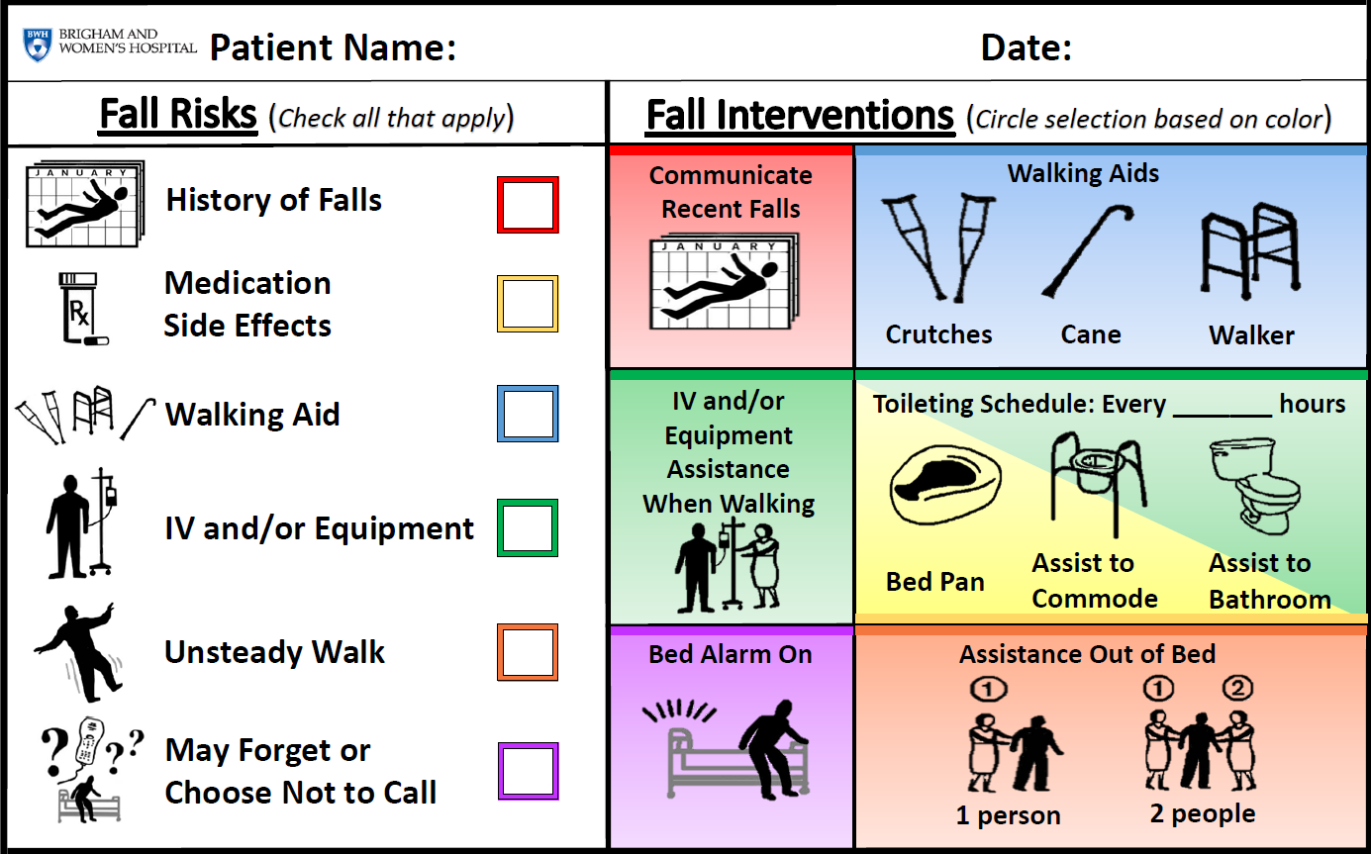
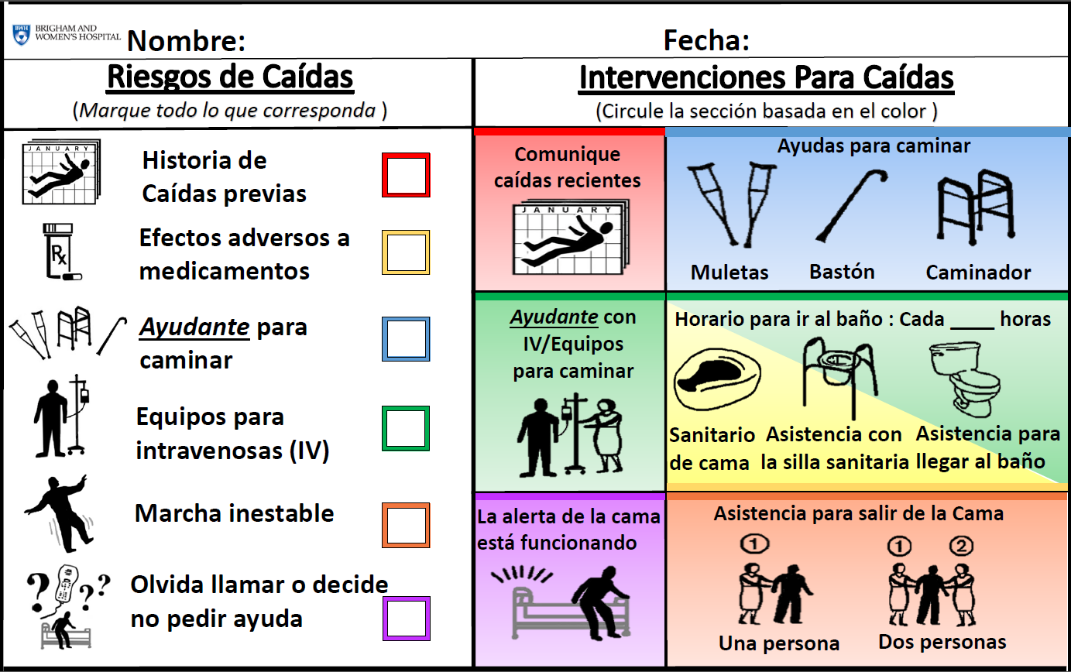
Paper Fall TIPS
Fall risk assessment
Tailored plan based on patient’s determinants of risk

Slide 143
Fall TIPS Pilot Test Results: BWH
Fall TIPS Adherence: 82%
Pre-Fall TIPS Fall Rate: 3.28
Post Fall TIPS Fall Rate: 2.80
Pre-Fall TIPS Injury Rate: 1.00
Post Fall TIPS Injury Rate: .54
In Press: Joint Commission Journal of Quality and Safety

Slide 144
Fall TIPS Pilot Test Results: MMC
Fall TIPS Adherence: 91%
Pre-Fall TIPS Fall Rate: 3.04
Post Fall TIPS Fall Rate: 3.10
Pre-Fall TIPS Injury Rate: .47
Post Fall TIPS Injury Rate: .31
In Press: Joint Commission Journal of Quality and Safety

Slide 145
Rationale for Patient Engagement in 3-Step Fall Prevention Process
Facilitates patient understanding of personal fall risk status and the plan to prevent a fall.
Promotes patient understanding of their role in fall prevention.
Facilitates patient (and family) partnership in ensuring that the plan is carried out consistently.
A common reason why patients fall is that planned interventions are not followed consistently by the patient (most frequently) or the team*
*Dykes PC, I-Ching EH, Soukup JR, Chang F, Lipsitz S. A case control study to improve accuracy of an electronic fall prevention toolkit. AMIA Annu Symp Proc. 2012; 2012:170-9.

Slide 146
The Fall TIPS Toolkit: A Suite of Tools to Promote Adoption and Spread of Evidence-based Fall Prevention Best Practices
General Resources
Fall TIPS Website (falltips.org)
Fall TIPS Implementation Protocol
Fall TIPS Rollout Guide
Laminated Paper Fall TIPS Template (English)
Laminated Paper Fall TIPS Template (Spanish)
Leadership Resources
Fall TIPS Leadership Talking Points
Fall TIPS Gap Analysis Form
Fall TIPS SWOT Analysis Form
Fall TIPS Implementation Checklist
Fall TIPS Patient Engagement Monthly Report Template
Training Resources
Fall TIPS Training Slides
Fall TIPS Super User Training Slides
Fall TIPS Instruction Sheet for Nurses
Fall TIPS Instruction Sheet for Nursing Assistants
Fall TIPS Information Sheet for Patients
Fall TIPS Quality Audit and Audit Instructions

Slide 147
AHRQ: Health Literacy Strategies in new Primary Care Guide to Patient and Family Engagement
The strategies are:
Teach Back
Be Prepared to Be Engaged
Medication Management
Warm Handoff
https://www.ahrq.gov/professionals/quality-patient-safety/patient-family-engagement/pfeprimarycare/index.html

Slide 148
Teach Back Resources
Materials include: a quick start guide and resources for
Patients and families (poster, flyer, handout),
Clinicians (job aid and self-assessment), and
Practice staff (handout and assessing use in practice).

Slide 149
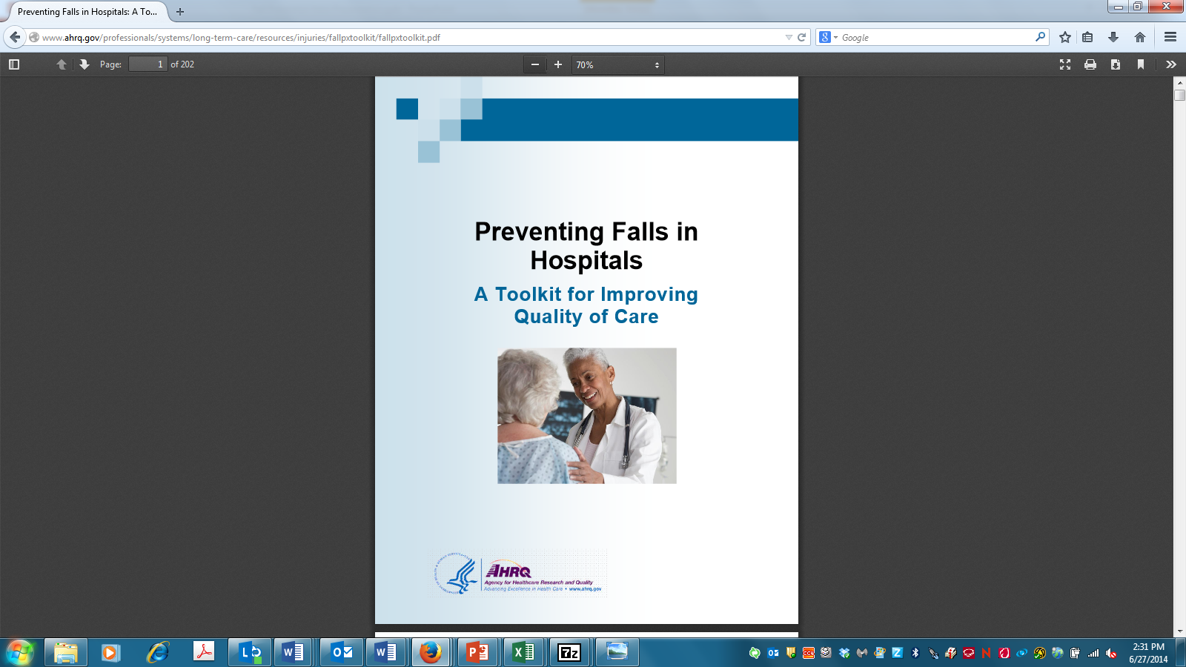
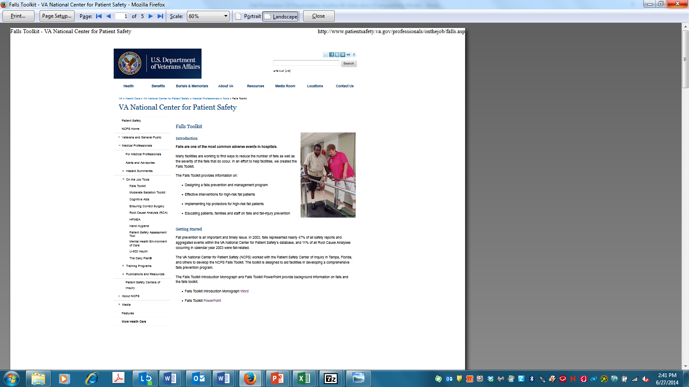
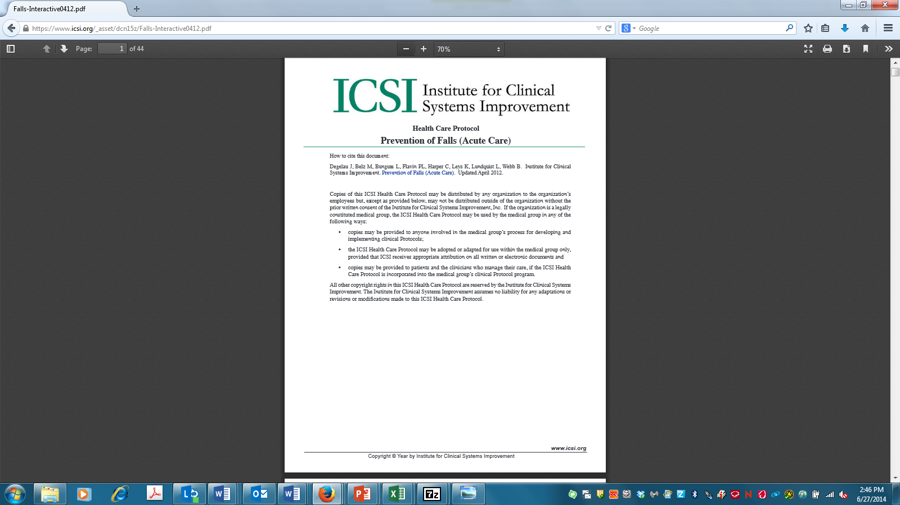
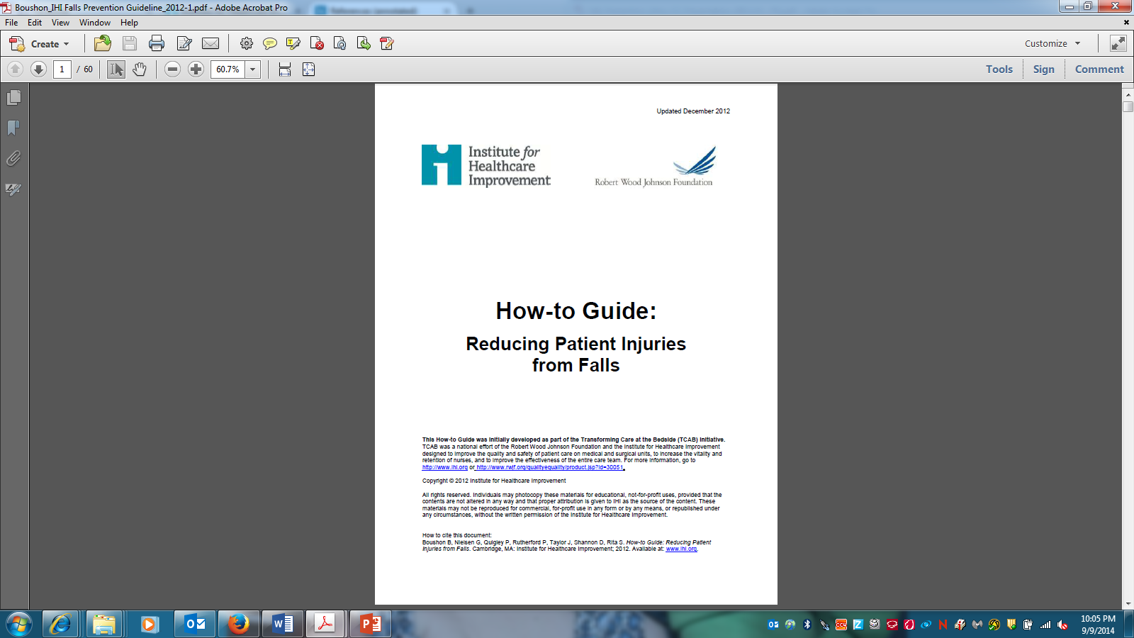
Other Toolkits and Best Practice Recommendations for Fall Prevention
IHI Reducing Patient Injuries from Falls How-to Guide
AHRQ Falls Prevention Toolkit
ICSI Prevention of Falls Protocol
VA NCPS Falls Toolkit
Ganz DA, et al. Agency for Healthcare Research and Quality. 2013.
VA National Center for Patient Safety (NCPS). 2014.
Degelau J, et al. Institute for Clinical Systems Improvement (ICSI). 2012.
Boushon B, et al. Institute for Healthcare Improvement. 2008.
Notes:
AHRQ: Ganz DA, Huang C, Saliba D, et al. Preventing falls in hospitals: a toolkit for improving quality of care. (Prepared by RAND Corporation, Boston University School of Public Health, and ECRI Institute under Contract No. HHSA290201000017I TO #1.) Rockville, MD: Agency for Healthcare Research and Quality; January 2013. AHRQ Publication No. 13-0015-EF.
Chapter 1:
1.1 Assess the culture of safety in your hospital
1.2 Evaluate current organizational attention to falls Tool 1B, Stakeholder Analysis Implementation Team leader
1.3 Assess and develop leadership support for the fall prevention program Tool 1C, Leadership Support Assessment
Tool 1D, Business Case Form Implementation Team leader
1.5 Identify resources that are available and resources that are needed Tool 1E, Resource Needs Assessment Implementation Team
VA Toolkit: Department of Veterans Affairs, National Center for Patient Safety. Falls Toolkit. Washington, DC: Department of Veterans Affairs; 2014. http://www.
patientsafety.va.gov/professionals/onthejob/falls.asp. Updated June 2014. Accessed July 13, 2015.
ICSI Toolkit: Degelau J, Belz M, Bungum L, et al.; Institute for Clinical Systems Improvement (ICSI). Prevention of falls (acute care). Health care protocol.
3rd ed. Bloomington, MN: ICSI; 2012. icsi.org/_asset/dcn15z/Falls-Interactive 0412.pdf
Chapter 1: Obtain Organizational Support for a Falls Prevention Program
IHI: Boushon B, Nielsen G, Quigley P, et al. Transforming Care at the Bedside How-to Guide: Reducing Patient Injuries from Falls. Cambridge,
MA: Institute for Healthcare Improvement. http://www.ihi.org/resources/Pages/Tools/TCABHowToGuideReducingPatientInjuriesfromFalls.
aspx. Published 2012. Accessed July 13, 2015.
Section 2: The team needs encouragement and commitment from senior leadership; an administrative representative on the team is powerful in keeping the team focused and removing barriers.

Slide 150
Evaluation of Learning
Design patient education program evaluation as a knowledge and skills checklist for cognitive and psychomotor domains of learning.
Include Health Literacy Assessment to check ability to comprehend and use health information

Slide 151
To Change Practice is Not for the Faint of Heart!
But… You can change your teaching!

Slide 152
Experiences Redesigning Post Fall Management: Getting to Types of Falls, Repeat Falls, and Determining Preventability
Pat Quigley,PhD,MPH,ARNP,CRRN,FAAN,FAANP
Nurse Consultant
Retired Associate Director, VISN 8 Patient Safety Center
Retired Associate Chief for Nursing Service/Research
E-Mail: pquigley1@tampabay.rr.com

Slide 153
Objectives
Understand post fall practices as key intervention to reduce repeat falls
Apply Implementation Science to Post Fall Huddle
Address Fidelity and Reliability of Post Fall Huddles

Slide 154
Post Fall Practices
Post Fall Huddle
Post Fall Assessment
Patient/Resident/Family Education
Staff Education

Slide 155
Let’s Refresh: Safety Huddles
Pre-Shift Huddles
Post Fall Huddles
Conducted with the patient/resident where the fall occurred within 15 minutes of the fall
Post Fall Analysis
  What was different this time?
  When
  How
  Why
  Prevention: Protective Action Steps to Redesign the Plan of Care

Slide 156
Post Fall Huddle (PFH): Essential Components
A brief staff gathering, interdisciplinary when possible, that immediately follows a fall event.
Convenes within 15 minutes of the fall event
Clinician(s) responsible for patient/resident during fall event leads the PFH
Involves the patient/resident whenever possible in the environment where the patient/resident fell
Requires Group Think to discovery what happened.
Utilizes discovery to determine the root cause / immediate cause of the fall: why the patient/resident fell.
Guiding question to ask: What was different this time you were doing this activity, compared to all the other times you performed the same activity (and did not fall), but this time you fell?

Slide 158
Let’s Share!
What are your experiences redesigning your post fall management?
How did you go forward?
How is your post fall program working?
How did you measure success?
What questions do you have?

Slide 159
Program Effectiveness AND Implementation Effectiveness
Program
Effectiveness
Implementation Effectiveness
Outcome
+ program, - implementation = inconsistent, unsustainable, or poor outcomes
- program, + implementation = poor outcomes
Notes:
+ = effective
- = ineffective

Slide 160
Implementation Matters
Identifying and adopting what works is not enough to achieve successful outcomes
Evidence-based programs and practices still have to be delivered with fidelity / integrity in diverse and complex real-world settings
One of the strongest messages coming from the research is fidelity—the quality with which the treatment is delivered – in crucial to successful outcomes (Lipsey et al. 2010)
Notes:
Lipsey, M. W., Howell, J. C., Kelly, M. R., Chapman, G., & Carver, D. (2010). Improving the effectiveness of juvenile justice programs: A new perspective on evidence-based practice. Washington, DC: Georgetown University, Center for Juvenile Justice Reform.

Slide 161
High Quality Implementation is Difficult to Achieve
What appears simple and straight forward in the implementation process often turns out to be more complex than anticipated
During implementation, we often underestimate the number of steps involved, the number of separate decisions that have to be made, or the number of participants whose preferences have to be taken into account
Because of the complexity involved, implementation, even under the best of circumstances, is exceedingly difficult

Slide 162
Performance Improvement Model Incorporating Donabedian’s Quality Framework
Plan
Do
Study
Act
Structure
Outcome
Process
Notes:
The standard PDSA model here also incorporates Donabedian’s Quality Framework.
The quality improvement framework is different from strategic planning. The goal is to move from issue to impact. With your quality improvement efforts how are you bringing the interprofessional team members and how are they bringing patient’s and families?
How do you use data to identify the issues?
How do you use data to identify actions that need to be evaluated?
How do you use data to pull it all together?
Before we have you answer those questions in your roundtables and discussion we’d like to review our basic PI model.
The initial step in any improvement effort is understanding and first knowing - what is the issue?

Slide 163
Plan
Plan
Do
Study
Act
Structure
Outcome
Process
Notes:
Plan:
What impacts the issue?
What is the contributing variable to the issue?
What do you need to change?
What structural, process or outcome measure are contributing to the issue or need to be improved?
What’s the evidence?

Slide 164
Do
Plan
Do
Study
Act
Structure
Outcome
Process
Notes:
Do:
Implement your plan
Do a small test of change

Slide 165
Study
Plan
Do
Study
Act
Structure
Outcome
Process
Notes:
Study:
Initial test of change & debrief
Evaluate your outcomes.
Have you made an impact?
What needs to change?
Are you still measuring the right things?
Are you measuring the change?

Slide 166
Act
Plan
Do
Study
Act
Structure
Outcome
Process
Notes:
Act:
Implement additional changes based on your evaluation.
Continue to do rapid test of changes and repeat the PDSA cycle

Slide 167
Plan
Do
Study
Act
Plan
Do
Study
Act
Plan
Do
Study
Act
Plan
Do
Study
Act
Plan
Do
Study
Act
Notes:
Continuous quality improvement with ongoing rapid tests of change.

Slide 168
Did You Audit Steps to the Post Fall Huddle for Reliability?
1. TL makes announcement
2. Convene within 15 mins with the patient/resident in the environment where the patient/resident fell
3. Conduct Analysis: Determine root cause of fall, injury and Type of Fall
4. TL summarizes information gleaned from PFH and intervention(s) for prevention of repeat fall are decided by the huddle team.
5. TL completes of the Post-Fall Huddle Form and processes the form according to medical center policy and procedure.
6. Modifies the fall prevention plan of care to include interventions to prevent repeat fall
7. Communicate updated plan of care in patient/resident hand-off reports.
8. Complete EMR Post Fall Note

Slide 169
Determine Preventability
Step 1: Conduct the Post Fall Huddle.
Step 2: Determine the Immediate Cause of the Fall.
Step 3: Determine the Type of Fall.
Step 4. If Accidental and Anticipated Physiological Falls, determine Preventability:
Could the care provider (direct care provider) have anticipated this event with the information available at the time?
  If the Answer is NO, the fall is Not preventable.
  If the answer is YES, the provider must ask another question: Were appropriate precautions taken to prevent this event?
    No, Clearly or likely Preventable;
    Yes, Clearly or likely Unpreventable
Levinson, D. R., (2010, Nov). Adverse events in hospitals: National incidence among Medicare beneficiaries. DHHS. OEI-06-09-00090

Slide 170
Implementation Science and
Strategies
Empirically-based insights and tools that can be used to support high-quality implementation in diverse and complex real world settings
Unit-based Champions
Prepare to monitor fidelity and reliability

Slide 171
Outcomes of Post Fall Huddles
Specify Root Cause (proximal cause)
Specify Root Cause of Injury
Specify Type of Fall
Identify actions to prevent reoccurrence
Changed Planned of Care
Patient/Resident (family) involved in learning about the fall occurrence
Prevent Repeat Falls, Fall Rate and Fallers
Reduce Repeat Fallers

Slide 172
Formative Measures
Structures:
  Who attends: Nursing and others – Count them
  Changed Plan of Care: Add actions to your run-chart: Annotated run chart; Capture interventions
Processes:
  Timeliness of Post Fall Huddle (number of minutes)
  Timeliness of changing plan of care
  Time to implemented changed plan of care

Slide 173
Summative Outcome
Prevent Repeat Fall: Same Root Cause and Same Type of Fall
Reduce costs associated with falls and fall related injuries

Slide 174
Post Fall Assessment
Different than a Huddle!

Slide 175
Post Fall Assessment
In-depth Data Gathering
Circumstances of the Fall
Patient/Resident Presentation
Assessment of Patient/Resident Condition

Slide 176
Comprehensive Post-Fall Assessment
Includes:
General information about the fall
Subjective & objective falls documentation
Patient/Resident Assessment – vital signs; visible signs of injury (type & pain scores); glucometer (if diabetic or facility policy); Glasgow Scale (if suspected brain injury) and Morse Falls scale
Interventions based on Fall Risk Scale/ Morse falls scale
Facility personnel and family notification

Slide 177
Teaching: After a Fall
Reframe patient/resident education curricula to include "what happens after a fall".
What can we learn from this event?
How can we work together to prevent this again?

Slide 178
Staff Education
Universal Fall Prevention
Individualized Fall Prevention
Injury Reduction Strategies
Root Cause Trends of Falls
Interventions for Improvement
Impact of Changes in Practices

Slide 179
What is your Story Board
On your units, what charts are posted in public and / or nursing break rooms?

Slide 180
You Can Always Reach Me!
Patricia Quigley, PhD, MPH, ARNP, CRRN, FAAN, FAANP, Nurse Consultant
pquigley1@tampabay.rr.com

Slide 181
Break ~15 minutes

Slide 182
Hospital Presentations: Lessons Learned and Progress Made

Slide 183

ASLMC Fall Prevention
Alyson Leon MSN,RN, AGCNS-BC
Rachel Loberg MSN, RN, APNP, FNP, NE-BC

Slide 184
Identifying Need
System Practice Excellence Committee (SPEC)
  Created to demonstrate sustained improvement in patient outcomes related to nursing practice
  Outcomes reflected in the Aurora Nursing Impact Score with quarterly metrics for four NDNQI nurse sensitive indicators
  Current interventions evaluated
  Opportunities identified
  Align our effort to reduce falls on our journey to high reliability with a goal of zero harm

Slide 185
Gap Analysis
System wide gap analysis conducted
Gathering 40 points of data
Served as baseline
Guided direction in identifying appropriate intervention

Slide 186
Hospital Consultation Visit
Focused attention & resources of fall prevention efforts
Increased committee meeting frequency
Goal to diversify committee members
Risk factor focus vs. Fall risk focus
  Identify and treat
“Aha” moments: one safe bed exit side for unilateral weakness

Slide 187
Action items
EBQI Fall Prevention Mini-Series
Comprehensive Mobility Evaluation Tool (CMET) with early & progressive mobilization

Slide 188
EBQI Mini Series
Falls: system wide initiative supported by System Practice Excellence Committee (SPEC)
Clinical nurses from each site attended 3, 4 hour sessions to learn about Evidence Based Quality Improvement.
Day 1: Introduction/literature review/PICOT/IOWA model
Day 2: Patient Panel/Data Collection
Day 3: Presentation of data and action plan for each site/Integrate and Sustain

Slide 189
ASLMC EBQI Mini Series Team
Jon Iserloth, clinical nurse 10T, NCC Chairperson
Liz Dye, clinical nurse 12S, ACC Chair
Keafah Mahmoud, clinical nurse 4EF, Fall Committee member
Rachel Loberg, Nursing Director ASLMC
Alyson Leon, Clinical Nurse Specialist 4KLM ASLMC /Falls Champion Facilitator
Mari St. Clair, Clinical Nurse Specialist ASLMC
Mark McIlquaham, Nursing Quality Coordinator Senior
Mary Hook, Research Scientist

Slide 190
PICOT Statement
Patient population: Aurora St. Luke’s Medical Center w/ focus on all inpatient units.
Intervention:
Team member education
Led by unit base Fall Champions
Review EHR data that will enhance fall risk assessment, individualized interventions and documentation
Content and intent of FYWB written materials
Real time coaching when findings fall short of expectations
Identify team members role (e.g. Department leadership, Fall Champions, RN, NA, EVS, etc.)
Comparison group: Q1 2018 Data
Outcomes:
Each Department (Fall Champion) will audit 10 patients per month
Determine patients understanding of their fall risk and plan of care. Patients who do have cognitive and language barriers to learning will be excluded.
Presence of posted FYWB
Individualized plan of care documented in EHR.
Timeline: During the next 3 months with monitored maintenance over next 6 months.

Slide 191
Plan/Proposed Practice Change
Team member education
Led by unit base Fall Champions in collaboration EBQI team
Content and intent of FYWB written materials
Real time coaching when findings fall short of expectations
Identify team members role (e.g. Department leadership, Fall Champions, RN, NA, EVS, etc.)
Evaluate
# of falls
# of falls with injury
# of patients able to identify their fall risk and plan of care
# of patients with FYWB posted

Slide 192
Timeline
SPEC
Restructuring
Falls Gap Analysis
Hospital Consultation
Gained insights
EBQI Mini-Series
Staff nurse led
Activation of patients

Slide 193
CMET with Early
& Progressive Mobilization
Evaluate patients for clinical stability, ability to move, sit, transfer, and walk and determine assistance and equipment needs
Highlighting and educating patients on benefits of early and progressive mobilization

Slide 194
Contact information
Alyson.Leon@aurora.org – Alyson Leon MSN, RN, AGCNS-BC
Rachel.Loberg@aurora.org – Rachel Loberg MSN, RN, APNP, FNP, NE-BC

Slide 195


Slide 196


ThedaCare Fall Prevention
Amy LeRoy, MSN, RN, NEA-BC
Nurse Practice Specialist
Ann Hanson, MSN, RN
Education Specialist

Slide 197
Fall and Injury Prevention Committee
Re-established in the fall of 2017
Recommendations from EBP and professional organizations were reviewed
Gap analysis performed
Opportunities for improvement and specific barriers identified

Slide 198
Leadership Support
Senior and Executive Leaders identified opportunity to improve fall prevention and pulled a committee together to review policy and practice
  Committee has membership from across the continuum of care: 7 hospitals, skilled nursing facilities, and home care
  Working committee for data analysis and determine next steps in PDSA.
Weekly falls leadership meeting (identify/discuss barriers to progression, action item follow up, agenda planning)
  Committee sponsor (DON), Nurse Practice Specialist, Education Specialist, Risk Manager, and Quality Coordinator

Slide 199
Changes to Practice
Updated system policy – included guide to alternative interventions
Education
Environmental changes
Floor mats and Hip protectors
Monthly rounds
Monthly newsletter
Fall and Injury Risk Assessment
Documentation to support new policy
Post Fall Huddle
Sitter Algorithm and Policy
Notes:
Education to nursing staff, providers, pharmacists, ancillary services, and operational leaders
Gave nurses permission to make environmental changes to fit the needs of the patient (moving furniture; taking unnecessary/unused equipment out of the room – IV pole, etc; putting in Just Do It work ticket requests to have sharp objects or other environmental safety risks removed from walls)
Brought increased awareness to floor mats and hip protectors
Monthly rounds by the Nurse Practice Specialist and Education Specialist dyad to observe fall and injury prevention practice, understand their barriers to doing the right thing and provide feedback/education to individual practices.
Monthly newsletter – includes YTD data, our outcome metric, process metrics, trends/opportunities identified in falls for the year and/or previous month, and education on fall and/or injury prevention measures. This gets sent to all DONs, managers, hospitalists, and fall committee members to disseminate to their teams.
Ongoing work to improve assessment for risks and targeted interventions; Epic to support this
Initiated post fall huddle process. Auditing the process, providing feedback to the managers/huddle team members to increase knowledge of root cause analysis for fall and injury.
Fall prevention measures increased sitter utilization in some areas. Developed a sitter policy and algorithm to guide staff in appropriate usage of a sitter

Slide 200
Barriers/Challenges
Critical thinking/clinical judgment vs task oriented thinking
  Risk/injury Screen score
  Frequency of completing risk/injury screening
  RCA
Individualized care planning
  Universal precautions
  One size fits all for high risk patients
Post Fall Huddle Form
  Outlook email created FallsCommittee@thedacare.org
  Case study to teach through the process
Notes:
Nurse Practice Specialist and Education Specialist rounds include connecting with front line clinicians and the unit leaders to increase knowledge and abilities in developing individualized care plans to target identified risks
Providing real time feedback in the work, where the clinicians are at

Slide 201
Standardization
System Policy
Accountability
Outlook email for consistent feedback
NPS/ES rounding across system reinforces implementation
EBP research
Pat Quigley visit
Notes:
To standardize practices across 7 hospitals and 2 skilled nursing facilities we developed 1 system policy for all to follow.
Falls committee leaders hold the managers accountable when a fall occurred on their unit by following up on the post fall huddle form, providing feedback in root cause analysis and targeting interventions to mitigate risks.

Slide 202
UW Health Fall Prevention Program
Anne Leclaire MSN, RN, CRRN

Slide 203
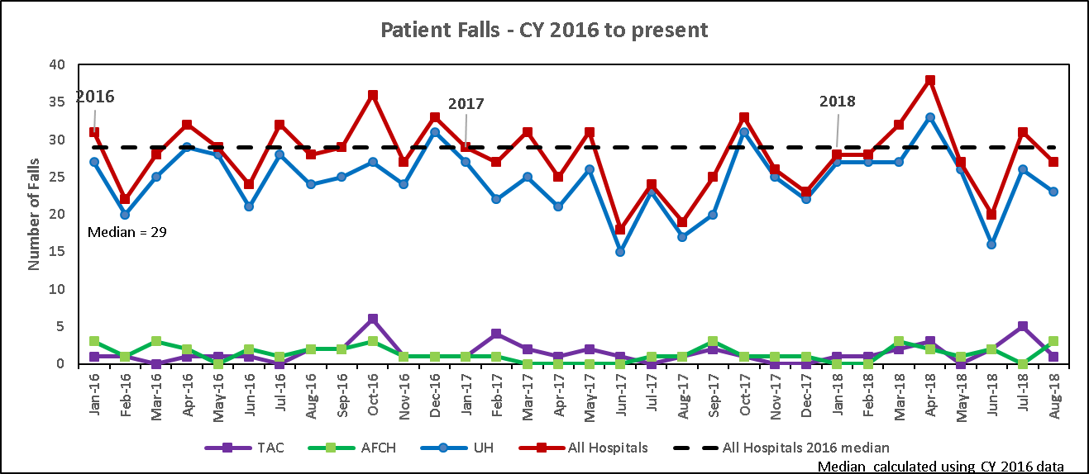
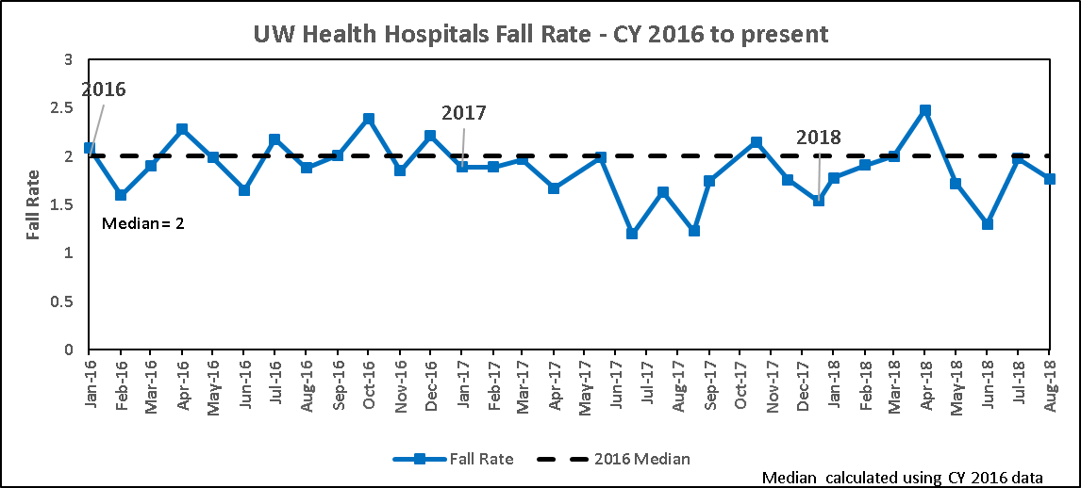
Reasons for visit
11% Decrease
CY 2016 to CY 2017
Notes:
How and why our organization made the decision to have a hospital consultation visit
We were excited about the opportunity to have national expert on fall prevention come to our hospitals and provide fresh eyes on our program
Fall prevention is very challenging with many moving parts and variables. Just when you think you have a handle on
Change is hard to sustain. We have been focusing on fall reduction forever and have made improvements over time, although they seem slow. We made some headway on decreasing our falls and falls with injury
Last year we demonstrated an 11% decrease in the overall number of falls, but creeping back up in 2018

Slide 204
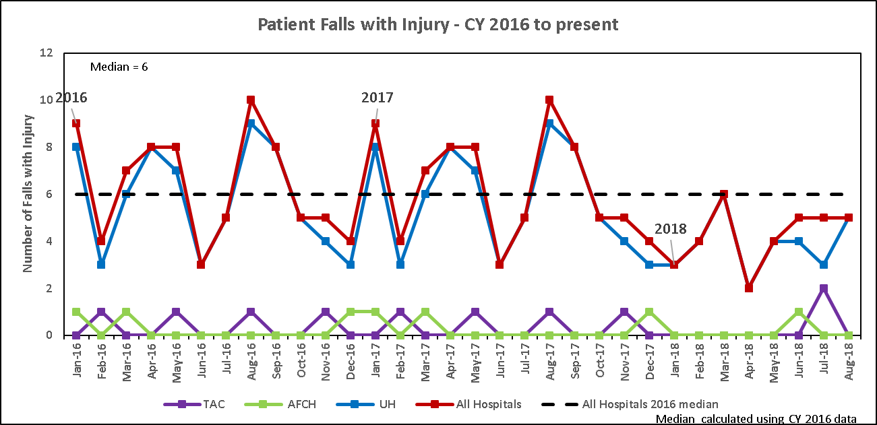
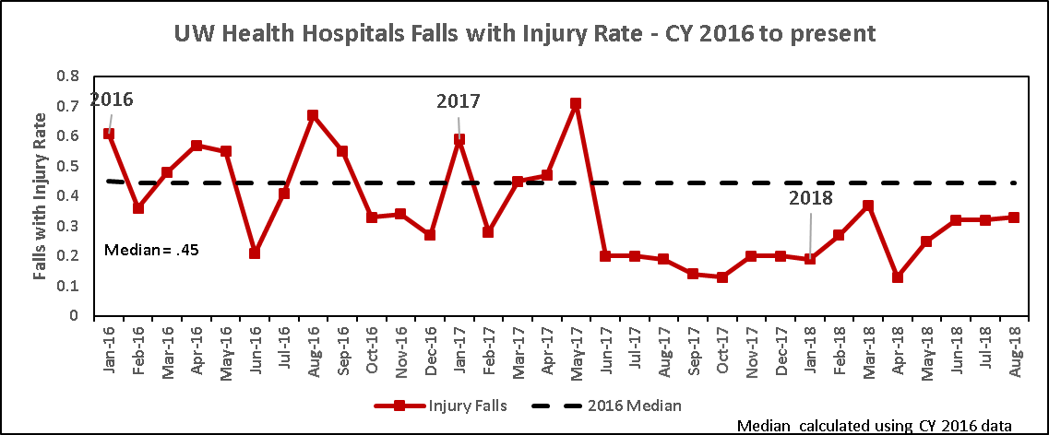
Reasons for visit
22% Decrease
CY 2016 to CY 2017
Notes:
And an 22% decrease in falls with injury. These improvements are hard to sustain and we are always looking for ways to improve our quality and outcomes.
Pat spent the day at each of the hospitals and met with direct care staff and attended our Fall Prevention workgroup.
How did the results of the site visit shape our fall and fall injury prevention committee and program?
Pat made some recommendations about reshaping the focus of our fall committee to focus more on strategic planning - goals and outcomes rather than reporting on the status for the month. We are hoping that this change in focus will allow this group to drive practice instead of reacting to it.

Slide 205
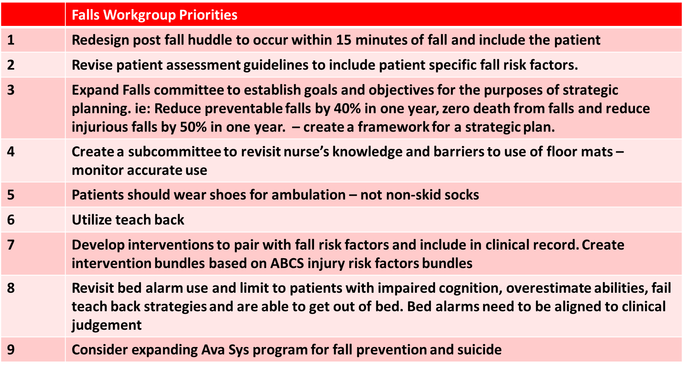
Recommendations
Notes:
Our group reviewed all the recommendations, performed a GAP anaylsis and then prioritized them - identifying what might be quick wins and which items will take a focused workgroup

Slide 206
Action Plan
Redesign post fall huddle to occur within 15 minutes of fall and include the patient
Patients should wear shoes for ambulation – not non-skid socks
Create a subcommittee to revisit nurse’s knowledge and barriers to use of floor mats – monitor accurate use
Notes:
I have listed 3 action items that the group has already started on
We started a pilot on a new post fall huddle process shortly after Pat’s visit. This process is now spreading throughout the organization
We believed that encouraging patients to wear shoes when OOB – asking them to bring from home if possible. Will educate staff through a marketing campaign (1 page)
We have created a group to work on promoting the use of floor mats – signs to educate staff on when to use and how to obtain
Recommendations to move from site visit to action
Review the recommendations and then identify what items can be accomplished quickly and which items will take more planning
Involve direct care staff if possible

Slide 207
Panel Discussion

Slide 208
Summary/Closing Remarks
Pat Quigley,PhD,MPH,ARNP,CRRN,FAAN,FAANP
Nurse Consultant
Retired Associate Director, VISN 8 Patient Safety Center
Retired Associate Chief for Nursing Service/Research
E-Mail: pquigley1@tampabay.rr.com

Slide 209
Evaluations

Slide 210
Thank you & have a safe trip!

