Slide 1



Conducting a Community Health Needs Assessment
May 11, 2011
Julie Willems Van Dijk RN PhD
University of Wisconsin
Population Health Institute
Notes:
Brenda

Slide 2
Outline
The Foundation: Determinants of Health
Exploring Models for Community Needs Assessments & Plans
Action: Resources & Examples
Notes:
Brenda

Slide 3
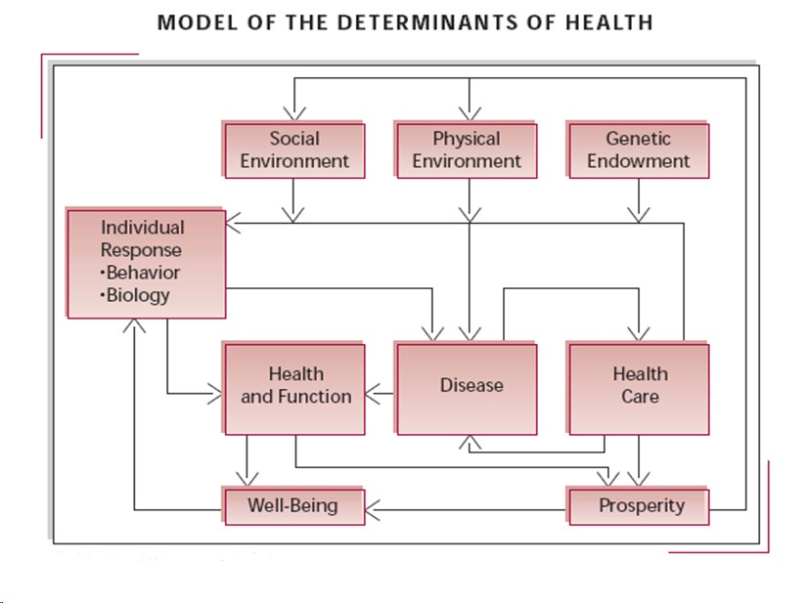
Notes:
Bob Evans and Greg Stoddart, two Canadian health economists, were among the first to identify that there is more to health than health care, genetics, and individual behaviors. They first published this model of the multiple determinants of health in 1990 in an article titled “Producing Health, Consuming Health Care”, identifying the role of individual behavior and biology, genetics, and the social and physical environment.

Slide 4
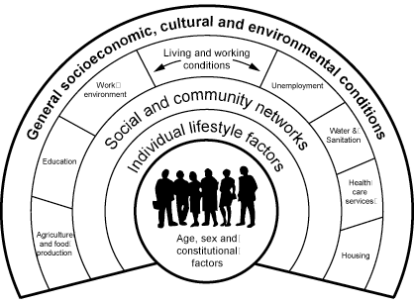
Dahlgren G, Whitehead M. Policies and strategies to promote social equity in health. Stockholm: Institute of Futures Studies, 1991.
Notes:
Around the same time, a number of European researchers were beginning to identity multiple categories of factors that determine health:
Biological determinants include genetic dispositions (“heredity factors”), sex and age.
Individual lifestyle factors– healthy behaviors (e.g. healthy nutrition, exercise) and unhealthy behavior (e.g. smoking).
Social and community networks that also strongly influence health status, e.g. social integration reduces the risks of mortality and leads to better mental health
Living and working conditions – including work environment, education, hygiene, housing and many more.
General socioeconomic, cultural and environmental conditions are defined as the “macro-level” influencing health.

Slide 5
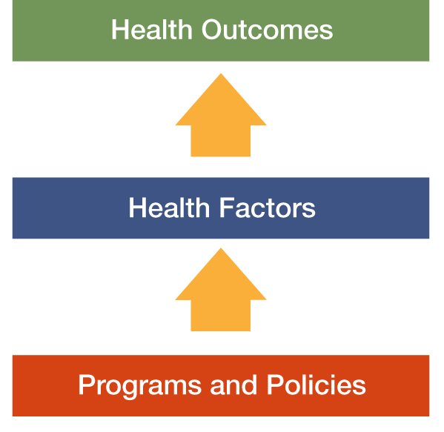
Population Health Model
Notes:
Our own Dave Kindig, the founder of our University of Wisconsin Population Health Institute, began working with Bob Evans and Greg Stoddart and has been a leader in bringing “population health” thinking into the U.S. In 2003, he published an article with Greg Stoddart that provided the impetus for our work with the County Health Rankings. While this model itself does not delineate all the multiple determinants of health it forms the basis for the Rankings model.

Slide 6
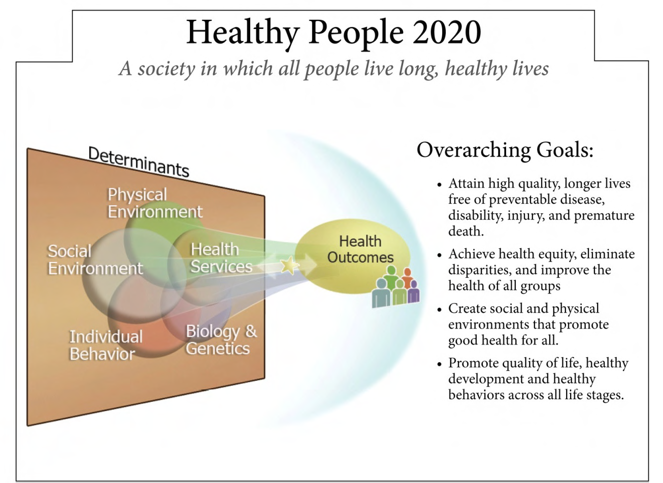
Notes:
Most recently, you probably have all seen the new Healthy People 2020 framework that is also a model of the multiple determinants of health. With its goals, emphasizes not only improving health but also achieving health equity (or reducing health disparity) by improve the health of ALL groups.

Slide 7


Wisconsin’s State Health Plans

Slide 8
Outline
The Foundation: Determinants of Health
Exploring Models for Community Needs Assessments & Plans
Action: Resources & Examples
Notes:
Brenda

Slide 9
Key Ingredients of a CHA
S: Subjective Information
O: Objective Information
A: Assessment or Diagnosis
P: Plan & Intervention

Slide 10
Subjective: The Stories
Patient
Community
Symptoms/Chief Complaint
What makes it better &
worse
Timeframe
What other issues might
have an impact on this situation
Obtained through patient
interview
Attitudes
Beliefs & Values
Behaviors
Political Environment
Obtained through surveys, focus groups, observation, qualitative review

Slide 11
Objective: The Data
Patient
Community
Vital Signs
Physical Exam
Laboratory Data
Radiology
Mortality Data
Morbidity Data
Birth Data
Injury Data
Socioeconomic Data
Environmental Data
Sub-analysis by Age, Race, Gender, Geography

Slide 12
Assessment:
What’s Wrong
Patient
Community
Medications
Diagnosis
Needs

Slide 13
Plan
Action Steps
Patient
Community
Medications
Surgery
Therapies
Activity Restrictions
Dietary Changes
Environmental Changes
Institutional Policy Changes
Mass Media Campaigns
Screening Programs
Public Policy Changes

Slide 14
Models used in Wisconsin
State Health Plan
Mobilizing for Action Through Partnership and Planning (MAPP)
County Health Rankings
Hybrids

Slide 15
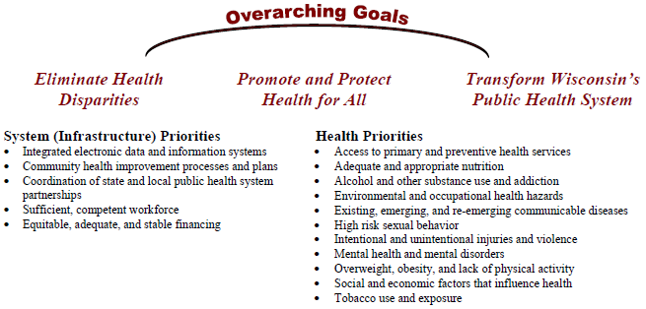
Healthiest Wisconsin 2010
http://www.dhs.wisconsin.gov/statehealthplan/shp-pdf/framework.pdf

Slide 16
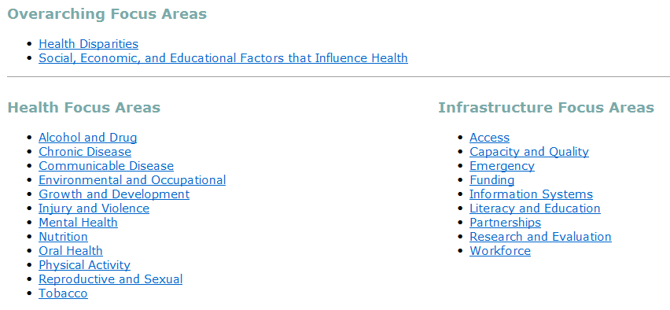
Healthiest Wisconsin 2020
http://www.dhs.wisconsin.gov/hw2020/focusareas/index.htm

Slide 17


Strategic Planning
Dialogue
Systems Thinking
Shared Vision
Collaboration &
Partnership

Slide 18
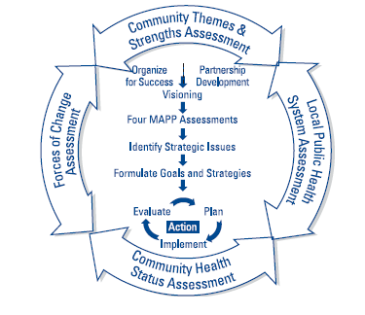

Slide 19
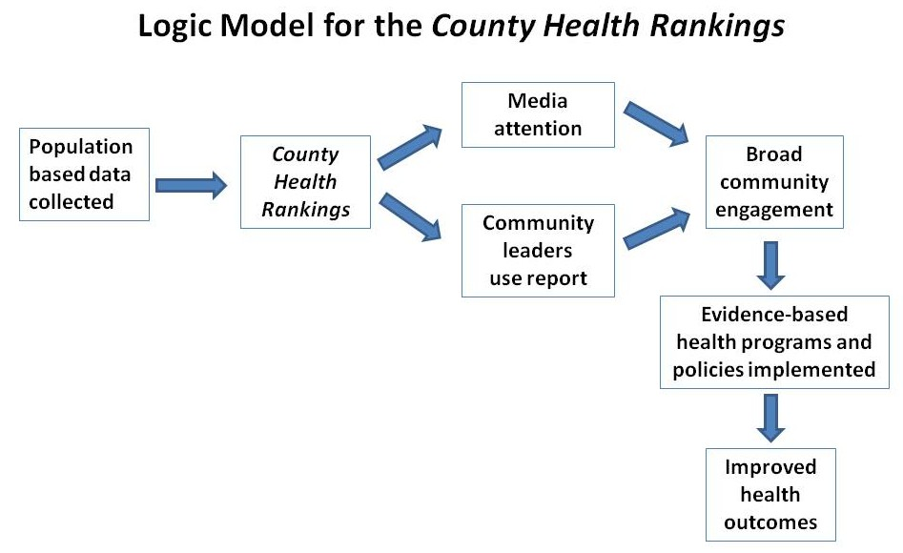
Logic Model
Notes:
Julie

Slide 20
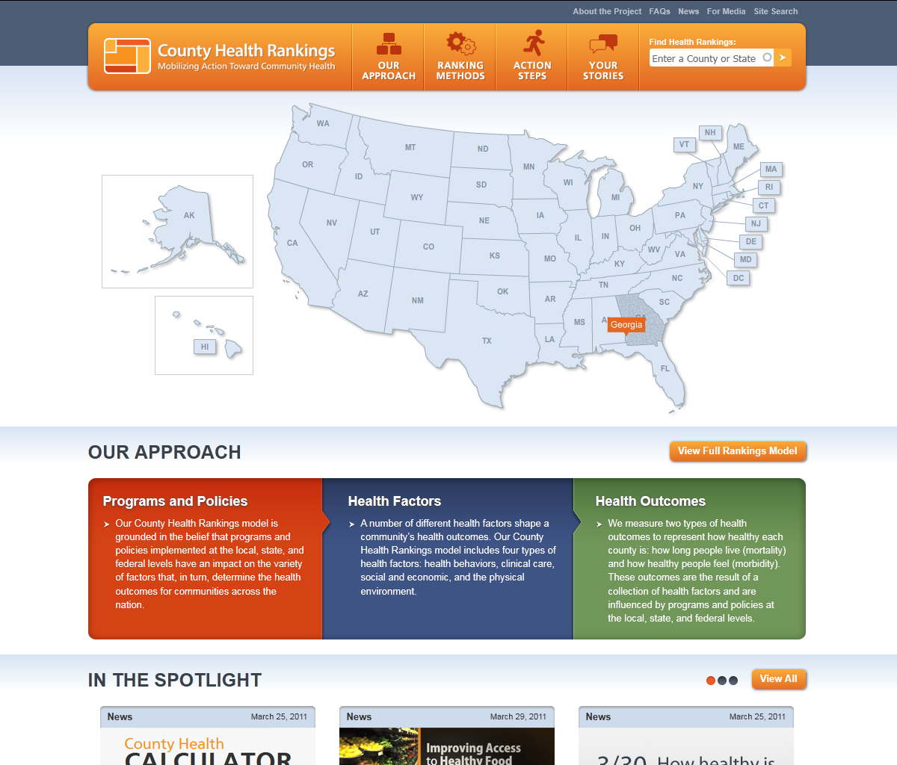
www.countyhealthrankings.org
Notes:
Julie

Slide 21
Health Outcomes
Mortality (length of life): 50%
Morbidity (quality of life): 50%
Tobacco use
Health behaviors
(30%)
Diet & exercise
Alcohol use
Unsafe sex
Clinical care
(20%)
Access to care
Quality of care
Health Factors
Education
Employment
Social & economic factors
(40%)
Income
Family & social support
Community safety
Programs and Policies
Physical environment
(10%)
Environmental quality
Built environment
County Health Rankings model © 2010 UWPHI
Notes:
So, here is the County Health Rankings model – a model that is rooted in the multiple determinants of health models from the early 1990s but focuses on those health factors (or determinants) that are modifiable and measurable at the community level: health behaviors, clinical care, social and economic factors, and the physical environment. We use this model to measure disparities in health by place or geography within states.

Slide 22
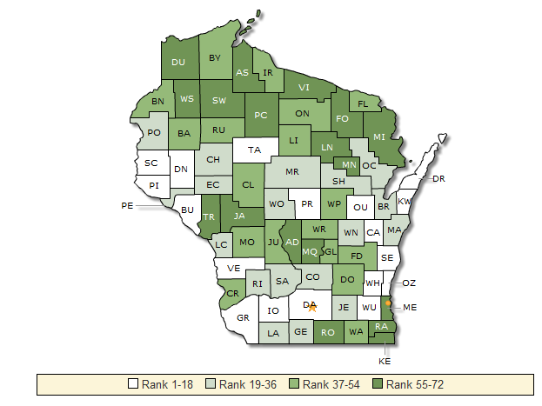

Slide 23
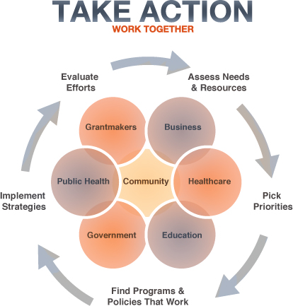

Slide 24

A Wisconsin Example

Slide 25
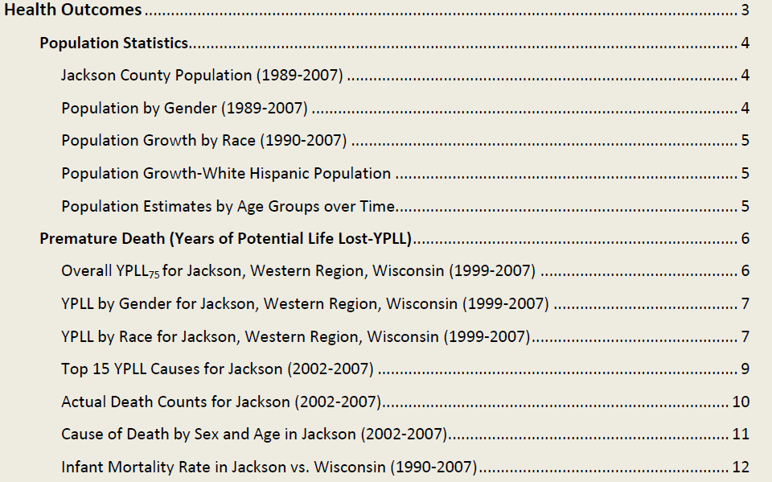
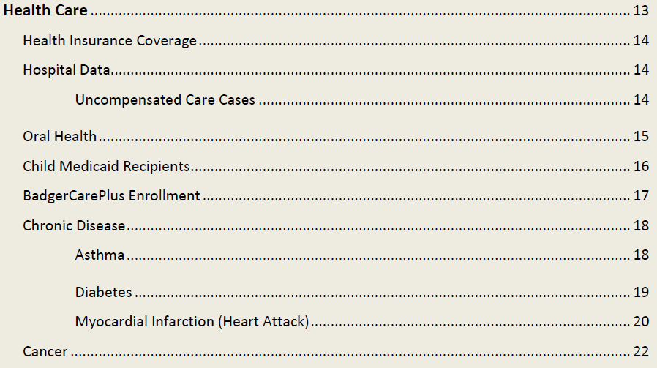
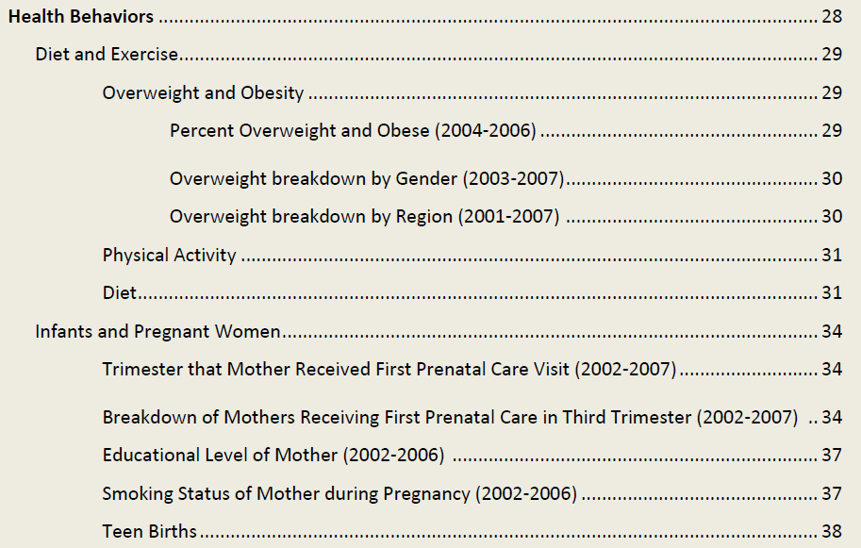
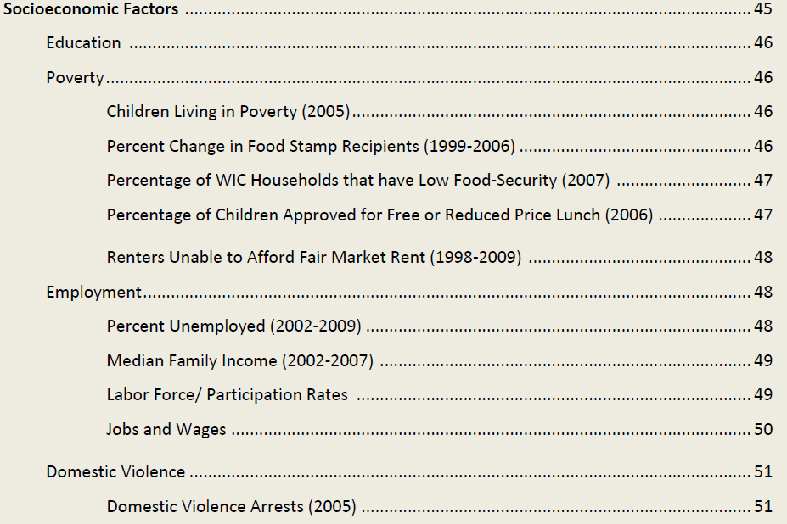
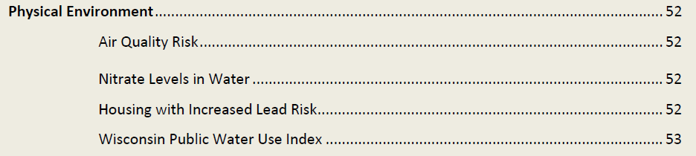

Slide 26
Hybrid

Slide 27
Outline
The Foundation: Determinants of Health
Exploring Models for Community Needs Assessments & Plans
Action: Resources & Examples
Notes:
Brenda

Slide 28
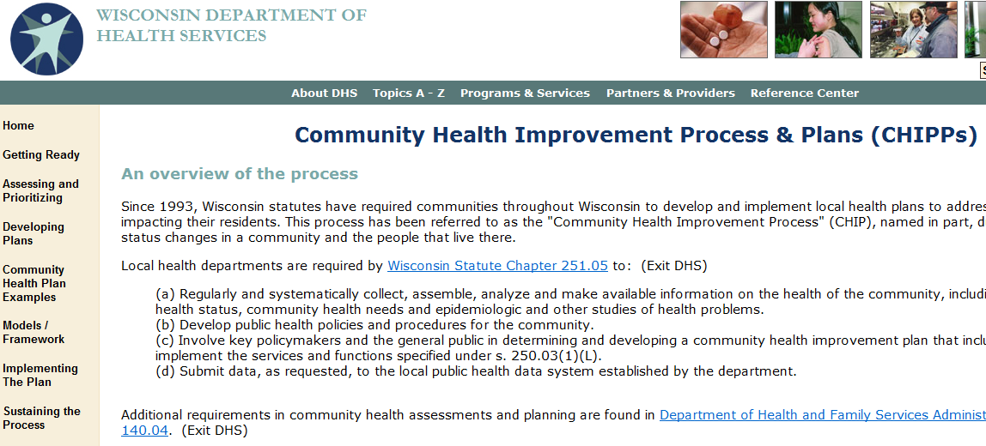
http://www.dhs.wisconsin.gov/chip/

Slide 29
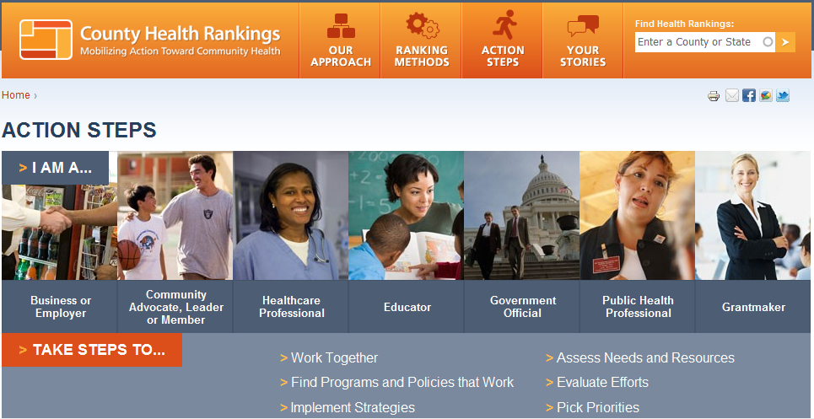
Notes:
Julie

Slide 30
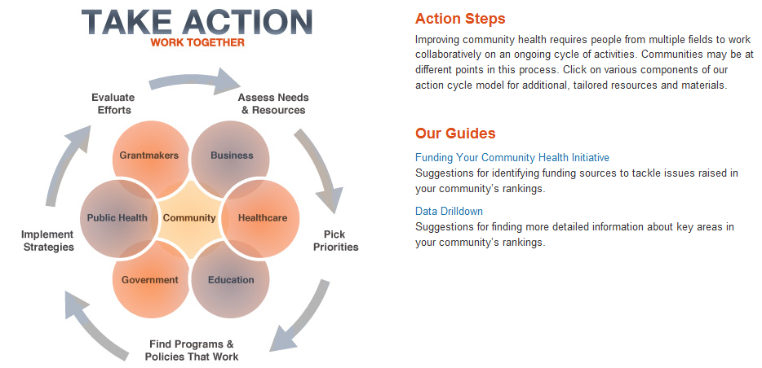
Notes:
Julie

Slide 31
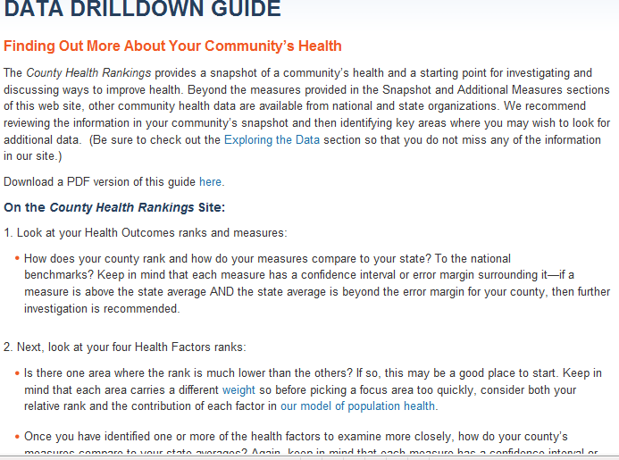
Notes:
Julie

Slide 32
Notes:
Julie

Slide 33
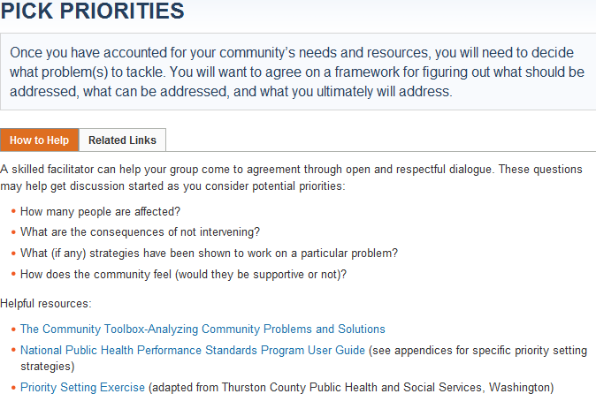
Notes:
Julie

Slide 34
Notes:
Julie

Slide 35
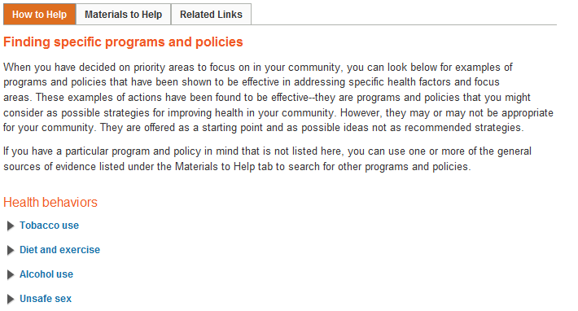
Notes:
Julie

Slide 36
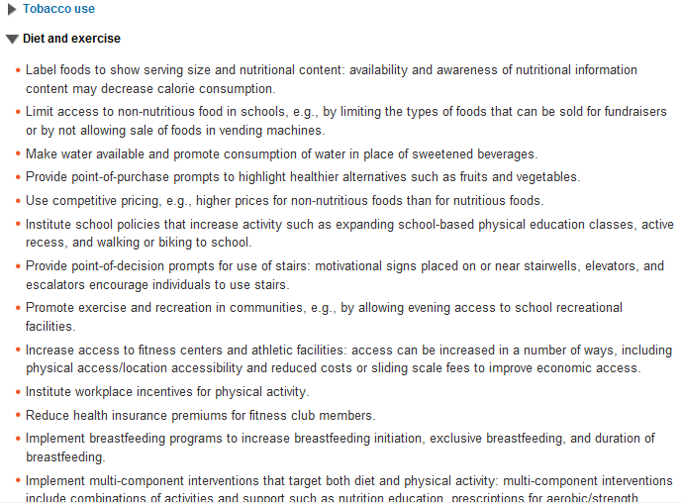
Notes:
Julie

Slide 37
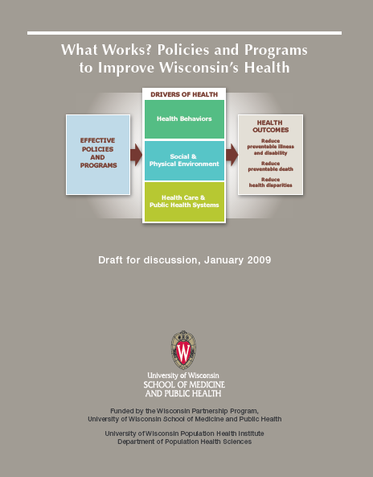
What Works? www.whatworksforhealth.wisc.edu

Slide 38
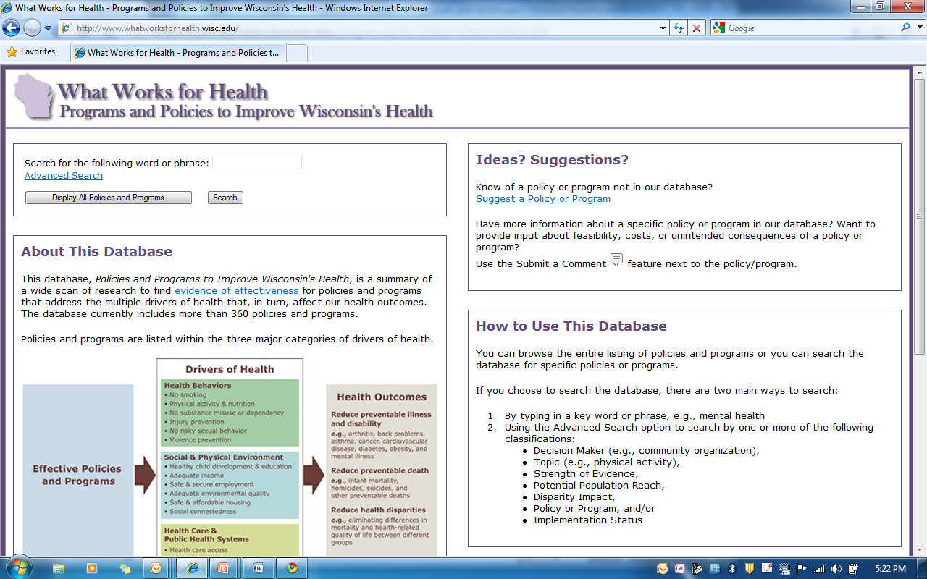

Slide 39
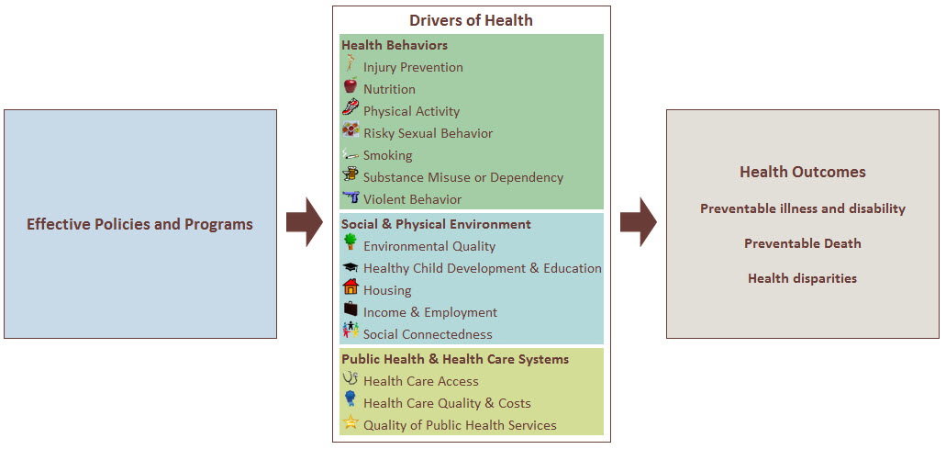

Slide 40
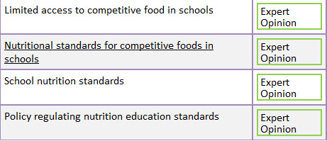
Nutritional Standards

Slide 41
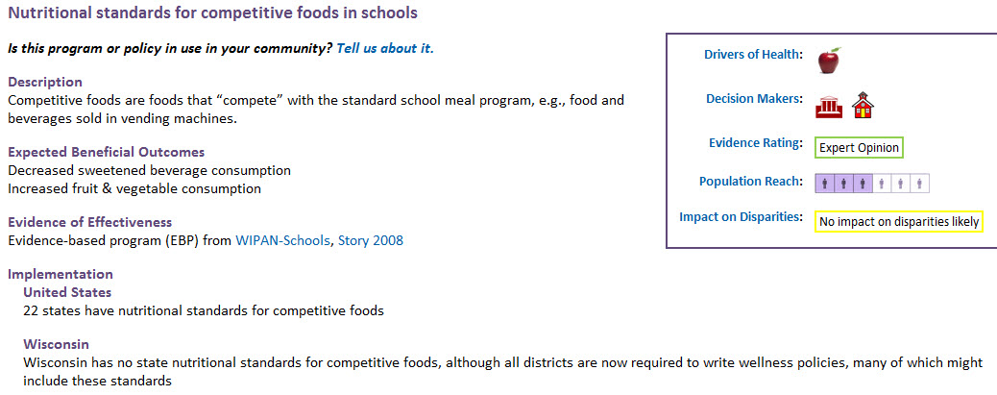

Slide 42
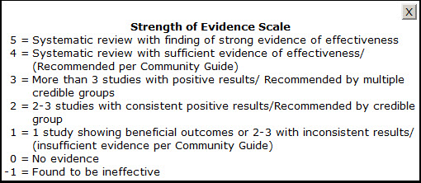
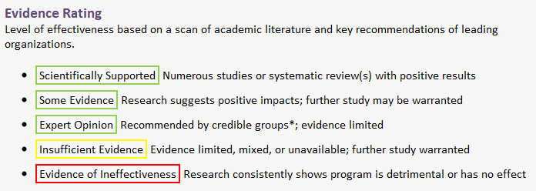

Slide 43
Roles
Local Health Department Led Assessment
Hospital Led Assessment
United Way Led Assessment
Integrated Collaborative Approach

Slide 44
Shared Challenges
Unfunded Mandate
Staff Expertise
High Expectations
Limited Resources

Slide 45
Shared Opportunities
Shared Vision & Values to Meet Mission
Staff Development
High Expectations in Dialogue with Community
Stewardship of Resources

Slide 46
Integrated Collaborative Approach
Shared Resource, Independent Assessment
Example: Aurora Survey in Southeastern Wisconsin
Shared Governance, Shared Resources, One Agency Primary Responsibility for Work
Example: Marathon County
Shared Governance, Pooled Resources, Collaborative Employs Staff
Example: LaCrosse Area

Slide 47
Discussion
What questions do you have?

Slide 48
MATCH, County Health Rankings, & Healthiest State Project
The Wisconsin MATCH Team
  Patrick Remington, Bridget Booske, David Kindig, Julie Willems Van Dijk, Jessica Athens, Angela Russell
Robert Wood Johnson Foundation
  Brenda Henry, Michelle Larkin, Jim Marks, Joe Marx, Pamela Russo, Abbey Cofsky
The Wisconsin Partnership Fund
Our Partners
  CDC, NCHS, ASTHO, NACCHO, NNPHI, Leah Devlin, Dartmouth Institute, 11-member Metrics Advisory Group
Notes:
Julie

Slide 49
For More Information
www.countyhealthrankings.org
Julie Willems Van Dijk
University of WI Population Health Institute
Madison, WI
willemsvandi@wisc.edu
608-263-6731

